Slide 1
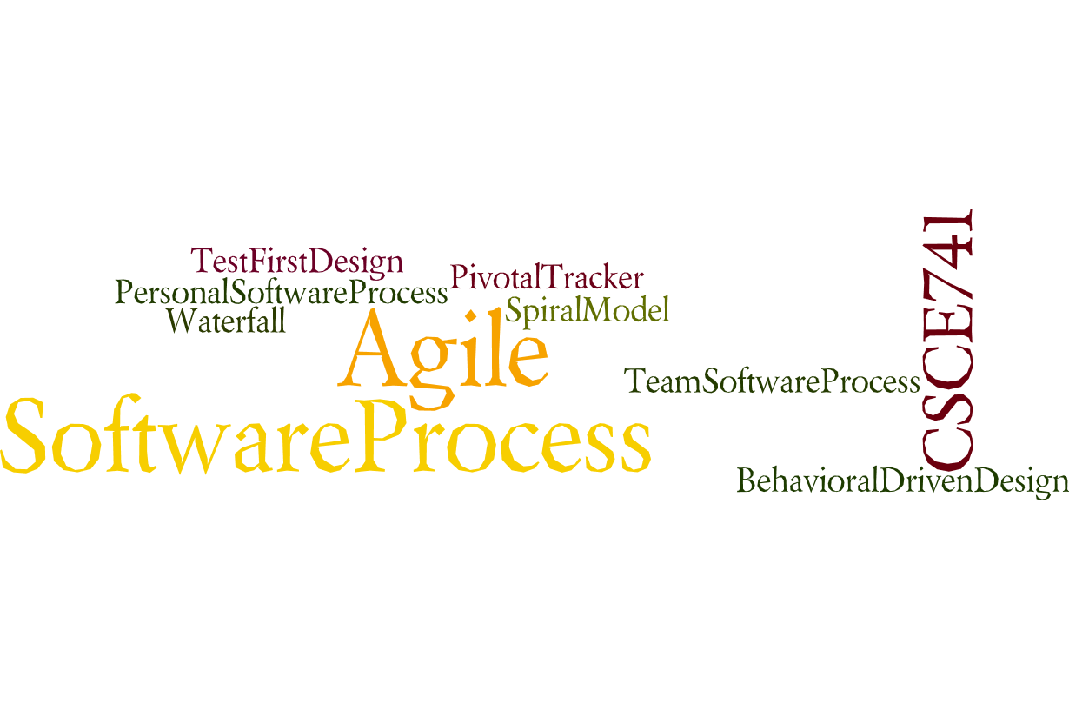
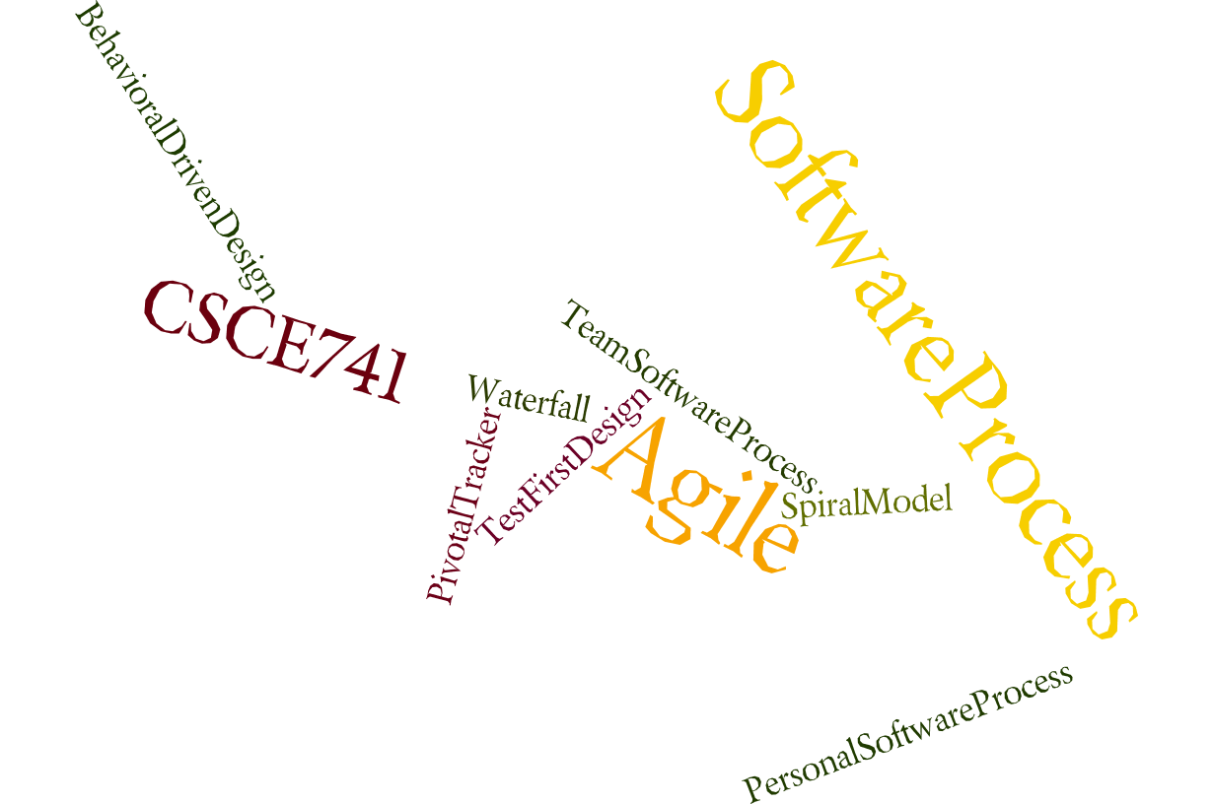
Lecture 04
Availability
CSCE 741 Software Process
Topics
  Chapter 5 – Availability
Lecture 2 -- Overview
  Scrum
  Agile principles of scrum
Readings:ES Ch 2-3
August 30, 2017

Slide 2
Last Time
  Overview:
  Agile
  Spring Framework
  Spring Boot – Convention over configuration
    Configuration increases modifiability
  Virtual Machines
New
  Syllabus and other course pragmatics -- Website (not shown)
  Core Agile/Scrum Concepts

Slide 3
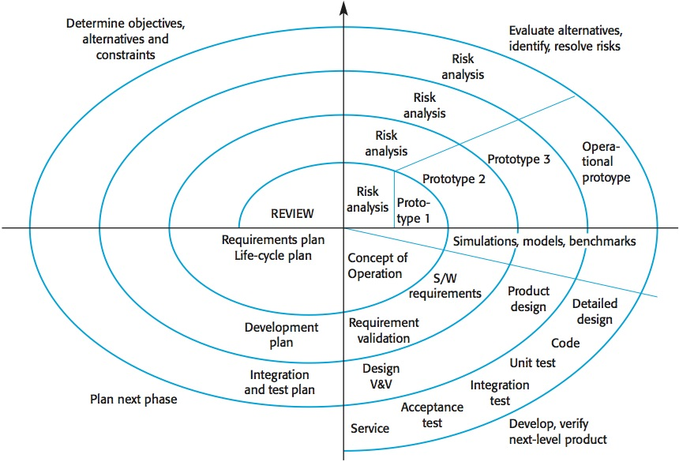
Spiral model revisited (B. Boehm)
Boehm’s Original Diagram What was in Sommerville

Slide 4
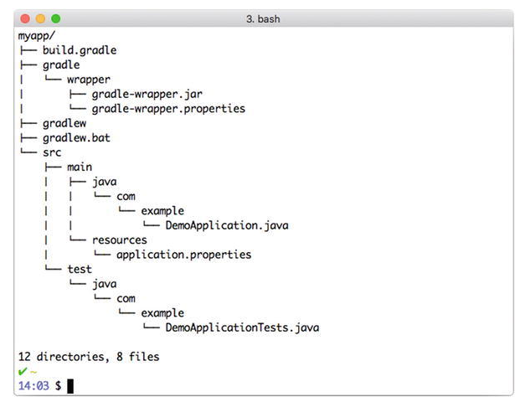
Spring Project Structure

Slide 5
Fall CSCE schedule -- csv file
Schedule -- Tab separated values (Comma separated values, csv files)
SR 18629 CSCE 740 001 COL 3.000 30 - Columbia Full Term Software Engineering TR 08:30 am-09:45 am 28 18 10
Gregory James Gay (P) 08/24-12/08 SWGN 2A05
SR 25398 CSCE 741 001 COL 3.000 30 - Columbia Full Term Software Process MW 02:20 pm-03:35 pm 40 10 30
Manton M. Matthews (P) 08/24-12/08 WMBB 409
SR 25399 CSCE 741 006 COL 3.000 30 - Columbia Full Term Software Process MW 02:20 pm-03:35 pm 50 1 49
Manton M. Matthews (P) 08/24-12/08 WEB COLUMBIA
SR 12841 CSCE 750 001 COL 3.000 30 - Columbia Full Term Analysis of Algorithms TR 11:40 am-12:55 pm 50 46 4
Jason Matthew Okane (P) 08/24-12/08 WMBB 409
…

Slide 6

Spring Tool Suite (STS)
Eclipse extension? Variation? Eclipse based development environment

Slide 7
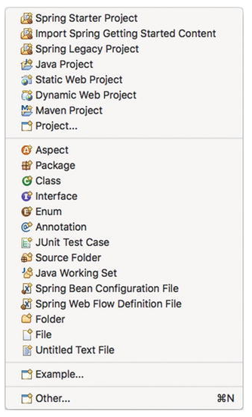
Spring Starter project
Google(SpringBoot Javabrain)

Slide 8
Spring Example = Spring Boot Journal
Chapter 2 --

Slide 9
Experience
Why are you taking this course?
Software Engineering courses?
Favorite language?
Programs in Java (if none C++ or C#)
Estimate lines of Code

Slide 10
Java World
Java (the language)
JVM (java virtual machine)
  Write once, run anywhere – Wikipedia a slogan created by Sun Microsystems to illustrate the cross-platform benefits of the Java language.
javac
java
IDEs(Integrated Development environments)
  Eclipse
  IntelliJ (IDEA)
  Netbeans
What’s a bean? What’s a POJO?

Slide 11
Essential Scrum by Rubin

Slide 12
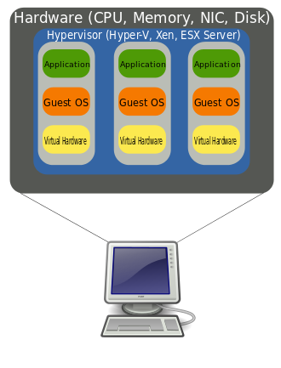
Virtual Box
Virtual machine

Slide 13


Slide 14
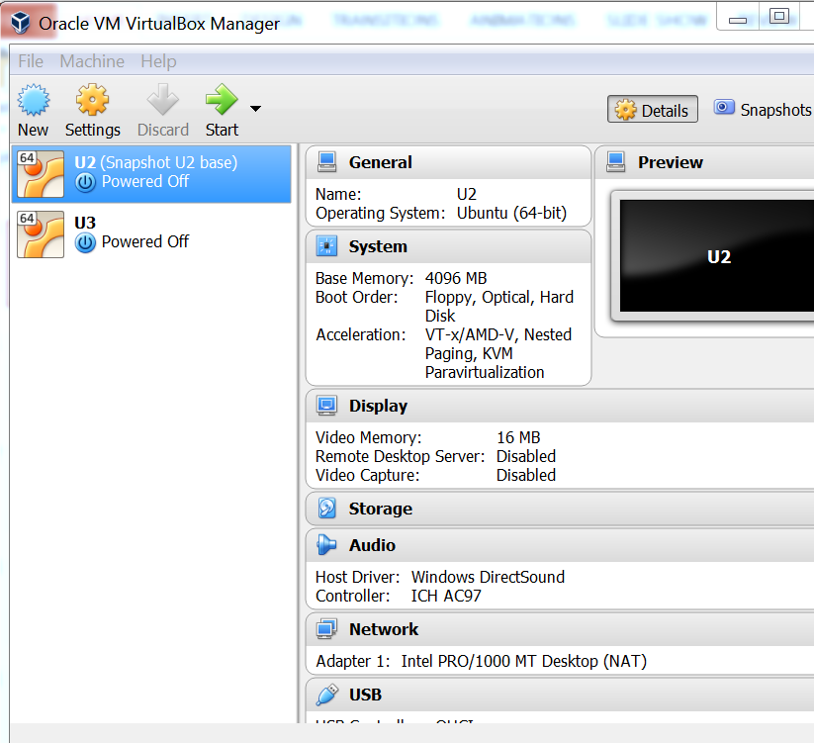
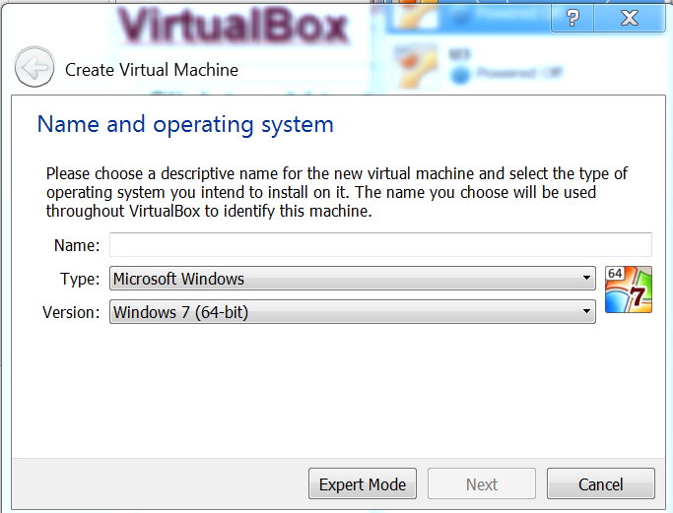
VirtualBox

Slide 15
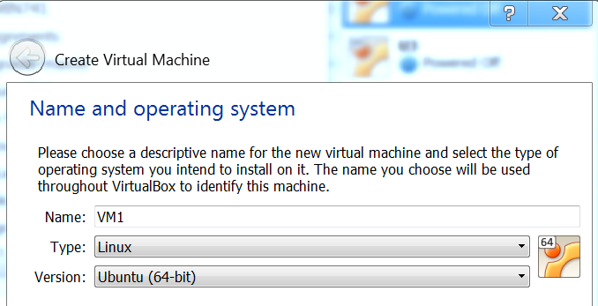

Slide 16
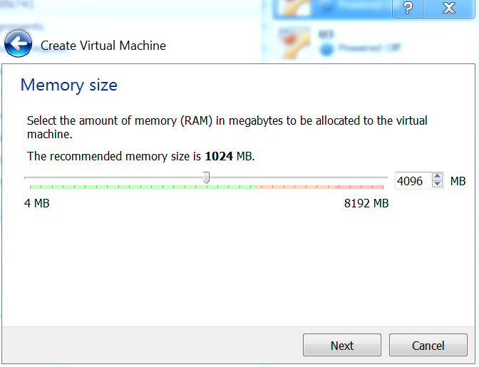
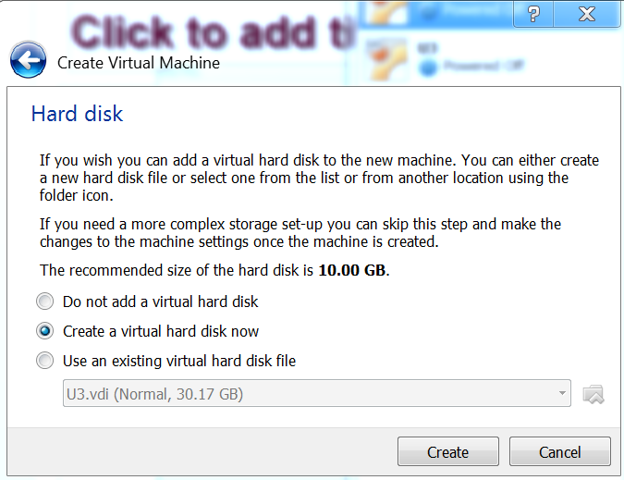
VDI
Dynamically allocated

Slide 17
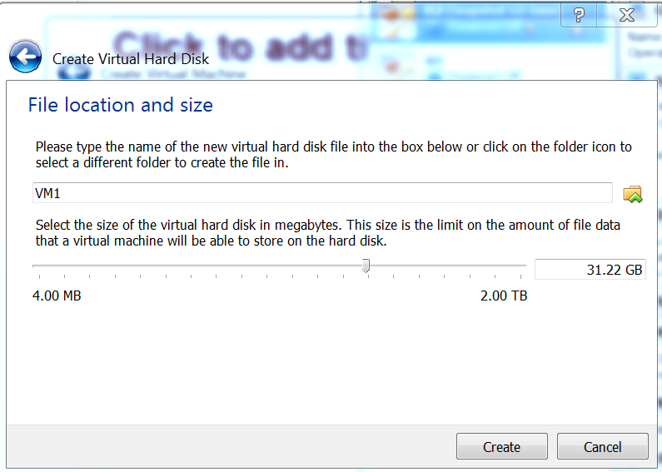

Slide 18
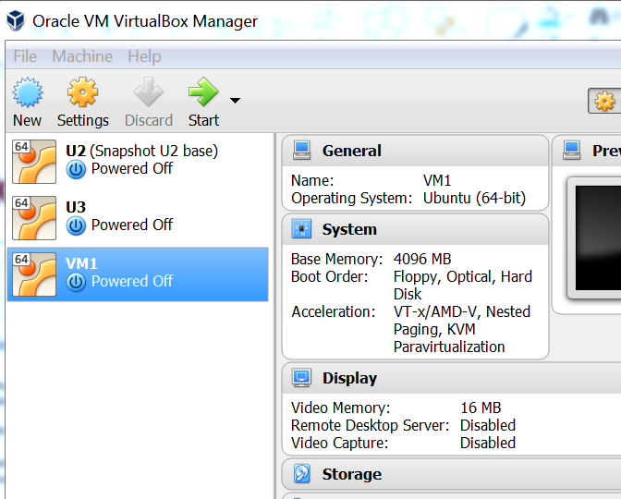

Slide 19
What’s left?
Install Ubuntu
Create Share

Slide 20
1) Download: VirtualBox and VirtualBox Extensions
2) run installer
3) New
a) Choose Linux
b) Memory 4G=4096MB
c) Create virtual Hard disk now
d) VDI
e) Dynamically allocated
f) 30 GB
4) Extensions
a) File ==> Preferences ==> extensions
b) select virtualBox Extensions file downloaded earlier

Slide 21
5) Operating System
a) Storage
b) Controller
c) add optical disk
d) select Ubuntu (or other OS) from download folder or ...
e) click on disk and select Live CD/DVD
f) Start
6) Linux install
7) Storage ==> IDSE Controller: remove linux_iso
8) Shared folder: Storage ==> Shared folders ==> "+" (add shared folder)
path on host
name on VM

Slide 22
Setup base system like you like; then snapshot
Linux Base system
java
spring
STS

Slide 23
Required Tools
Java 8 or later
Eclipse = STS
Maven
Spring library
Spring Boot conventions

Slide 24
Relationship between Scrum and Agile
Scrum is a pre-defined development lifecycle based on agile principles.
Agile methodologies promote a project-management process that encourages frequent inspection and adaptation, and a leadership philosophy using teamwork, self-organization and accountability.
Agile is a general philosophy regarding software production,
Scrum is an implementation of that philosophy pertaining specifically to project management.
http://www.360logica.com/blog/what-is-the-relationship-between-scrum-and-agile/

Slide 25
Scrum distinguished from Agile (continued)
Agile and scrum are related but distinct.
Agile describes a set of guiding principles for building software through iterative development.
Agile principles are best described in the Agile Manifesto.
Scrum is a specific set of rules to follow when practicing agile software development.
Scrum is an iterative and incremental agile development methodology.
Scrum may be viewed as an agile framework for developing software.
http://www.360logica.com/blog/what-is-the-relationship-between-scrum-and-agile/

Slide 26
Scrum distinguished from Agile (continued)
Unlike many other software development methodologies, scrum does not provide a complete template or detailed description of what to do during software development.
Scrum prescribes desired outcomes and leaves it to the agile scrum team to best determine how to solve the problems they encounter.
Scrum may be used for both software development and software maintenance projects.
http://www.360logica.com/blog/what-is-the-relationship-between-scrum-and-agile/

Slide 27
Scrum is a framework for organizing and managing work.
Not a standardized process
Based on a set of values, principles and practices
“Scrum is a refreshingly simple, people-centric framework based on the values of honesty, openness, courage, respect, focus, trust, empowerment, and collaboration.”
Rubin, Kenneth S.. Essential Scrum: A Practical Guide to the Most Popular Agile Process (Addison-Wesley Signature Series (Cohn)) (p. 13). Pearson Education. Kindle Edition.
Essential Scrum by Rubin

Slide 28
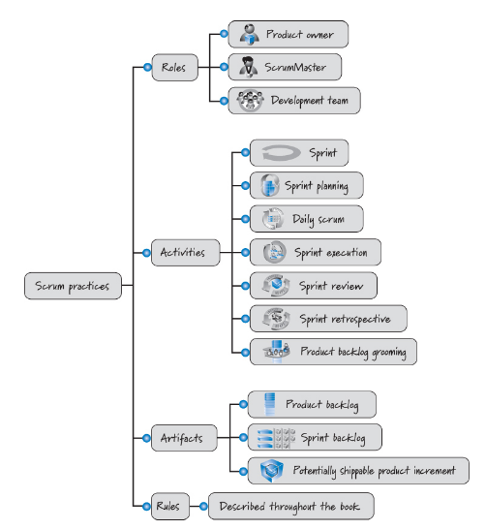
Scrum Practices
Roles
  Product owner
  Scrum Master
  Development team
Activities
  Sprint: planning, execution, review
  Daily scrum
  Product backlog grooming
Artifacts
  Backlog: product, sprint
Rules
Essential Scrum by Rubin

Slide 29
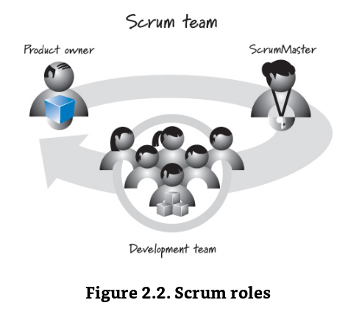
Scrum Roles
Essential Scrum by Rubin

Slide 30
Product Owner
The product owner is the empowered central point of product leadership.
They are the single authority responsible for deciding which features and functionality to build and the order in which to build them.
The product owner maintains and communicates to all other participants a clear vision of what the Scrum team is trying to achieve.
As such, the product owner is responsible for the overall success of the solution being developed or maintained.
Essential Scrum by Rubin

Slide 31
Scrum Master
The ScrumMaster helps everyone involved understand and embrace the Scrum values, principles, and practices.
She acts as a coach, providing process leadership and helping the Scrum team and the rest of the organization develop their own high-performance, organization-specific Scrum approach.
At the same time, the ScrumMaster helps the organization through the challenging change management process that can occur during a Scrum adoption.
As a facilitator, the ScrumMaster helps the team resolve issues and make improvements to its use of Scrum.
She is also responsible for protecting the team from outside interference
Essential Scrum by Rubin

Slide 32
Development Team
Traditional Software development roles
Architect
Programmer
Tester
DB administrator
UI designer
Scrum development team – a diverse, cross-functional collection of these tyes who are responsible for …
Essential Scrum by Rubin

Slide 33
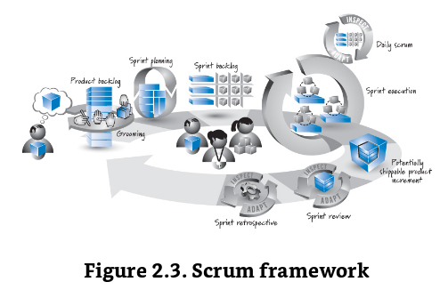
Scrum Artifacts
.
Essential Scrum by Rubin

Slide 34
Product Backlog
Product Backlog (text) -- (user stories) (use cases)
Product Owner prioritizes the user-stories
Team Identifies amount of work for each user-story
Forecast or commitment – the user stories selected for this sprint
Essential Scrum by Rubin

Slide 35
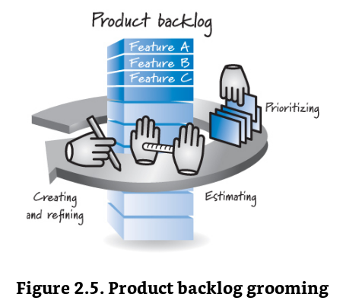
Product Backlog manipulations
Essential Scrum by Rubin

Slide 36
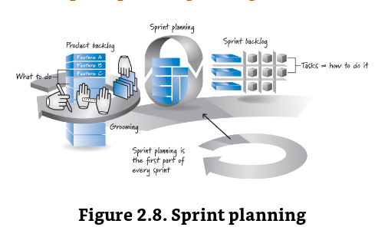
Essential Scrum by Rubin

Slide 37
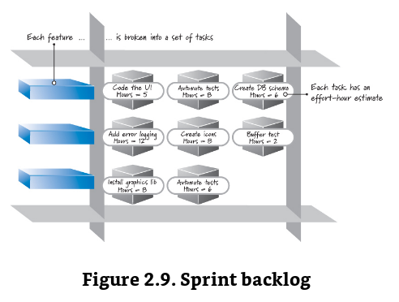
Sprint Backlog -- tasks
Tasks to break down entries in product backlog
Sprint backlog of tasks
Just in time planning
Sprint planning 4 to 8 hours
Essential Scrum by Rubin

Slide 38
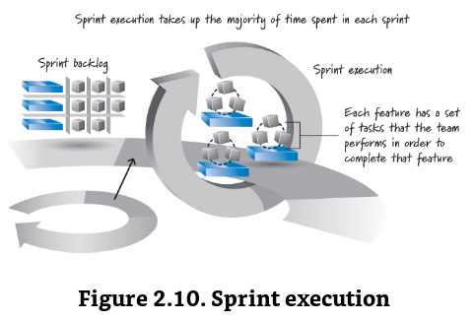
Essential Scrum by Rubin

Slide 39
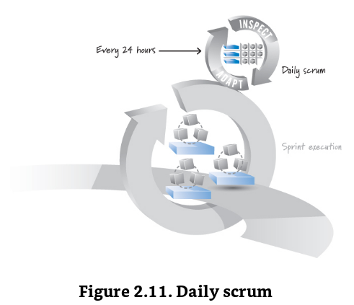
Daily Scrum
Essential Scrum by Rubin

Slide 40
Daily Stand-Up
What did I accomplish since the last daily scrum?
What do I plan to work on by the next daily scrum?
What are the obstacles or impediments that are preventing me from making progress?
Rubin, Kenneth S.. Essential Scrum: A Practical Guide to the Most Popular Agile Process (Addison-Wesley Signature Series (Cohn)) (p. 24). Pearson Education. Kindle Edition.
Essential Scrum by Rubin

Slide 41
The chickens and the pigs
Essential Scrum by Rubin

Slide 42
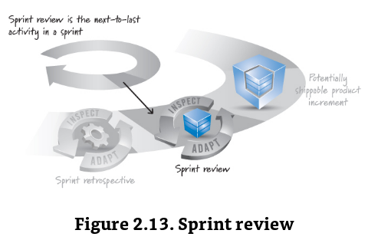
Essential Scrum by Rubin

Slide 43
Agile Principles (Chapter 3)
Before we delve deeper into the mechanics of Scrum, it will be helpful to understand the underlying principles that drive and inform those mechanics.
This chapter describes the agile principles that underlie Scrum and compares them with those of traditional, plan-driven, sequential product development.
Essential Scrum by Rubin

Slide 44
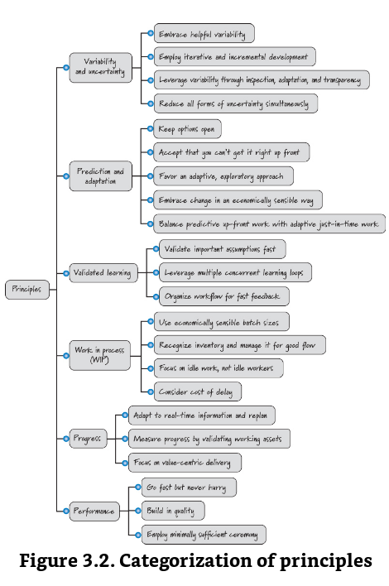
Categorization of Principles
Essential Scrum by Rubin

Slide 45
Variability and Uncertainty
Scrum leverages the variability and uncertainty in product development to create innovative solutions.
Embrace helpful variability.
Employ iterative and incremental development.
Leverage variability through inspection, adaptation, and transparency.
Reduce all forms of uncertainty simultaneously.
Essential Scrum by Rubin

Slide 46
Waterscrum or Scrummerfall
Essential Scrum by Rubin

Slide 47
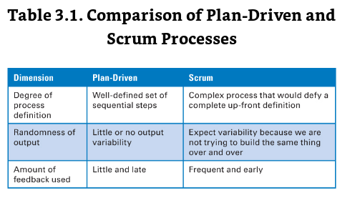
.
Essential Scrum by Rubin

Slide 48
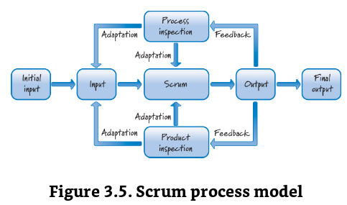
Scrum Process Model
Essential Scrum by Rubin

Slide 49
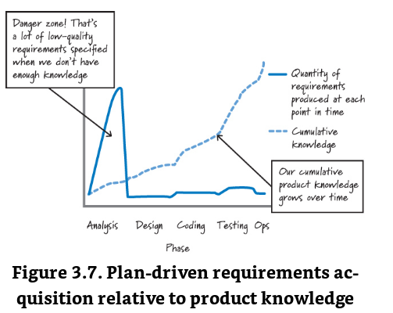
Accept that there will be changes in Requirements
Essential Scrum by Rubin

Slide 50
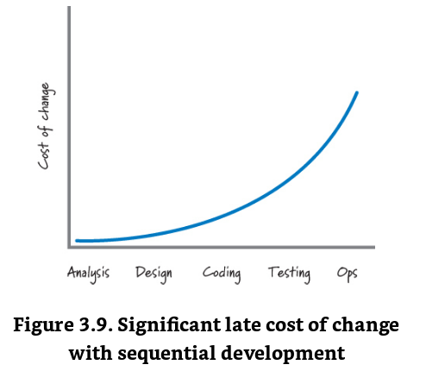
Cost of changes to Requirements
Essential Scrum by Rubin

Slide 51
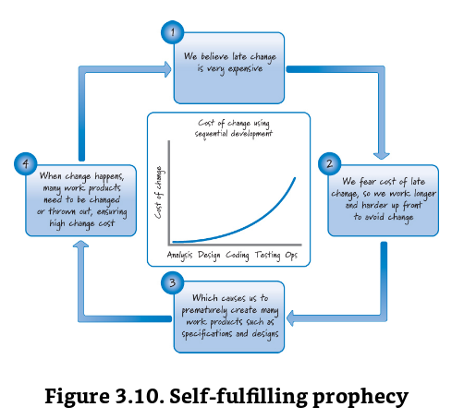
Essential Scrum by Rubin

Slide 52
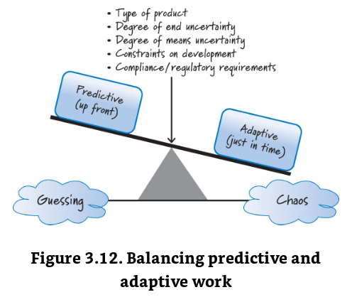
Essential Scrum by Rubin

Slide 53
Validated learning
Validate important assumptions fast.
Leverage multiple concurrent learning loops.
Organize workflow for fast feedback.
Rubin, Kenneth S.. Essential Scrum: A Practical Guide to the Most Popular Agile Process (Addison-Wesley Signature Series (Cohn)) (p. 45). Pearson Education. Kindle Edition.
Essential Scrum by Rubin

Slide 54
Adapt to real-time information and replan.
Measure progress by validating working assets.
Focus on value-centric delivery.
Rubin, Kenneth S.. Essential Scrum: A Practical Guide to the Most Popular Agile Process (Addison-Wesley Signature Series (Cohn)) (p. 54). Pearson Education. Kindle Edition.
Essential Scrum by Rubin

Slide 55
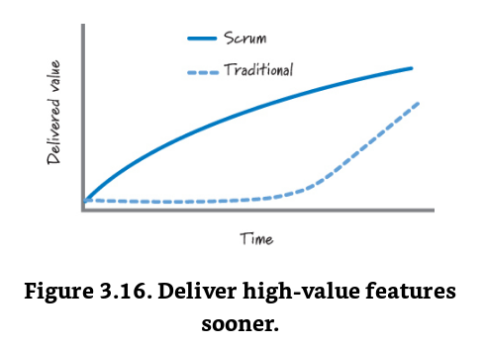
Essential Scrum by Rubin

Slide 56
Performance
Go fast but never hurry.
Build in quality.
Employ minimally sufficient ceremony.
  “process for the sake of process”
Essential Scrum by Rubin

Slide 57
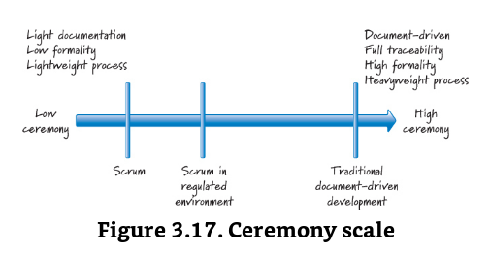
Essential Scrum by Rubin

Slide 58
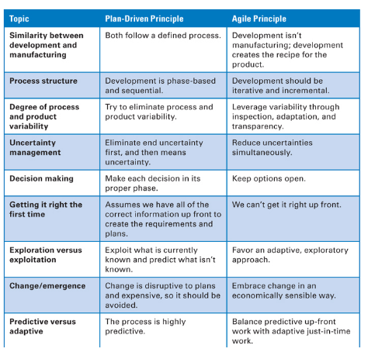
Essential Scrum by Rubin

Slide 59
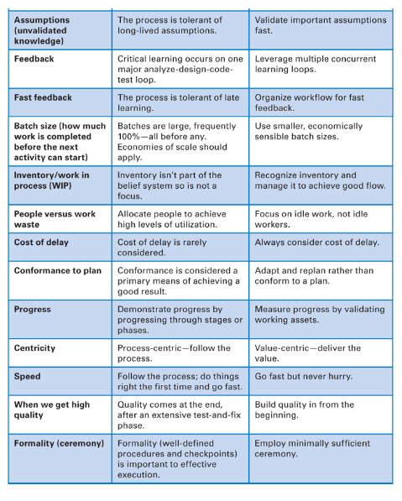
continued
Essential Scrum by Rubin

Slide 60
Essential Scrum by Rubin

