Slide 1
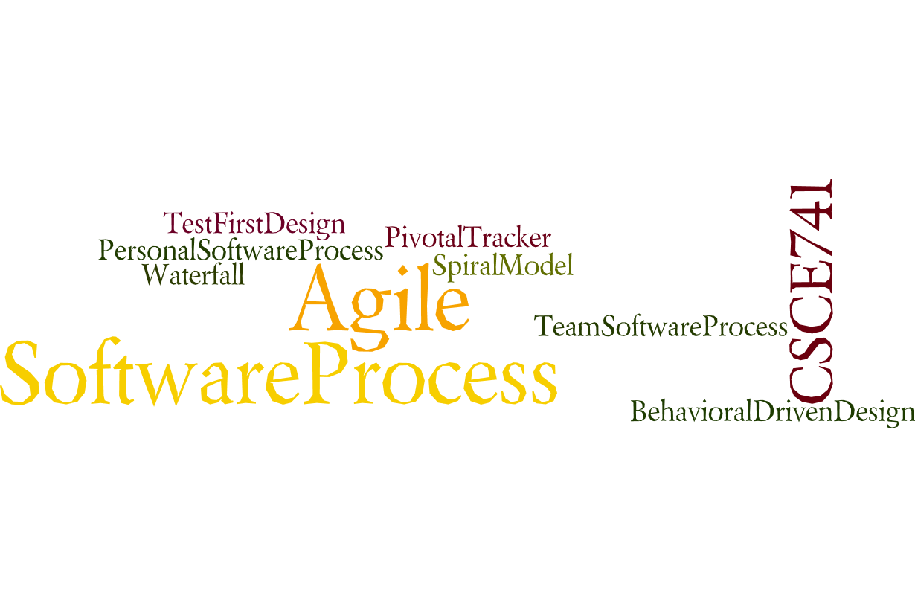
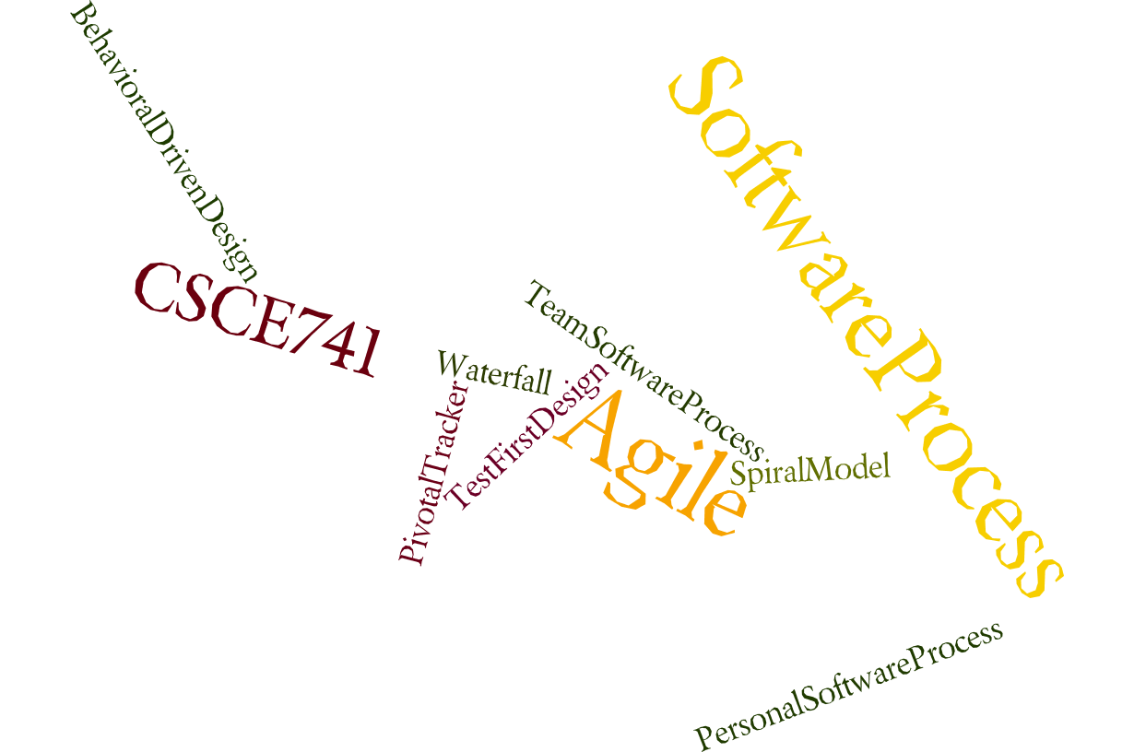
Lecture 04
Availability
CSCE 741 Software Process
Topics
  Chapter 5 – Availability
Lecture 1 -- Overview
  The Old CSCE 741
  Agile
  Scrum
  Spring Boot
Readings:ES Ch 01, PSB
August 28, 2017

Slide 2
Course Pragmatics
Syllabus
  Instructor: Manton Matthews
  Teaching Assistant: none
Texts
  Essential Scrum: A Practical Guide to the Mos… (Paperback) by Kenneth S. Rubin ISBN-13: 978-0-13-704329-3 ISBN-10: 0-13-704329-5
  Pro Spring Boot 1st ed. Edition by Felipe Gutierrez ISBN-13: 978-1484214329 ISBN-10: 1484214323
  Important Dates
    http://registrar.sc.edu/html/calendar5yr/5YrCalendar3.stm
  Academic Integrity

Slide 3
Deliverables / Grading
Midterm and Final
Projects – several sprints

Slide 4
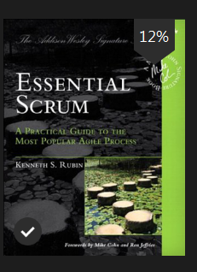

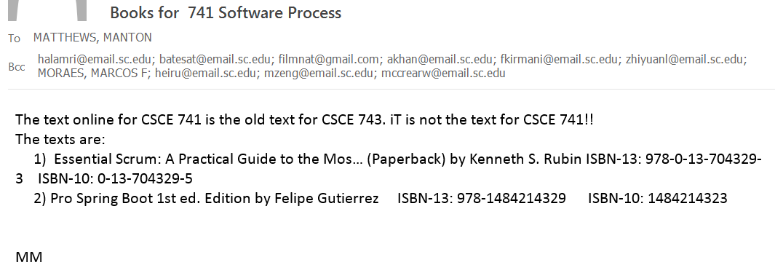
Texts
.

Slide 5

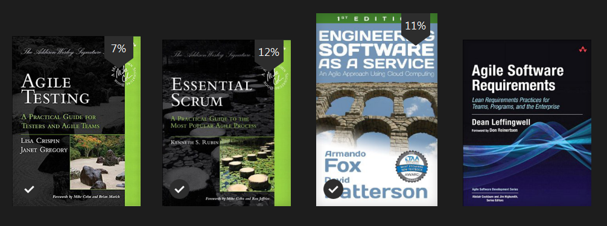
Other Agile resources

Slide 6

Spring Books

Slide 7

Design Resources

Slide 8


Java Resources

Slide 9
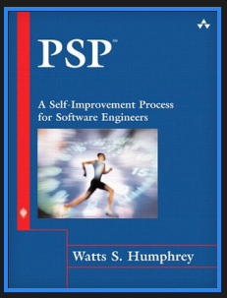

The Old 741
Personal Software Process
How do you measure programmer productivity?
What kind of errors do you make?
Error logs
Time records
Mythical Man-Month
Agile/PivotalTracker points

Slide 10
Overview
Topics for today
  Traditional
    Waterfall
    Spiral model
  Agile
  Scrum
  Spring
Next time
  x
"Architecture is the art and technique of building..."

Slide 11
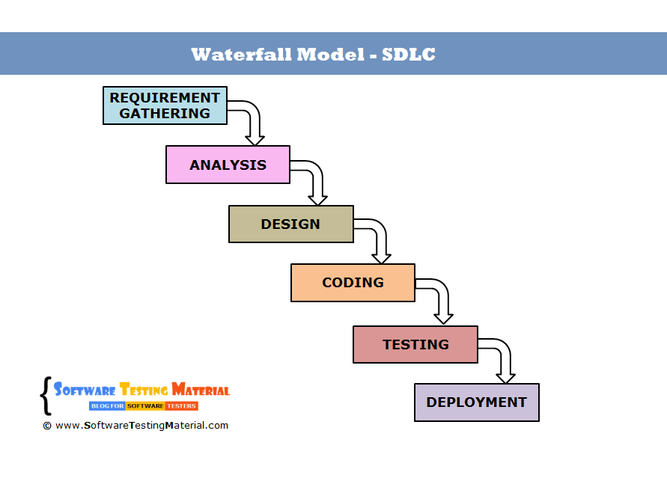
Waterfall Design

Slide 12
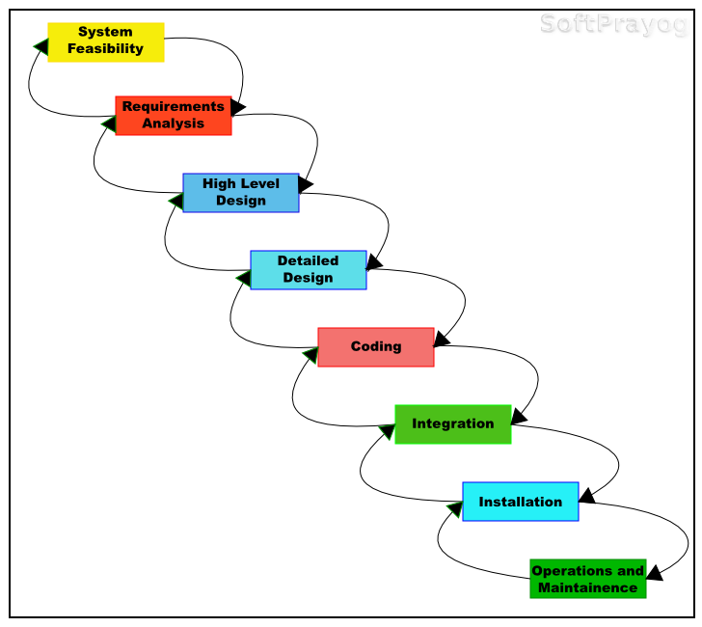
Waterfall with feedback

Slide 13
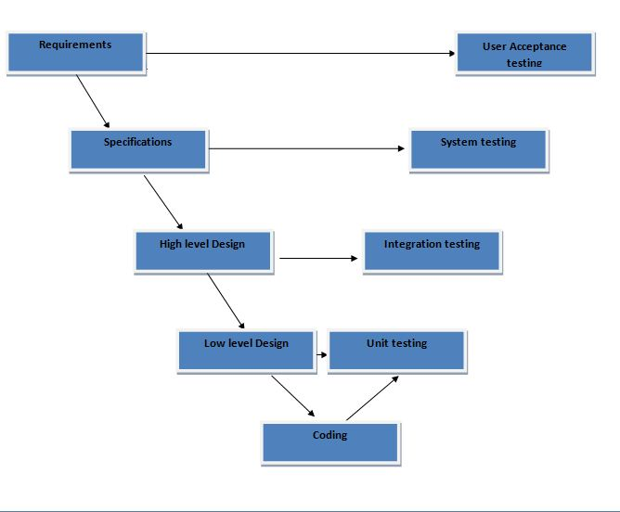
V-model
http://thebuggingplace.blogspot.com/2011/04/v-model.html

Slide 14
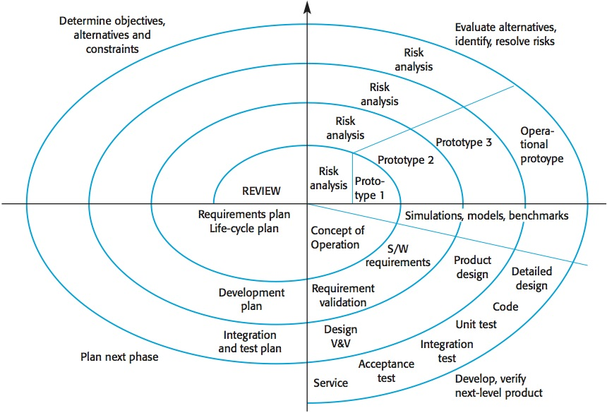
Spiral model
Software Engineering by Sommerville

Slide 15
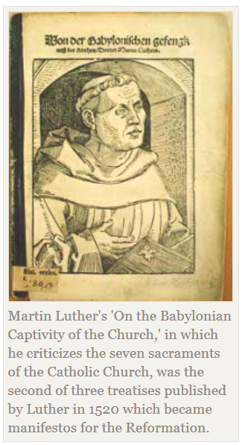
Manifestos
Martin Luther 1520 criticized Catholic Church
Communist Manifesto - 1848
Karl Marx & Fredrich Engels

Slide 16
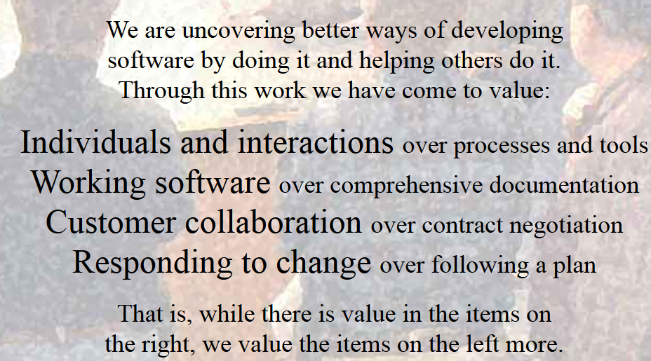
Manifesto for Agile Software Development
http://agilemanifesto.org/

Slide 17
Scrum
Not an acronym
Term from rugby
Scrum is an agile approach for developing innovative products and services.
Rubin, Kenneth S.. Essential Scrum: A Practical Guide to the Most Popular Agile Process (Addison-Wesley Signature Series (Cohn)) (p. 1). Pearson Education. Kindle Edition.
Essential Scrum by Rubin

Slide 18
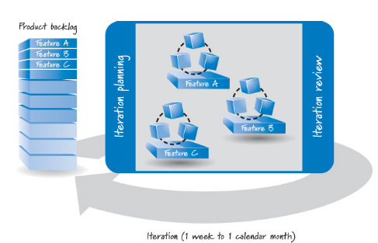
Agile Software development overview
Essential Scrum by Rubin

Slide 19
Agile terminology
Sprint
Iterations
Cross-functional team
Essential Scrum by Rubin

Slide 20
Agile Teams
Typically 5-9 member teams
One room - minimizing communication “costs”
One is the customer (or someone playing their role)
“Daily Standup”
What I did yesterday
What I am going to do today
Obstacles

Slide 21
Scrum origins
1986 Harvard Business Review article, “The New New Product Development Game” (Takeuchi and Nonaka 1986).
This article describes how companies such as Honda, Canon, and Fuji-Xerox produced world-class results using a scalable, team-based approach to all-at-once product development.
Essential Scrum by Rubin

Slide 22
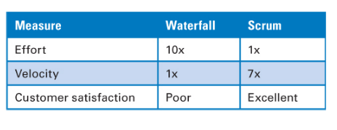
Table 1.1 Genomica Scrum Results
Essential Scrum by Rubin

Slide 23
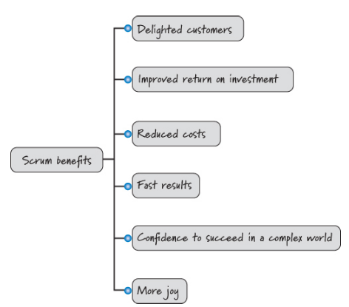
Scrum Benefits
Essential Scrum by Rubin

Slide 24
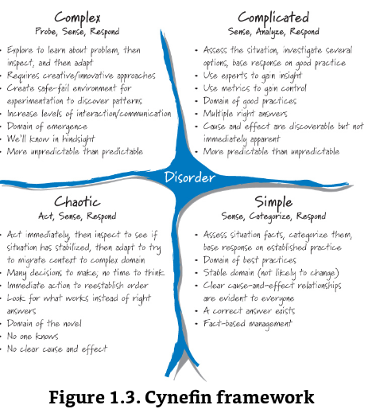
Essential Scrum by Rubin

Slide 25
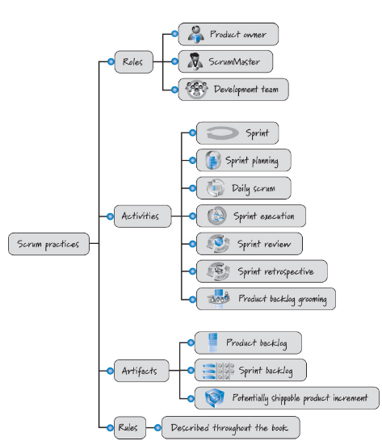
Scrum Practices
Essential Scrum by Rubin

Slide 26
Spring Framework
https://spring.io/
google(Spring Boot Video Javabrains)

Slide 27
J2EE applications

Slide 28
A Spring application
Create a folder structure that contains your WAR (Web ARchive): It must contain:
a WEB-INF folder with lib and
classes subfolders that contain the third-party libraries and your web application classes, respectively.
Some JSP (if needed), HTML, CSS, images, and JavaScript (if needed) files.
A file named web.xml that will contain the Spring org.springframework.web.servlet.
DispatcherServlet class. Your Spring beans in the form < servlet-name >-servlet.xml

Slide 29
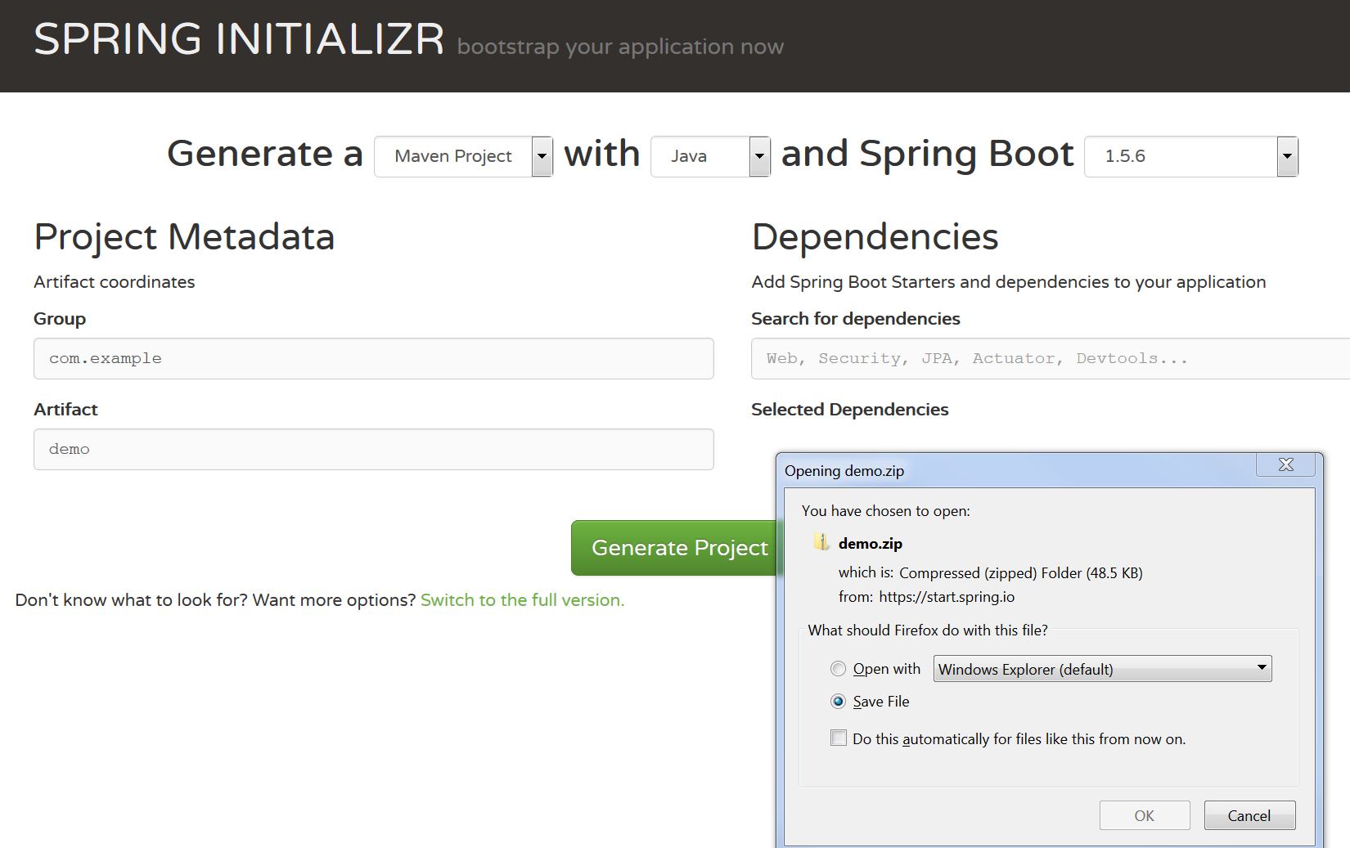

Slide 30
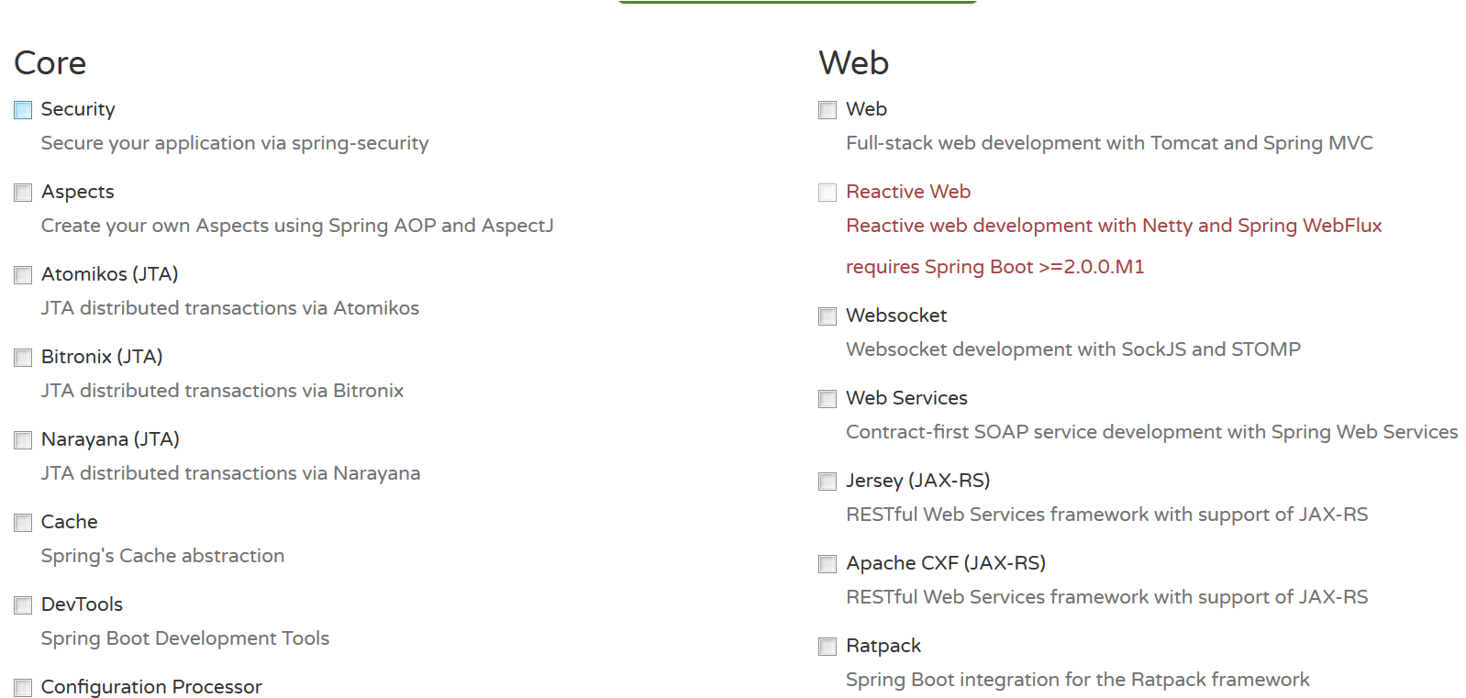
Some of the Spring Initialzr choices

Slide 31

Design patterns – Gof4 (Gang of Four)
What is your favorite design pattern?
What is a design pattern?

Slide 32
Spring Boot to the rescue

Slide 33
Spring Boot
Pro Spring Boot (2016) Felipe Gutierrez
In a sense like design patterns, abstracting the configurations of spring projects to “Boot”

Slide 34
Virtual Machines vs Containers
Vmware
Linux containers and Docker

Slide 35
Virtual Box

