Slide 1
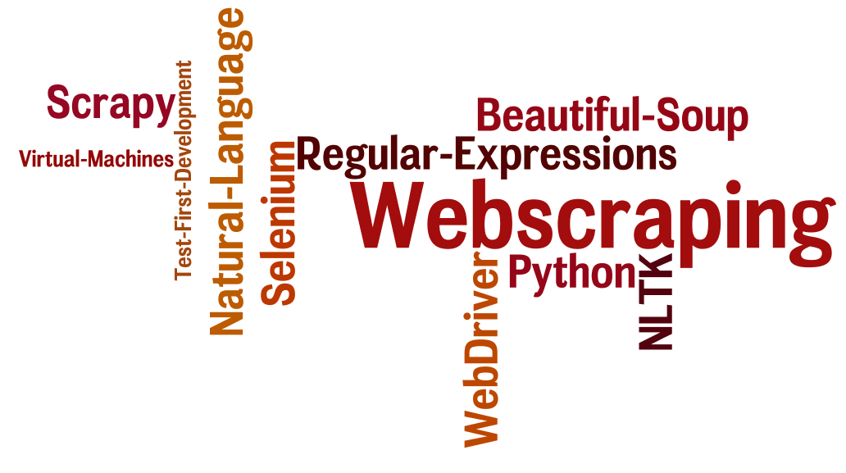
CSCE 590 Web Scraping – XPaths
Topics
The Scrapy framework revisited
Readings:
Scrapy User manual –
https://scrapy.org/doc/
https://doc.scrapy.org/en/1.3/
March 16, 2017

Slide 2
Overview
Last Time
Scrapy yet again
Review of some slides from lecture 14 before the break
Quotes-spider, author-spider, login-then-scrape
Scrappy commands: startproject, genspider, shell, crawl
Spider templates
Debugging example from Stackoverflow
Yahoo/finance – site analysis
Today
Scrapy one more time

Slide 3
Auxilliary lambda function to test xpaths
Testing xpaths can be a lot of typing
response.xpath('//ul[@class="directory-url"]/li')
Instead define
xp = lambda x: response.xpath(x).extract_first()
Then instead you just have to type the path to test
xp ('//ul[@class="directory-url"]/li')

Slide 4
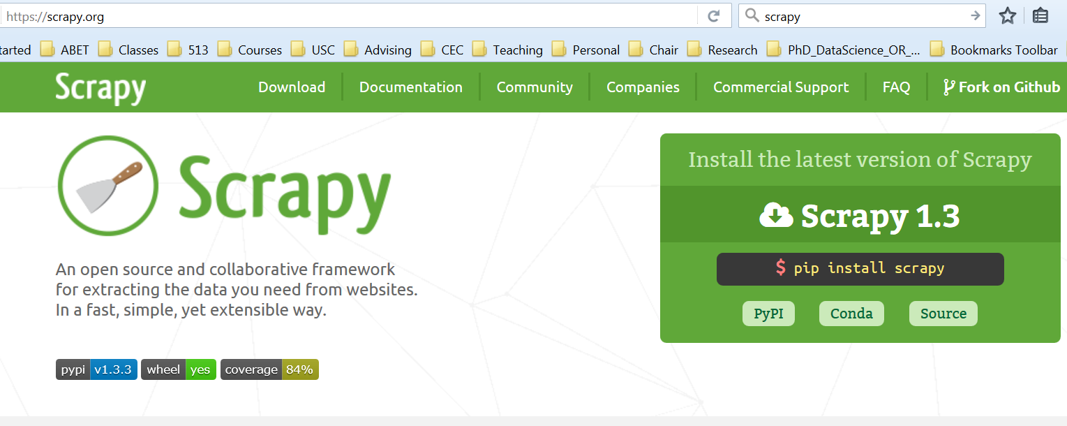
https://scrapy.org
Documentation – pdf and online
FAQ - https://doc.scrapy.org/en/1.3/faq.html

Slide 5
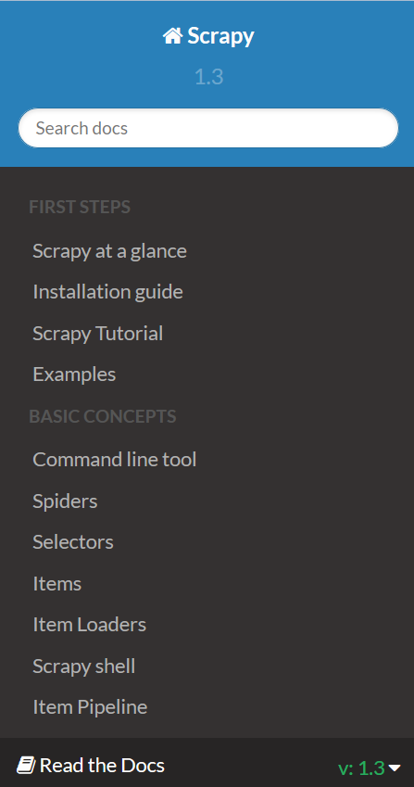

Slide 6
Using BeautifulSoup with Scrapy
from bs4 import BeautifulSoup
import scrapy
class ExampleSpider(scrapy.Spider):
name = "example"
allowed_domains = ["example.com"]
start_urls = (
'http://www.example.com/',
)
def parse(self, response):
# use lxml to get decent HTML parsing speed
soup = BeautifulSoup(response.text, 'lxml')
yield {
"url": response.url,
"title": soup.h1.string
}
https://doc.scrapy.org/en/1.3/faq.html

Slide 7
Build and run your web spiders
pip install scrapy
cat > myspider.py <<EOF
import scrapy
class BlogSpider(scrapy.Spider):
name = 'blogspider'
start_urls = ['https://blog.scrapinghub.com']
def parse(self, res):
for title in res.css('h2.entry-title'):
yield {'title': title.css('a ::text').extract_first()}
next_page = res.css('div.prev-post > a::attr(href)'). extract_first ()
if next_page: … (next slide)

Slide 8
def parse(self, response):
for title in response.css('h2.entry-title'):
yield {'title': title.css('a ::text').extract_first()}
next_page = response.css('div.prev-post > a ::attr(href)'). extract_first()
if next_page:
yield scrapy.Request(response.urljoin(next_page), callback=self.parse)
EOF
scrapy runspider myspider.py

Slide 9
Deploy them to Scrapy Cloud
pip install shub
shub login
Insert your Scrapinghub API Key: <API_KEY>
# Deploy the spider to Scrapy Cloud
shub deploy
# Schedule the spider for execution
shub schedule blogspider
Spider blogspider scheduled, watch it running here:
https://app.scrapinghub.com/p/26731/job/1/8
# Retrieve the scraped data
shub items 26731/1/8
{"title": "Improved Frontera: Web Crawling at Scale with Python 3 Support"}
{"title": "How to Crawl the Web Politely with Scrapy"} ...

Slide 10
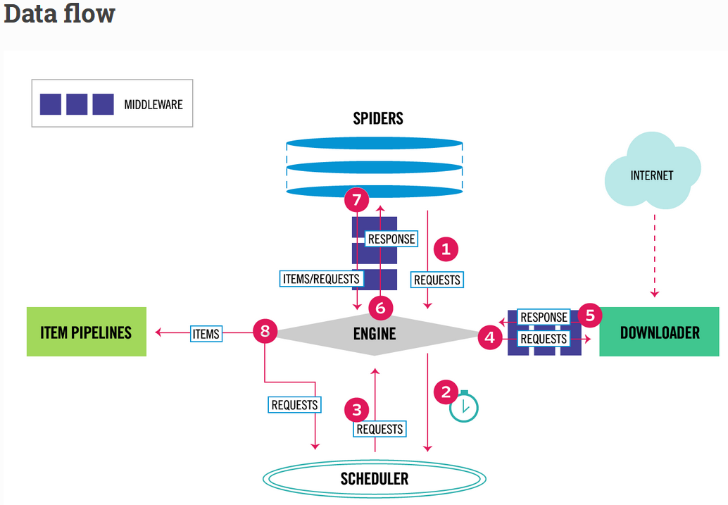
Architecture Overview

Slide 11
The data flow in Scrapy is controlled by the execution engine, and goes like this:
The Engine gets the initial Requests to crawl from the Spider.
The Engine schedules the Requests in the Scheduler and asks for the next Requests to crawl.
The Scheduler returns the next Requests to the Engine.
The Engine sends the Requests to the Downloader, passing through the Downloader Middlewares (see process_request()).
Once the page finishes downloading the Downloader generates a Response (with that page) and sends it to the Engine, passing through the Downloader Middlewares (see process_response()).
The Engine receives the Response from the Downloader and sends it to the Spider for processing, passing through the Spider Middleware (see process_spider_input()).
The Spider processes the Response and returns scraped items and new Requests (to follow) to the Engine, passing through the Spider Middleware (see process_spider_output()).
The Engine sends processed items to Item Pipelines, then send processed Requests to the Scheduler and asks for possible next Requests to crawl.
The process repeats (from step 1) until there are no more requests from the Scheduler.

Slide 12
Xpath
>>> response.xpath('//title') [<Selector xpath='//title' data='<title>Quotes to Scrape</title>'>]
>>> response.xpath('//title/text()').extract_first() 'Quotes to Scrape'
https://doc.scrapy.org/en/1.3/

Slide 13
XPATH Tutorial
http://zvon.org/comp/r/tut-XPath_1.html#intro
http://zvon.org/comp/r/tut-XPath_1.html#intro

Slide 14
List of XPaths
XPath as filesystem addressing
Start with //
All elements: *
Further conditions inside [ ]
Attributes
Attribute values
Nodes counting
Playing with names of selected elements
Length of string
Combining XPaths with |
Child axis
Descendant axis
Parent axis
Ancestor axis
Following-sibling axis
Preceding-sibling axis
Following axis
Preceding axis
Descendant-or-self axis
http://zvon.org/comp/r/tut-XPath_1.html

Slide 15
XPATH as filesystem – full vs relative
<A> <B> <C> <B> <B> <D> <B> </D> <C>
</A>
/A
/A/C
/A/D/B
//B
//D/B
/A/C/D/*
http://zvon.org/comp/r/tut-XPath_1.html#intro

Slide 16
XPATH as filesystem – // and *
<A> <X>
<D>
<B> <C> <B> <B> </D>
</X> <D> <B> </D>
</A>
//D
//D/B
/A/C/D/*
//D/*
/*/*/*/B – B’s with 3 ancestors
//*
http://zvon.org/comp/r/tut-XPath_1.html#intro

Slide 17
XPATH -Further conditions inside [ ]
<A> <X>
<D>
<B> <C> <B> <B> </D>
</X> <D> <B> </D>
</A>
/A/X/D/B[1]
/A/X/D/B[last()]
http://zvon.org/comp/r/tut-XPath_1.html#intro

Slide 18
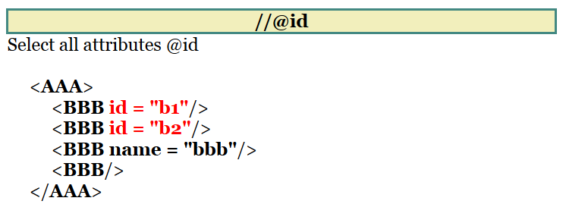
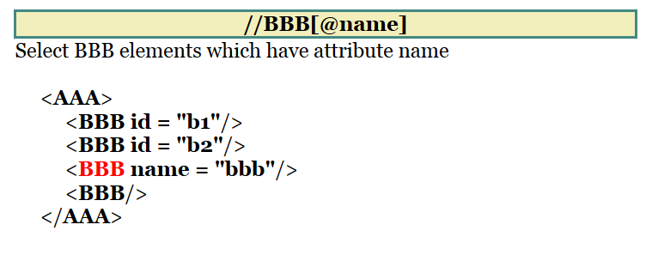
Attributes
http://zvon.org/comp/r/tut-XPath_1.html

Slide 19
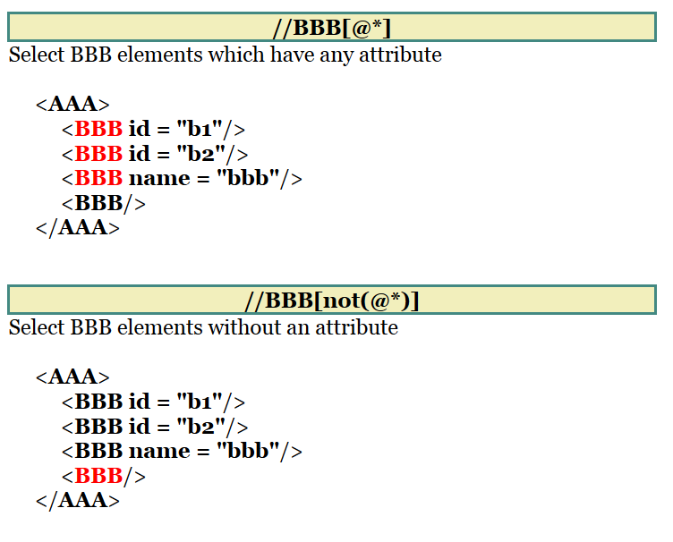
Any Attributes / no attributes
http://zvon.org/comp/r/tut-XPath_1.html

Slide 20
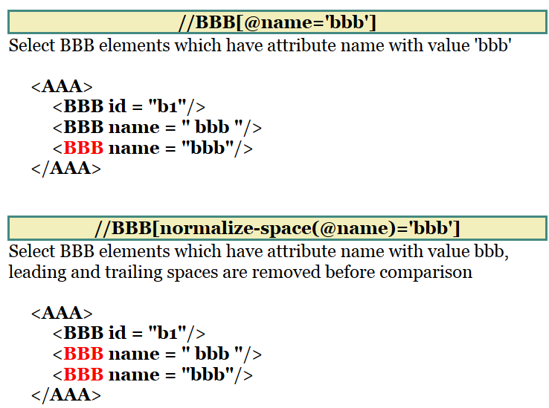
Attribute values
http://zvon.org/comp/r/tut-XPath_1.html

Slide 21
Node counting
//*[count(BBB)=2]
//*[count(*)=2]
//*[count(*)=3]
http://zvon.org/comp/r/tut-XPath_1.html

Slide 22
Playing with names of selected elements
//*[name()='BBB']
//*[starts-with(name(),'B')]
//*[contains(name(),'C')]
//*[string-length(name()) = 3]
//*[string-length(name()) < 3]
http://zvon.org/comp/r/tut-XPath_1.html

Slide 23
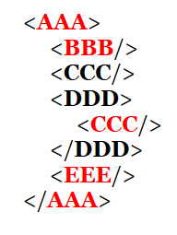
Combining XPaths with |
//CCC | //BBB
/AAA/EEE | //BBB
/AAA/EEE | //DDD/CCC | /AAA | //BBB
http://zvon.org/comp/r/tut-XPath_1.html

Slide 24
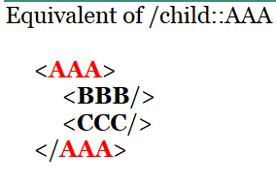
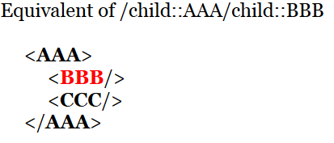
Child axis Default
/AAA
/AAA/BBB
http://zvon.org/comp/r/tut-XPath_1.html

Slide 25
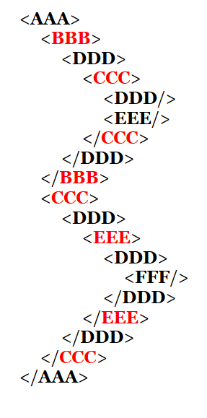
Parent
//DDD/parent::*
Select all parents of a DDD element
http://zvon.org/comp/r/tut-XPath_1.html

Slide 26
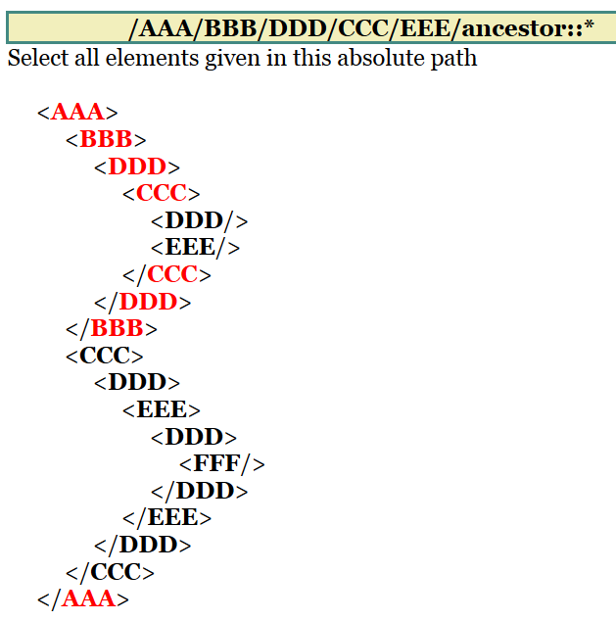
Ancestor axis
http://zvon.org/comp/r/tut-XPath_1.html

Slide 27
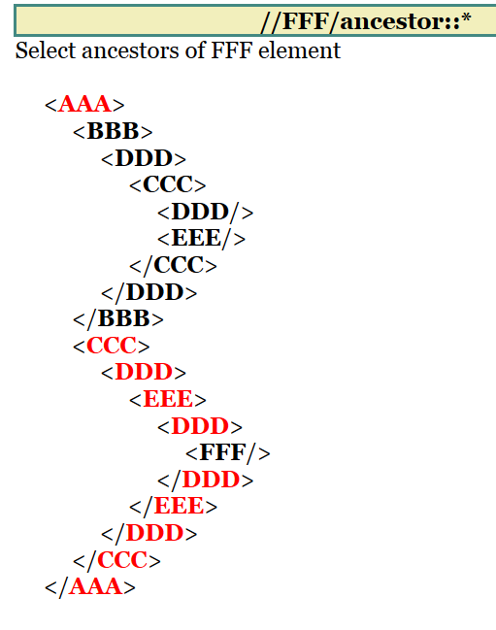
http://zvon.org/comp/r/tut-XPath_1.html

Slide 28
List of XPaths
XPath as filesystem addressing
Start with //
All elements: *
Further conditions inside []
Attributes
Attribute values
Nodes counting
Playing with names of selected elements
http://zvon.org/comp/r/tut-XPath_1.html

Slide 29
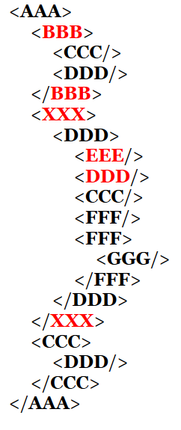
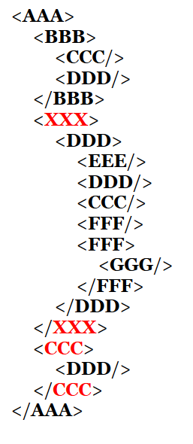
Siblings
/AAA/BBB/following-sibling::*
//CCC/preceding-sibling::*
http://zvon.org/comp/r/tut-XPath_1.html

Slide 30
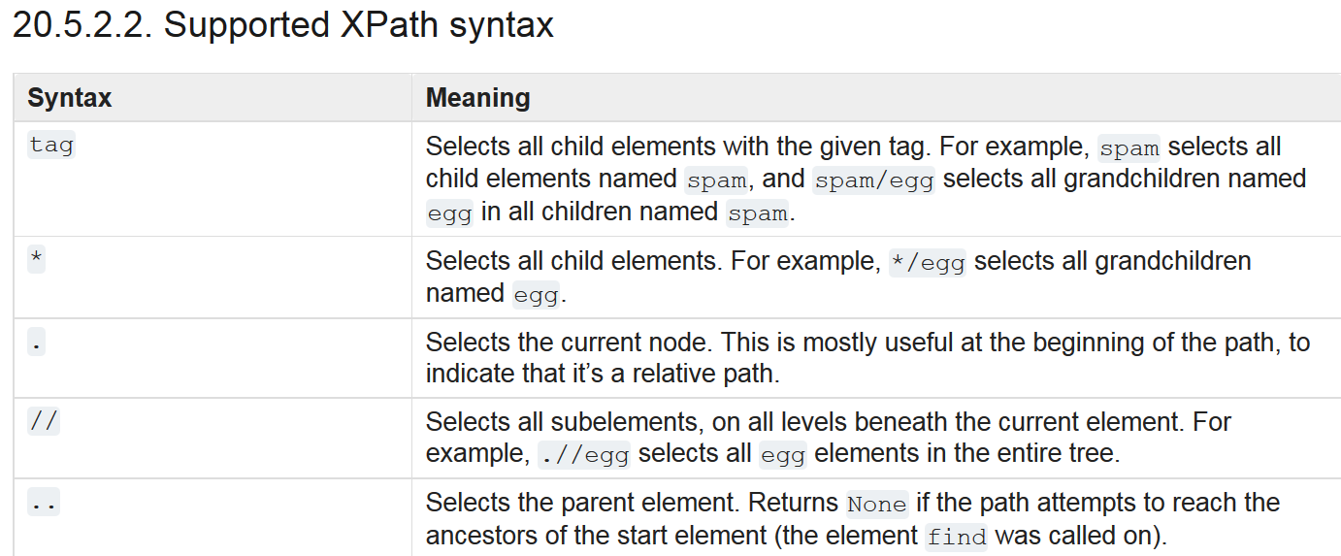
Xpath syntax -Python 3 direct support
20.5.2.2. Supported XPath syntax
Predicates (expressions within square brackets) must be preceded by a tag name, an asterisk, or another predicate. position predicates must be preceded by a tag name.
https://docs.python.org/3/library/xml.etree.elementtree.html

Slide 31
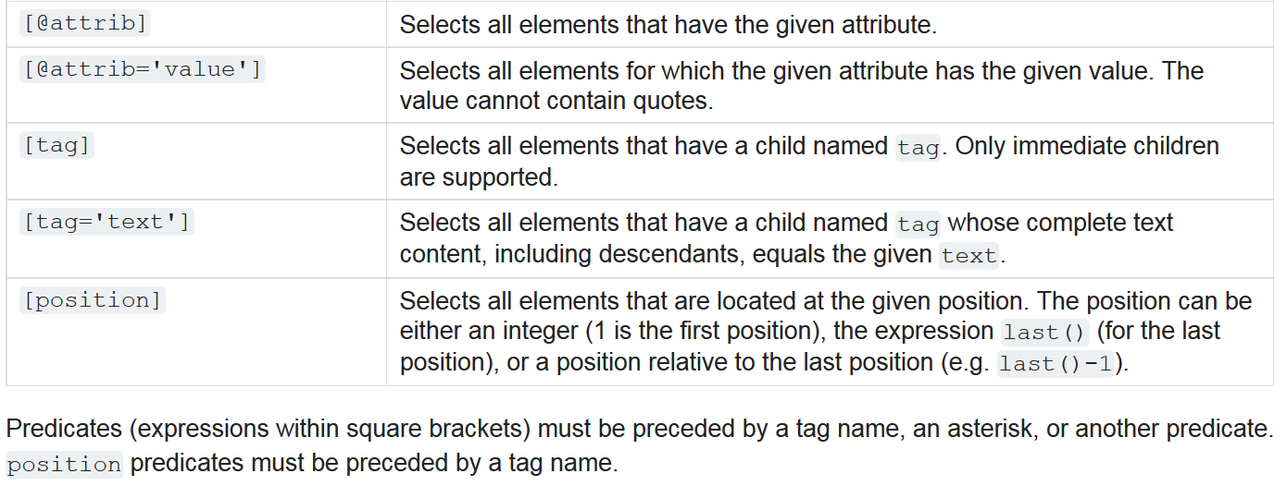
Xpath syntax -Python 3 direct support
20.5.2.2. Supported XPath syntax
Predicates (expressions within square brackets) must be preceded by a tag name, an asterisk, or another predicate. position predicates must be preceded by a tag name.
https://docs.python.org/3/library/xml.etree.elementtree.html

Slide 32
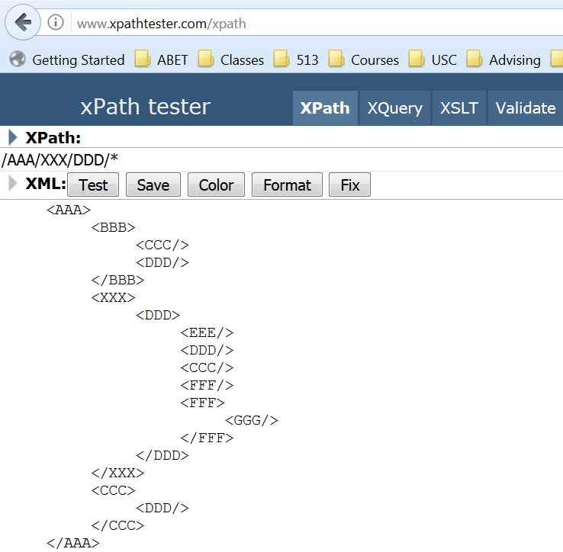
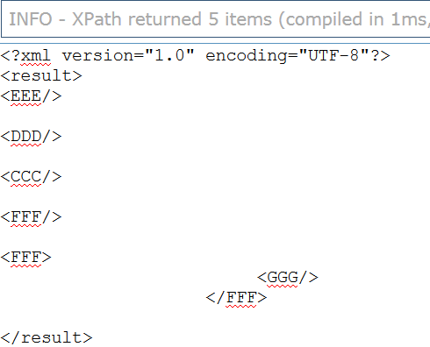
xpathtester
http://www.xpathtester.com/xpath
http://www.xpathtester.com/xpath

Slide 33
xml.py (emailed to you)
import xml.etree.ElementTree as ET
#tree = ET.parse('country_data.xml')
#root = tree.getroot()
a = ET.Element('a')
b = ET.SubElement(a, 'b')
c = ET.SubElement(a, 'c')
d = ET.SubElement(c, 'd')
ET.dump(a)
https://docs.python.org/3/library/xml.etree.elementtree.html

Slide 34
Xml.py – test the xpath tutorial
import xml.etree.ElementTree as ET
my_string="""
<AAA>
<BBB>
<CCC/>
<DDD/>
</BBB>
<XXX>
<DDD>
…
</AAA>
"""
root = ET.fromstring(my_string)
ET.dump(root)
path=".//CCC/.."
print(root.findall(path))

Slide 35
Login then scrape
import scrapy
from scrapy.linkextractors import LinkExtractor
from scrapy.spiders import CrawlSpider, Rule
class LoginSpider(CrawlSpider):
name = 'login'
allowed_domains = ['www.example.com']
rules = (
Rule(LinkExtractor(allow=r'Items/'), callback='parse_item', follow=True),
)
def start_requests(self):
return [scrapy.FormRequest("http://www.example.com/login",
formdata={'user': 'john', 'pass': 'secret'},
callback=self.logged_in)]
def logged_in(self, response):
# here you would extract links to follow and return Requests for
# each of them, with another callback
pass
def parse_item(self, response):
i = {}
#i['domain_id'] = response.xpath('//input[@id="sid"]/@value').extract()
#i['name'] = response.xpath('//div[@id="name"]').extract()
#i['description'] = response.xpath('//div[@id="description"]').extract()
return i

Slide 36
27.3. pdb — The Python Debugger
Source code: Lib/pdb.py
The module pdb defines an interactive source code debugger for Python programs. It supports setting (conditional) breakpoints and single stepping at the source line level, inspection of stack frames, source code listing, and evaluation of arbitrary Python code in the context of any stack frame. It also supports post-mortem debugging and can be called under program control.
The debugger is extensible – it is actually defined as the class Pdb. This is currently undocumented but easily understood by reading the source. The extension interface uses the modules bdb and cmd.
The debugger’s prompt is (Pdb).

