Slide 1
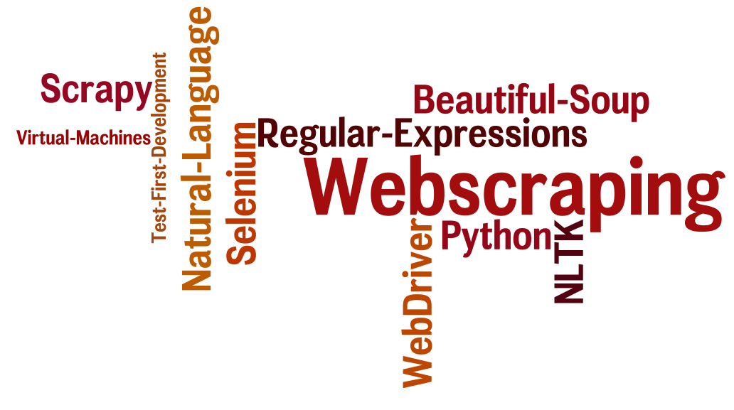
CSCE 590 Web Scraping – Scrapy II
Topics
The Scrapy framework revisited
Readings:
Scrapy User manual –
https://scrapy.org/doc/
https://doc.scrapy.org/en/1.3/
January 10, 2017

Slide 2
Scrapy Review
scrapy startproject tut3
scrapy genspider postLoginForm "www.example.com”
scrapy crawl postLoginForm
scrapy shell postLoginForm

Slide 3
Response.attributes (right term)
body
copy
css
encoding
flags
headers
meta
replace
request
selector
status
test
url
urljoin
xpath

Slide 4
Running the spider
scrapy crawl quotes # notes quotes ➔quotes_spider.py
https://doc.scrapy.org/en/1.3/

Slide 5
Scrapy shell
Linux and Mac-OS
scrapy shell 'http://quotes.toscrape.com/page/1/‘
Windows
scrapy shell "http://quotes.toscrape.com/page/1/"
https://doc.scrapy.org/en/1.3/

Slide 6
scrapy shell "www.yahoo.com/finance"

Slide 7
scrapy genspider –l
Basic
Crawl
Cvsfeed
Xmlfeed

Slide 8
Scrapy startproject ## notes

Slide 9
Project example from Stackoverflow
http://stackoverflow.com/questions/39243009/scrapy-tutorial-example
Fragile scraping project
Diagnosis
Run
Run in scrapy shell
view(response) – to see what the browser would show
Fix searches to adjust to changes in website

Slide 10
Fragile projects – break if
website changes format
Browser updates version (selenium only ???)

Slide 19
Xpath
>>> response.xpath('//title') [<Selector xpath='//title' data='<title>Quotes to Scrape</title>'>]
>>> response.xpath('//title/text()').extract_first() 'Quotes to Scrape'
https://doc.scrapy.org/en/1.3/

Slide 20
https://doc.scrapy.org/en/1.3/

