Slide 1
CSCE 590 Web Scraping Lecture 3
Topics
Beautiful Soup
Libraries, installing, environments
Readings:
Chapter 1
Python tutorial
January 10, 2017

Slide 2
Overview
Last Time:
Dictionaries
Classes
Today:
BeautifulSoup
Installing Libraries
References
Code in text:
https:// github.com/ REMitchell/ python-scraping.
Webpage of book:
http:// oreil.ly/1ePG2Uj.

Slide 3
URLLib.request

Slide 4
Example 1
from urllib.request import urlopen
#Retrieve HTML string from the URL
html = urlopen("http://www.pythonscraping.com/exercises/exercise1.html")
print(html.read())

Slide 5
Standard Python Libraries
https://docs.python.org/3/library/
37 sections
PyPI - the Python Package Index
The Python Package Index is a repository of software for the Python programming language. There are currently 96767 packages here.

Slide 6
Online Documentation

Slide 7
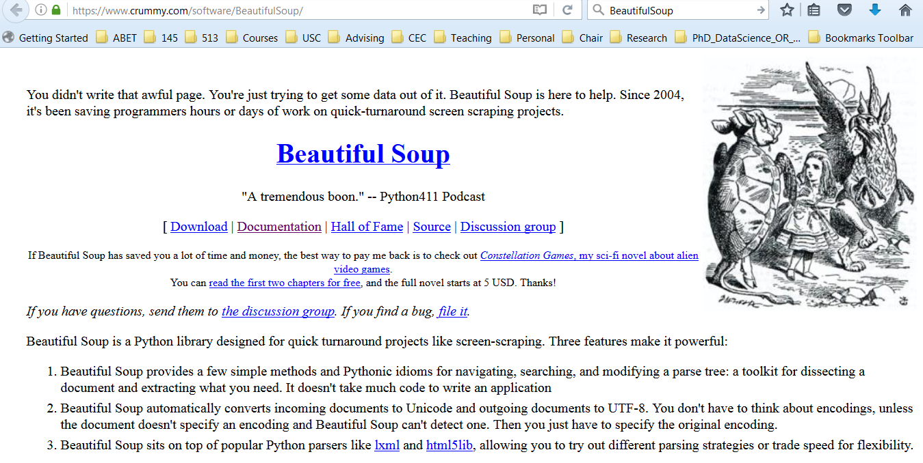
BeautifulSoup4
Library for reading and processing web pages
URL: crummy.com

Slide 8
Installation Problems
ImportError …
Crummy.com – BeautifulSoup documentation

Slide 9
Installing BeautifulSoup
Linux
sudo apt-get install python-bs4
Macs
sudo easy_install pip
pip install beautifulsoup4
Windows
pip install beautifulsoup4

Slide 10
Python3 installs
python3
Download library as tar-ball libr.tgz
tar xvfz libr.tgz
Find setup.py in package
sudo python3 setup.py install
Pip3
pip3 install beautifulsoup4
Import
From bs4 import BeautifulSoup

Slide 11
Virtual Environments
Keeping Python2 and Python3 separate
Also encapsulates package with right versions of libraries
$ virtualenv scrapingCode
$ cd scrapingCode
$ ls
bin lib include …
$ source bin/activate
(scrapingCode) $ pip install beautifulsoup4
deactivate
python3 myprog.py ➔ ImportError: no module ‘bs4’

Slide 12
Running Example 1
from urllib.request import urlopen
#Retrieve HTML string from the URL
html = urlopen("http://www.pythonscraping.com/exercises/exercise1.html")
print(html.read())

Slide 13
Example 2 Using BeautifulSoup
from urllib.request import urlopen
from bs4 import BeautifulSoup
html = urlopen("http://www.pythonscraping.com/exercises/exercise1.html")
bsObj = BeautifulSoup(html.read())
print(bsObj.h1)

Slide 14
Connecting Reliably
Distributed (Web) applications have connectivity problems
urlopen(URL)
Web server down
URL wrong
HTTPError

Slide 15
try:
…
except HTTPError as e:
…
else:
…

Slide 16
3-Exception handling.py
from urllib.request import urlopen
from urllib.error import HTTPError
from bs4 import BeautifulSoup
import sys
def getTitle(url):
try:
html = urlopen(url)
except HTTPError as e:
print(e)
return None
try:
bsObj = BeautifulSoup(html.read())
title = bsObj.body.h1
except AttributeError as e:
return None
return title
title = getTitle("http://www.pythonscraping.com/...l")
if title == None:
print("Title could not be found")
else:
print(title)

Slide 17
HTML sample (Python string)
html_doc = """
<html><head><title>The Dormouse's story</title></head>
<body>
<p class="title"><b>The Dormouse's story</b></p>
<p class="story">Once upon a time there were three little sisters; and their names were
<a href="http://example.com/elsie" class="sister" id="link1">Elsie</a>,
<a href="http://example.com/lacie" class="sister" id="link2">Lacie</a> and
<a href="http://example.com/tillie" class="sister" id="link3">Tillie</a>;
and they lived at the bottom of a well.</p>
<p class="story">...</p>
"""

Slide 18
HTML Parsing – chapter 2
from bs4 import BeautifulSoup
soup = BeautifulSoup(html_doc, 'html.parser')
print(soup.prettify())
# <html>
# <head>
# <title>
# The Dormouse's story
# </title>
# </head>
# <body>
# <p class="title">
# <b>
# The Dormouse's story
# </b>
# </p>
# <p class="story">

Slide 19
Navigating the tree
…
>>> soup.title
>>> soup.title.name
>>> soup.title.string
>>> soup.title.parent.name
>>> soup.p
>>> soup.p [ ‘class’]
>>> soup.p
Crummy.com – BeautifulSoup documentation

Slide 20
Find and Findall
soup.find_all('a')
# [<a class="sister" href="http://example.com/elsie" id="link1">Elsie</a>,
# <a class="sister" href="http://example.com/lacie" id="link2">Lacie</a>,
# <a class="sister" href="http://example.com/tillie" id="link3">Tillie</a>]
soup.find(id="link3")
# <a class="sister" href="http://example.com/tillie" id="link3">Tillie</a>
Crummy.com – BeautifulSoup documentation

Slide 21
Extracting text
print(soup.get_text())

Slide 22
Installing an HTML parser
lxml
Html5lib
$ apt-get install python-html5lib
$ easy_install html5lib
$ pip install html5lib

Slide 23
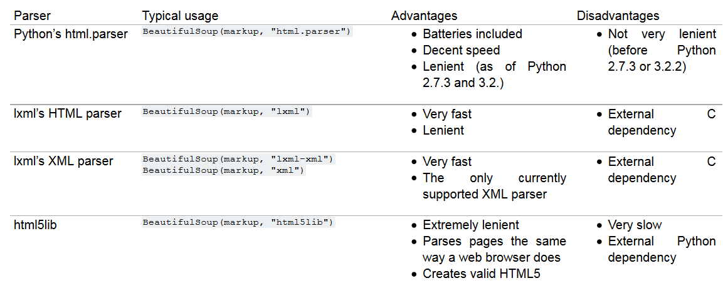

Slide 24
Kinds of Objects
Tags – corresponds to XML or HTML tag
Name of Tags
Attributes
tag[‘class’]
tag.attrs
NavigableString
BeautifulSoup object
Comments
Crummy.com – BeautifulSoup documentation

Slide 25
Navigating the tree
Name the tag: bsObj.tag.subtag.anotherSubTag
soup.head
soup.body.b
soup.a
# <a class="sister" href="http://example.com/elsie" id="link1">Elsie</a>
.parent
.next_sibling and .previous_sibling

Slide 26
sibling_soup = BeautifulSoup("<a><b>text1</b><c>text2</c></b></a>")
sibling_soup.b.next_sibling
# <c>text2</c>
sibling_soup.c.previous_sibling
# <b>text1</b>

Slide 27
Searching the tree
soup.find_all('b')
# [<b>The Dormouse's story</b>]
import re
for tag in soup.find_all(re.compile("^b")):
print(tag.name)
# body
# b
for tag in soup.find_all(re.compile("t")):
print(tag.name)
# html
# title

Slide 28
Filters
soup.find_all(["a", "b"])
for tag in soup.find_all(True):
print(tag.name)

Slide 29
Function as filter
def has_class_but_no_id(tag):
return tag.has_attr('class') and not tag.has_attr('id')
soup.find_all(has_class_but_no_id)
# [<p class="title"><b>The Dormouse's story</b></p>,
# <p class="story">Once upon a time there were...</p>,
# <p class="story">...</p>]

Slide 30
Searching by CSS
soup.find_all("a", class_="sister")
# [<a class="sister" href="http://example.com/elsie" id="link1">Elsie</a>,
# <a class="sister" href="http://example.com/lacie" id="link2">Lacie</a>,
# <a class="sister" href="http://example.com/tillie" id="link3">Tillie</a>]
Crummy.com – BeautifulSoup documentation

Slide 31
Calling a tag is like calling find_all()
These two lines are
equivalent soup.find_all("a")
soup("a")
These two lines are also equivalent:
soup.title.find_all(string=True)
soup.title(string=True)

Slide 32
HTML Advanced Parsing – chapter 2
Michelangelo on David “just chip away the stone that doesn’t look like David.”

Slide 33
CSS Selectors
from urllib.request import urlopen
from bs4 import BeautifulSoup
html = urlopen("http://www.pythonscraping.com/pages/warandpeace.html")
bsObj = BeautifulSoup(html, "html.parser")
nameList = bsObj.findAll("span", {"class":"green"})
for name in nameList:
print(name.get_text())

Slide 34
By Attribute
from urllib.request import urlopen
from bs4 import BeautifulSoup
html = urlopen("http://www.pythonscraping.com/pages/warandpeace.html")
bsObj = BeautifulSoup(html, "html.parser")
allText = bsObj.findAll(id="text")
print(allText[0].get_text())

Slide 35
Find Descendants
from urllib.request import urlopen
from bs4 import BeautifulSoup
html = urlopen("http://www.pythonscraping.com/pages/page3.html")
bsObj = BeautifulSoup(html, "html.parser")
for child in bsObj.find("table",{"id":"giftList"}).children:
print(child)

Slide 36
Find Siblings
from urllib.request import urlopen
from bs4 import BeautifulSoup
html = urlopen("http://www.pythonscraping.com/pages/page3.html")
bsObj = BeautifulSoup(html, "html.parser")
for sibling in bsObj.find("table",{"id":"giftList"}).tr.next_siblings:
print(sibling)

Slide 37
Find Parents
from urllib.request import urlopen
from bs4 import BeautifulSoup
html = urlopen("http://www.pythonscraping.com/pages/page3.html")
bsObj = BeautifulSoup(html, "html.parser")
for sibling in bsObj.find("table",{"id":"giftList"}).tr.next_siblings:
print(sibling)

Slide 38
Find – regular expressions
from urllib.request import urlopen
from bs4 import BeautifulSoup
import re
html = urlopen("http://www.pythonscraping.com/pages/page3.html")
bsObj = BeautifulSoup(html, "html.parser")
images = bsObj.findAll("img", {"src":re.compile("\.\.\/img\/gifts/img.*\.jpg")})
for image in images:
print(image["src"])

Slide 39
Another Serving of BeautifulSoup
from urllib.request import urlopen
from bs4 import BeautifulSoup
import datetime
import random
import re
random.seed(datetime.datetime.now())
def getLinks(articleUrl):
html = urlopen("http://en.wikipedia.org"+articleUrl)
bsObj = BeautifulSoup(html, "html.parser")
return bsObj.find("div", {"id":"bodyContent"}).findAll("a", href=re.compile("^(/wiki/)((?!:).)*$"))
links = getLinks("/wiki/Kevin_Bacon")
while len(links) > 0:
newArticle = links[random.randint(0, len(links)-1)].attrs["href"]
print(newArticle)
links = getLinks(newArticle)

Slide 40
Regular expressions
https://docs.python.org/3/library/re.html
Recursive definition:

