Slide 1
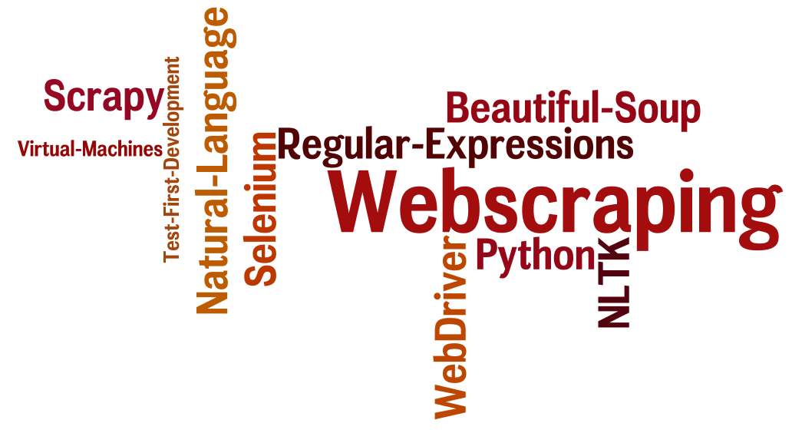
CSCE 590 Web Scraping
Topics
Overview – Web scraping
Introduction to Python 3.5
Readings:
Chapter 1
Python tutorial
January 10, 2017

Slide 2
Course Information
Contact Information:
Instructor: Manton Matthews
Office: Swearingen 3A53
Email: mm <at> sc
Office phone: 777-3285
Course location: Sumwalt 305
Course Time: TR 8:30-9:45
Office Hours: TR 11:30-1:00PM, others by appointment
Textbook:
Required: Web Scraping with Python – Collecting Data from the Modern Web by Ryan Mitchell, O’Reilly, 2015.

Slide 3
Resources - Websites or online texts
Python 3.5 documentation - https://docs.python.org/3.5/
Tutorial (Required) https://docs.python.org/3.5/tutorial/index.html
The Standard Library https://docs.python.org/3.5/library/index.html
Python – Fluent Python – Clear, Concise and Effective Programming by Luciano Ramalho, O’Reilly 2015.
Natural Language Toolkit – for Python 3.x http://www.nltk.org/book/ and for Python2.x http://www.nltk.org/book_1ed/
Scrapy - https://doc.scrapy.org/en/latest/intro/tutorial.html
Dive into Python 3- https://cloud.github.com/downloads/diveintomark/diveintopython3/dive-into-python3.pdf

Slide 4
Why Scrape?
“Cheapest flight to Boston”
Google knows what are on the content pages but not the results of queries about specific flights.
A scraper can query all the popular sites, with user preferences and optimize the results the way you would like

Slide 5
Views of Web Applications
2.1 100,000 Feet: Client-Server Architecture
2.2 50,000 Feet: Communication— HTTP and URIs
2.3 10,000 Feet: Representation— HTML and CSS
2.4 5,000 Feet: 3-Tier Architecture & Horizontal Scaling
2.5 1,000 Feet: Model-View-Controller Architecture
Fox, Armando; Patterson, David. Engineering Software as a Service: An Agile Approach Using Cloud Computing (Kindle Locations 1481-1485). Strawberry Canyon LLC. Kindle Edition.

Slide 6
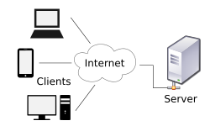
2.1 100,000 Feet View: Client-Server Architecture
⬅ HTTP & HTTP/2 // for browsers ⬅➔servers
TCP protocol
IP protocol
Ethernet protocol

Slide 7
2.2 50,000 Feet: Communication— HTTP and URIs

Slide 8
2.3 10,000 Feet: Representation— HTML and CSS

Slide 9
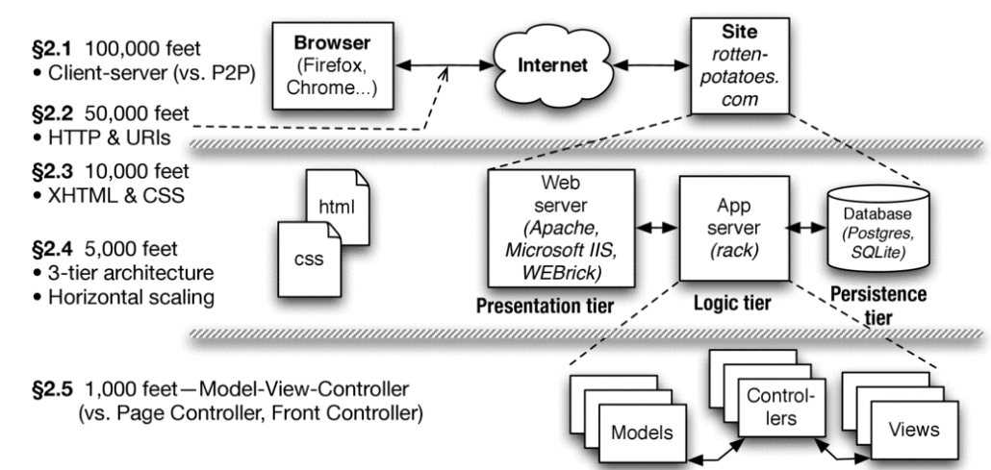
2.5 1,000 Feet: Model-View-Controller Architecture

Slide 10
Introduction to Python
Python 2.8 vs Python 3.5

Slide 11
Installing

Slide 12
Python References
Python 3.5 documentation - https://docs.python.org/3.5/
Tutorial (Required) https://docs.python.org/3.5/tutorial/index.html
The Standard Library https://docs.python.org/3.5/library/index.html
Dive into Python 3- https://cloud.github.com/downloads/diveintomark/diveintopython3/dive-into-python3.pdf
Python – Fluent Python – Clear, Concise and Effective Programming by Luciano Ramalho, O’Reilly 2015.

Slide 13
Python interpreter: Expressions
50 - 5*6
(50 - 5*6) / 4
8 / 5 # division always returns a floating point number
17 / 3 # classic division returns a float
17 // 3 # floor division discards the fractional part
17 % 3 # the % operator returns the remainder of the division
5 ** 2 # 5 squared
2 ** 7 # 2 to the power of 7

Slide 14
Variables and typing
width = 20
height = 5 * 9
width * height
print(width * height)

Slide 15
# 3.1.2 Strings
#'spam eggs' # single quotes
'doesn\'t' # use \' to escape the single quote...
"doesn't" # ...or use double quotes instead
'"Yes," he said.'
"\"Yes,\" he said."
'"Isn\'t," she said.'
'"Isn\'t," she said.'
print('"Isn\'t," she said.')

Slide 16
s = 'First line.\nSecond line.' # \n means newline
s # without print(), \n is included in the output
print(s) # with print(), \n produces a new line
print('C:\some\name') # here \n means newline!
print(r'C:\some\name') # note the r before the quote

Slide 17
concatenation
# 3 times 'un', followed by 'ium'
# 3 * 'un' + 'ium'
#
'Py' 'thon'
prefix = 'Py'
prefix 'thon' # can't concatenate a variable and a string literal

Slide 18
word = 'Python'
word[0] # character in position 0
word[5] # character in position 5
word[-1] # last character
word[-2] # second-last character
word[-6]

Slide 19
Slices
word[0:2] # characters from position 0 (included) to 2 (excluded)
word[2:5] # characters from position 2 (included) to 5 (excluded)
word[:2] + word[2:]
word[:4] + word[4:]
word[:2] # character from the beginning to position 2 (excluded)
word[4:] # characters from position 4 (included) to the end
word[-2:] # characters from the second-last (included) to the end

Slide 20
word[42] # the word only has 6 characters
word[4:42]
word[42:]
word[0] = 'J'
word[2:] = 'py'
'J' + word[1:]
word[:2] + 'py'
s = 'supercalifragilisticexpialidocious'
len(s)

Slide 21
squares = [1, 4, 9, 16, 25]
sauares
squares[0] # indexing returns the item
squares[-1]
squares[-3:] # slicing returns a new list
squares + [36, 49, 64, 81, 100]
cubes = [1, 8, 27, 65, 125] # something's wrong here
4 ** 3 # the cube of 4 is 64, not 65!
cubes[3] = 64 # replace the wrong value
cubes
cubes.append(216) # add the cube of 6
cubes.append(7 ** 3) # and the cube of 7
cubes

Slide 22
letters = ['a', 'b', 'c', 'd', 'e', 'f', 'g']
letters
# replace some values
letters[2:5] = ['C', 'D', 'E']
letters
# now remove them
letters[2:5] = []
letters
# clear the list by replacing all the elements with an empty list
letters[:] = []
letters
letters = ['a', 'b', 'c', 'd']
len(letters)

Slide 23
Nesting
a = ['a', 'b', 'c']
n = [1, 2, 3]
x = [a, n]
x
x[0]
x[0][1]

Slide 24
# 3.2. First Steps Towards Programming
Fibonacci series:
# the sum of two elements defines the next
a, b = 0, 1
while b < 10:
print(b)
a, b = b, a+b

Slide 25
a, b = 0, 1
while b < 1000:
print(b, end=',')
a, b = b, a+b

Slide 26
if Statements
x = int(input("Please enter an integer: "))
if x < 0:
x = 0
print('Negative changed to zero')
elif x == 0:
print('Zero')
elif x == 1:
print('Single')
else:
print('More')

Slide 27
# Measure some strings:
words = ['cat', 'window', 'defenestrate']
for w in words:
print(w, len(w))
for w in words[:]: # Loop over a slice copy of the entire list.
if len(w) > 6:
words.insert(0, w)

Slide 28
# 4.3. The range() Function
for i in range(5):
print(i)
range(5, 10)
5 through 9
range(0, 10, 3)
0, 3, 6, 9
range(-10, -100, -30)
-10, -40, -70

Slide 29
a = ['Mary', 'had', 'a', 'little', 'lamb']
for i in range(len(a)):
print(i, a[i])
print(range(10))
list(range(5))

Slide 30
Break and continue
for n in range(2, 10):
for x in range(2, n):
if n % x == 0:
print(n, 'equals', x, '*', n//x)
break
else:
# loop fell through without finding a factor
print(n, 'is a prime number')

Slide 31
Pass
while True:
pass # Busy-wait for keyboard interrupt (Ctrl+C)
class MyEmptyClass:
pass
def initlog(*args):
pass # Remember to implement this!

Slide 32
# 4.6. Defining Functions
def fib(n): # write Fibonacci series up to n
"""Print a Fibonacci series up to n."""
a, b = 0, 1
while a < n:
print(a, end=' ')
a, b = b, a+b
print()

