Slide 1
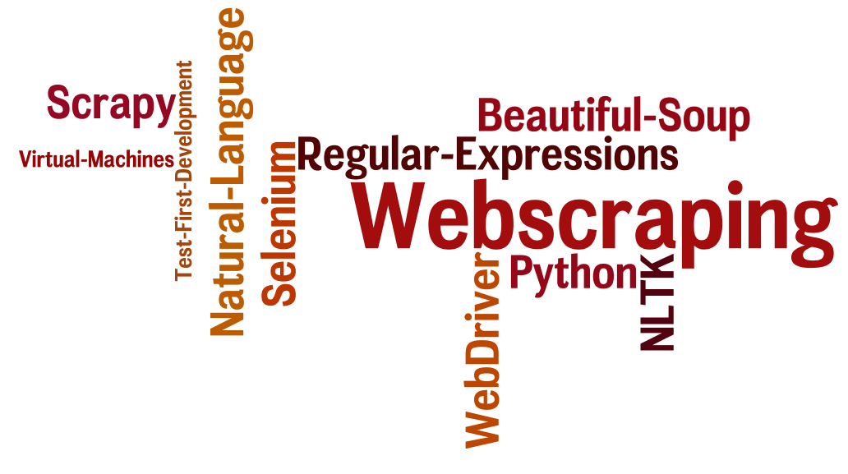
CSCE 590 Web Scraping – Scrapy III
Topics
The Scrapy framework revisited
Readings:
Scrapy User manual –
https://scrapy.org/doc/
https://doc.scrapy.org/en/1.3/
March 16, 2017

Slide 2
Overview
Last Time
Scrapy yet again
Review of some slides from lecture 14 before the break
Quotes-spider, author-spider, login-then-scrape
Scrappy commands: startproject, genspider, shell, crawl
Spider templates
Debugging example from Stackoverflow
Yahoo/finance – site analysis
Today
Scrapy one more time

Slide 3
Auxilliary lambda function to test xpaths
Testing xpaths can be a lot of typing
response.xpath('//ul[@class="directory-url"]/li')
Instead define
xp = lambda x: response.xpath(x).extract_first()
Then instead you just have to type the path to test
xp ('//ul[@class="directory-url"]/li')

Slide 4
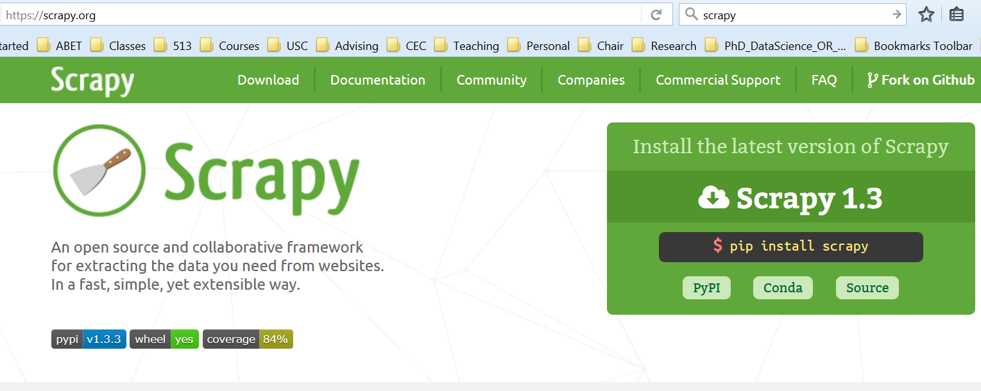
https://scrapy.org
Documentation – pdf and online
FAQ - https://doc.scrapy.org/en/1.3/faq.html

Slide 5
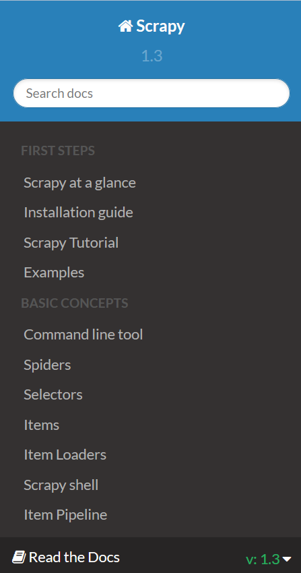

Slide 6
Using BeautifulSoup with Scrapy
from bs4 import BeautifulSoup
import scrapy
class ExampleSpider(scrapy.Spider):
name = "example"
allowed_domains = ["example.com"]
start_urls = (
'http://www.example.com/',
)
def parse(self, response):
# use lxml to get decent HTML parsing speed
soup = BeautifulSoup(response.text, 'lxml')
yield {
"url": response.url,
"title": soup.h1.string
}
https://doc.scrapy.org/en/1.3/faq.html

Slide 7
Build and run your web spiders
pip install scrapy
cat > myspider.py <<EOF
import scrapy
class BlogSpider(scrapy.Spider):
name = 'blogspider'
start_urls = ['https://blog.scrapinghub.com']
def parse(self, res):
for title in res.css('h2.entry-title'):
yield {'title': title.css('a ::text').extract_first()}
next_page = res.css('div.prev-post > a::attr(href)'). extract_first ()
if next_page: … (next slide)

Slide 8
def parse(self, response):
for title in response.css('h2.entry-title'):
yield {'title': title.css('a ::text').extract_first()}
next_page = response.css('div.prev-post > a ::attr(href)'). extract_first()
if next_page:
yield scrapy.Request(response.urljoin(next_page), callback=self.parse)
EOF
scrapy runspider myspider.py

Slide 9
Deploy them to Scrapy Cloud
pip install shub
shub login
Insert your Scrapinghub API Key: <API_KEY>
# Deploy the spider to Scrapy Cloud
shub deploy
# Schedule the spider for execution
shub schedule blogspider
Spider blogspider scheduled, watch it running here:
https://app.scrapinghub.com/p/26731/job/1/8
# Retrieve the scraped data
shub items 26731/1/8
{"title": "Improved Frontera: Web Crawling at Scale with Python 3 Support"}
{"title": "How to Crawl the Web Politely with Scrapy"} ...

Slide 10
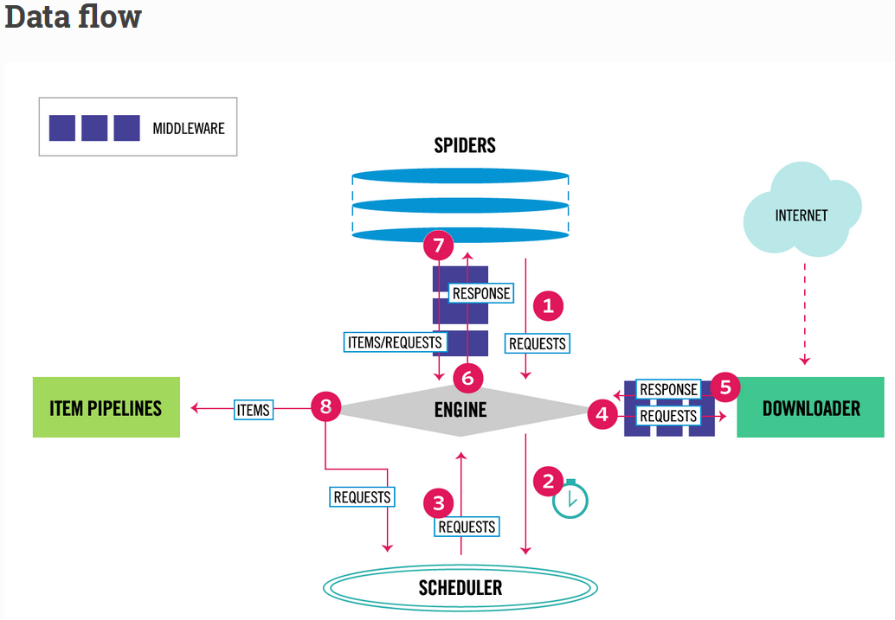
Architecture Overview

Slide 11
The data flow in Scrapy is controlled by the execution engine, and goes like this:
The Engine gets the initial Requests to crawl from the Spider.
The Engine schedules the Requests in the Scheduler and asks for the next Requests to crawl.
The Scheduler returns the next Requests to the Engine.
The Engine sends the Requests to the Downloader, passing through the Downloader Middlewares (see process_request()).
Once the page finishes downloading the Downloader generates a Response (with that page) and sends it to the Engine, passing through the Downloader Middlewares (see process_response()).
The Engine receives the Response from the Downloader and sends it to the Spider for processing, passing through the Spider Middleware (see process_spider_input()).
The Spider processes the Response and returns scraped items and new Requests (to follow) to the Engine, passing through the Spider Middleware (see process_spider_output()).
The Engine sends processed items to Item Pipelines, then send processed Requests to the Scheduler and asks for possible next Requests to crawl.
The process repeats (from step 1) until there are no more requests from the Scheduler.

Slide 12
Xpath
>>> response.xpath('//title') [<Selector xpath='//title' data='<title>Quotes to Scrape</title>'>]
>>> response.xpath('//title/text()').extract_first() 'Quotes to Scrape'
https://doc.scrapy.org/en/1.3/

