Slide 1
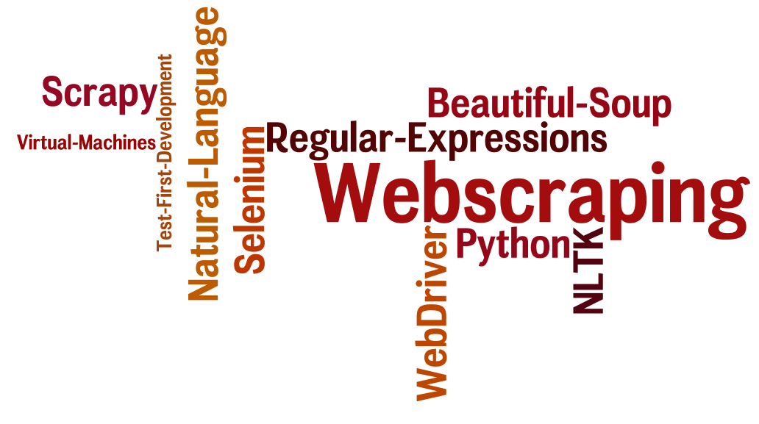
CSCE 590 Web Scraping – Scrapy III
Topics
The Scrapy framework revisited
Readings:
Scrapy User manual –
https://scrapy.org/doc/
https://doc.scrapy.org/en/1.3/
March 14, 2017

Slide 2
Scrapy Review
scrapy startproject tut3
scrapy genspider postLoginForm "www.example.com”
scrapy crawl postLoginForm
scrapy shell postLoginForm

Slide 3
Scrapy Tutorial Quotes_spider
import scrapy class QuotesSpider(scrapy.Spider): name = "quotes" start_urls = [ 'http://quotes.toscrape.com/page/1/', 'http://quotes.toscrape.com/page/2/', ]
def parse(self, response): page = response.url.split("/")[-2] filename = 'quotes-%s.html' % page with open(filename, 'wb') as f: f.write(response.body)
https://doc.scrapy.org/en/1.3/

Slide 4
quotes in http://quotes.toscrape.com
<div class="quote"> <span class="text">“The world as we have created it is a process of our thinking. It cannot be changed without changing our thinking.”</span> <span> by <small class="author">Albert Einstein</small> <a href="/author/Albert-Einstein">(about)</a> </span> <div class="tags"> Tags: <a class="tag" href="/tag/change/page/1/">change</a> <a class="tag" href="/tag/deep-thoughts/page/1/">deep-thoughts</a> <a class="tag" href="/tag/thinking/page/1/">thinking</a> <a class="tag" href="/tag/world/page/1/">world</a>
</div>
</div>

Slide 5
$ scrapy shell 'http://quotes.toscrape.com'
>>> quote = response.css("div.quote")[0]
>>> title = quote.css("span.text::text").extract_first()
>>> title '“The world as we have created it is a process of our thinking. It cannot be changed without changing our thinking.”'
>>> author = quote.css("small.author::text").extract_first()
>>> author 'Albert Einstein'
https://doc.scrapy.org/en/1.3/

Slide 6
>>> tags = quote.css("div.tags a.tag::text").extract()
>>> tags ['change', 'deep-thoughts', 'thinking', 'world']
https://doc.scrapy.org/en/1.3/

Slide 7
>>> for quote in response.css("div.quote"): ... text = quote.css("span.text::text").extract_first() ... author = quote.css("small.author::text").extract_first() ... tags = quote.css("div.tags a.tag::text").extract() ... print(dict(text=text, author=author, tags=tags))
{'tags': ['change', 'deep-thoughts', 'thinking', 'world'], 'author': 'Albert Einstein', 'text': '“The world as we have created it is a process of our thinking. It cannot be changed without changing our thinking.”'}
{'tags': ['abilities', 'choices'], 'author': 'J.K. Rowling', 'text': '“It is our choices, Harry, that show what we truly are, far more than our abilities.”'} ... a few more of these, omitted for brevity
>>>
https://doc.scrapy.org/en/1.3/

Slide 8
<ul class="pager">
<li class="next">
<a href="/page/2/"> Next
<span aria-hidden="true"> &rarr;
</span></a>
</li>
</ul>

Slide 9
AuthorSpider page 1
# -*- coding: utf-8 -*-
"""
Created on Tue Feb 28 12:07:25 2017
@author: Scrapy Tutorial quotes example author_spider
"""
import scrapy
class AuthorSpider(scrapy.Spider):
name = 'author'
start_urls = ['http://quotes.toscrape.com/']

Slide 10
AuthorSpider page 2
def parse(self, response):
# follow links to author pages
for href in response.css('.author+a::attr(href)').extract():
yield scrapy.Request(response.urljoin(href),
callback=self.parse_author)
# follow pagination links
next_page = response.css('li.next a::attr(href)').extract_first()
if next_page is not None:
next_page = response.urljoin(next_page)
yield scrapy.Request(next_page, callback=self.parse)

Slide 11
AuthorSpider page 3
def parse_author(self, response):
def extract_with_css(query):
return response.css(query).extract_first().strip()
yield {
'name': extract_with_css('h3.author-title::text'),
'birthdate': extract_with_css('.author-born-date::text'),
'bio': extract_with_css('.author-description::text'),
}

Slide 12
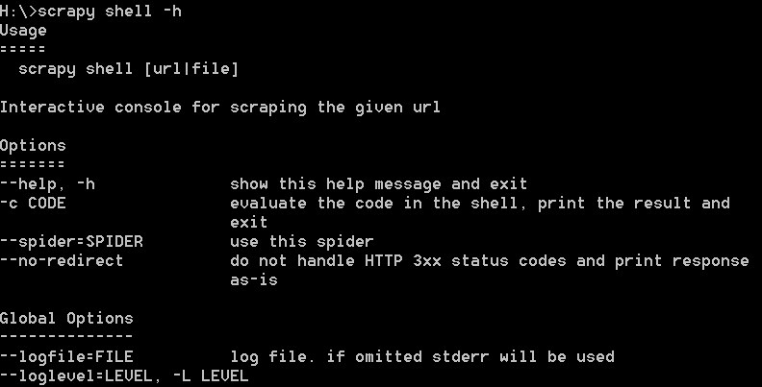
scrapy shell url | file

Slide 13
Response.attributes (right term)
body
copy
css
encoding
flags
headers
meta
replace
request
selector
status
test
url
urljoin
xpath

Slide 14
Running the spider
scrapy crawl quotes # notes quotes ➔quotes_spider.py
https://doc.scrapy.org/en/1.3/

Slide 15
scrapy genspider –l
Basic
Crawl
Cvsfeed
Xmlfeed

Slide 16
Basic spider template
# -*- coding: utf-8 -*-
import scrapy
class BasicSpider(scrapy.Spider):
name = "basic"
allowed_domains = ["www.yahoo.com"]
start_urls = ['http://www.yahoo.com/']
def parse(self, response):
pass

Slide 17
Crawl spider template
# -*- coding: utf-8 -*-
import scrapy
from scrapy.linkextractors import LinkExtractor
from scrapy.spiders import CrawlSpider, Rule
class CrawlSpider(CrawlSpider):
name = 'crawl'
allowed_domains = ['www.yahoo.com']
start_urls = ['http://www.yahoo.com/']
rules = (
Rule(LinkExtractor(allow=r'Items/'), callback='parse_item', follow=True),
)

Slide 18
Crawl spider template
def parse_item(self, response):
i = {}
i['domain_id'] = response.xpath('//input[@id="sid"]/@value').extract()
i['name'] = response.xpath('//div[@id="name"]').extract()
i['description'] = response.xpath('//div[@id="description"]').extract()
return i

Slide 19
Csv spider template
# -*- coding: utf-8 -*-
from scrapy.spiders import CSVFeedSpider
class CsvfeedSpider(CSVFeedSpider):
name = 'csvfeed'
allowed_domains = ['www.yahoo.com']
start_urls = ['http://www.yahoo.com/feed.csv']
# headers = ['id', 'name', 'description', 'image_link']
# delimiter = '\t'
# Do any adaptations you need here
#def adapt_response(self, response):
# return response

Slide 20
Csv spider template continued
def parse_row(self, response, row):
i = {}
#i['url'] = row['url']
#i['name'] = row['name']
#i['description'] = row['description']
return i

Slide 21
Fragile projects – break if
website changes format
Browser updates version (selenium only ???)

Slide 22
Project example from Stackoverflow
http://stackoverflow.com/questions/39243009/scrapy-tutorial-example
Fragile scraping project
Diagnosis
Run
Run in scrapy shell
view(response) – to see what the browser would show
Fix searches to adjust to changes in website

Slide 23
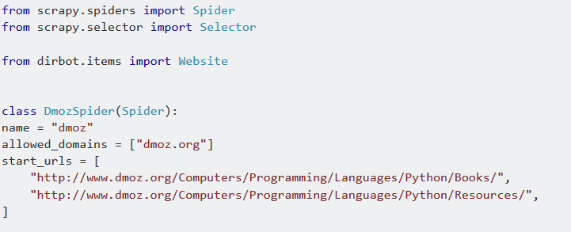
Debugging Fragile scraper

Slide 24
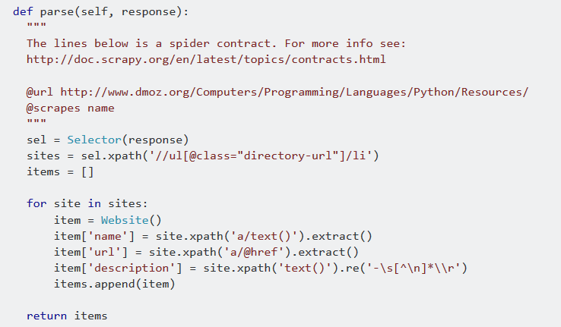
Debugging Fragile scraper

Slide 25
Debugging Fragile scraper results

Slide 26
Debug xpath expressions with Scrapy Shell

Slide 27
Auxilliary lambda function to test xpaths
Testing xpaths can be a lot of typing
response.xpath('//ul[@class="directory-url"]/li')
Instead define
xp = lambda x: response.xpath(x).extract_first()
Then instead you just have to type the path to test
xp ('//ul[@class="directory-url"]/li')

Slide 28
Corrected version
import scrapy
class MozSpider(scrapy.Spider):
name = "moz"
allowed_domains = ["www.dmoz.org"]
start_urls = ['http://www.dmoz.org/Computers/Programming/Languages/Python/Books/',
'http://www.dmoz.org/Computers/Programming/Languages/Python/Resources/']

Slide 29
def parse(self, response):
sites = response.xpath('//div[@class="title-and-desc"]')
for site in sites:
name = site.xpath('a/div[@class="site-title"]/text()').extract_first()
url = site.xpath('a/@href').extract_first()
description = site.xpath('div[@class="site-descr "]/text()').extract_first().strip()
yield{'Name':name, 'URL':url, 'Description':description}

Slide 30
Login then scrape
# -*- coding: utf-8 -*-
import scrapy
from scrapy.linkextractors import LinkExtractor
from scrapy.spiders import CrawlSpider, Rule
class LoginSpider(CrawlSpider):
name = 'login'
allowed_domains = ['www.example.com']
rules = (
Rule(LinkExtractor(allow=r'Items/'), callback='parse_item', follow=True),
)

Slide 31
Login the scrape page 2
def start_requests(self):
return [scrapy.FormRequest("http://www.example.com/login",
formdata={'user': 'john', 'pass': 'secret'},
callback=self.logged_in)]
def logged_in(self, response):
# here you would extract links to follow and return Requests
# for each of them, with another callback
pass
def parse_item(self, response):
pass

Slide 32
scrapy shell "www.yahoo.com/finance"

Slide 33
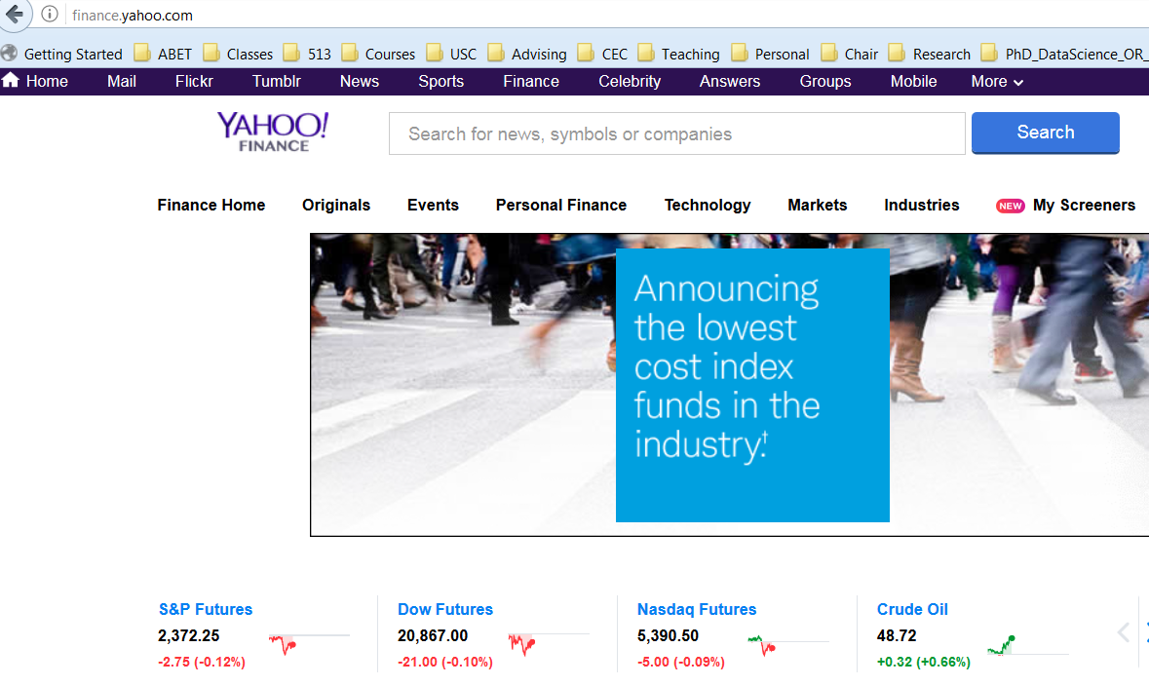
Finance.yahoo.com

Slide 34
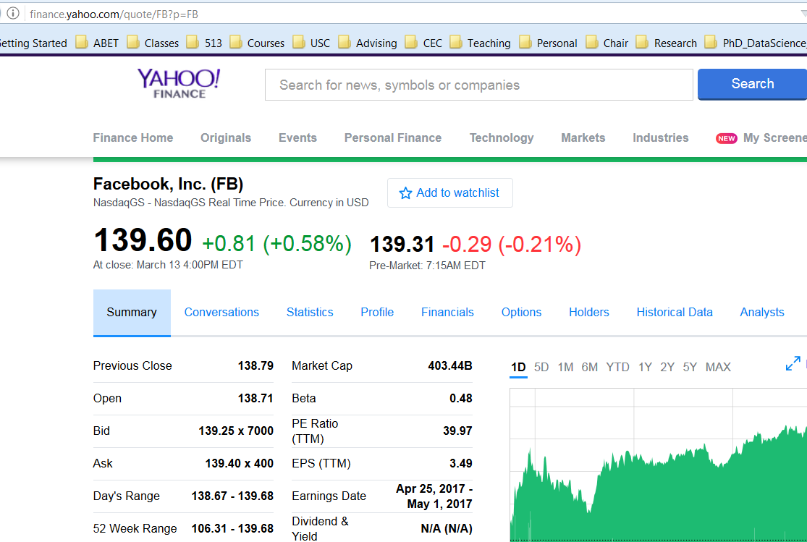

Slide 35
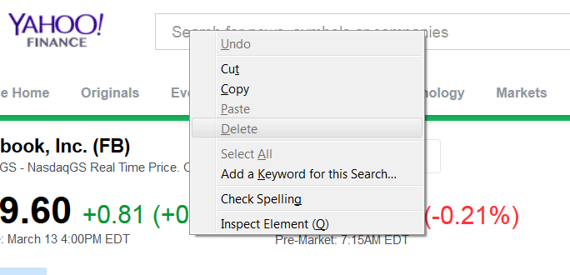
Inspect Element Firefox/Firebug
Position mouse over element then right-click

Slide 38
27.3. pdb — The Python Debugger
Source code: Lib/pdb.py
The module pdb defines an interactive source code debugger for Python programs. It supports setting (conditional) breakpoints and single stepping at the source line level, inspection of stack frames, source code listing, and evaluation of arbitrary Python code in the context of any stack frame. It also supports post-mortem debugging and can be called under program control.
The debugger is extensible – it is actually defined as the class Pdb. This is currently undocumented but easily understood by reading the source. The extension interface uses the modules bdb and cmd.
The debugger’s prompt is (Pdb).

Slide 39
Typical usage of pdb
>>> import pdb
>>> import mymodule
>>> pdb.run('mymodule.test()')
> <string>(0)?()
(Pdb) continue
> <string>(1)?()
(Pdb) continue
NameError: 'spam'
> <string>(1)?()
(Pdb)

Slide 40
Xpath
>>> response.xpath('//title') [<Selector xpath='//title' data='<title>Quotes to Scrape</title>'>]
>>> response.xpath('//title/text()').extract_first() 'Quotes to Scrape'
https://doc.scrapy.org/en/1.3/

