Slide 1
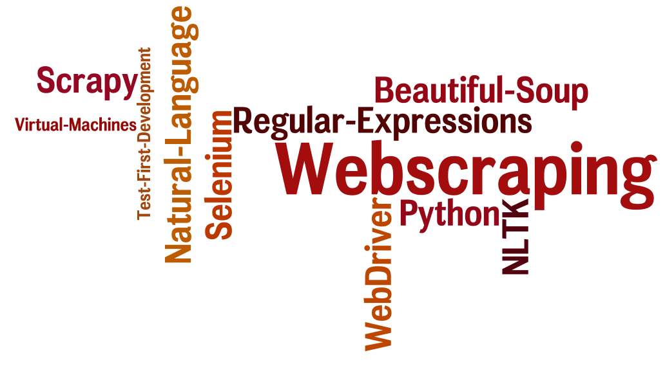
CSCE 590 Web Scraping – Scrapy II
Topics
The Scrapy framework revisited
Readings:
Scrapy User manual –
https://scrapy.org/doc/
https://doc.scrapy.org/en/1.3/
January 10, 2017

Slide 3
Scrapy Documentation
Scrapy
https://scrapy.org/doc/
https://doc.scrapy.org/en/1.3/
https://media.readthedocs.org/pdf/scrapy/1.3/scrapy.pdf

Slide 4
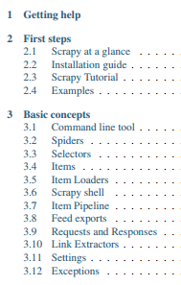
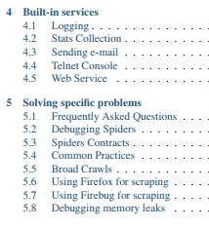
Partial Table of Contents
Pdf emailed to you
https://doc.scrapy.org/en/1.3/

Slide 5
Installation done before
Using Anaconda
conda install -c conda-forge scrapy
scrapy startproject tutorial
scrapy crawl example
https://doc.scrapy.org/en/1.3/

Slide 6
Scrapy Tutorial
This tutorial will walk you through these tasks: 1. Creating a new Scrapy project 2. Writing a spider to crawl a site and extract data 3. Exporting the scraped data using the command line 4. Changing spider to recursively follow links 5. Using spider arguments
https://doc.scrapy.org/en/1.3/

Slide 7
2.3.1 Creating a project
scrapy startproject tutorial
Creates a directory name “tutorial” with the structure
tutorial/ scrapy.cfg # deploy configuration file tutorial/ # project's Python module, you'll # import your code from here __init__.py items.py # project items definition file pipelines.py # project pipelines file settings.py # project settings file spiders/ # a directory where you'll later put # your spiders __init__.py
https://doc.scrapy.org/en/1.3/

Slide 8
quotes_spider.py
import scrapy class QuotesSpider(scrapy.Spider): name = "quotes" def start_requests(self): urls = [ 'http://quotes.toscrape.com/page/1/', 'http://quotes.toscrape.com/page/2/', ] for url in urls: yield scrapy.Request(url=url, callback=self.parse)
def parse(self, response): page = response.url.split("/")[-2] filename = 'quotes-%s.html' % page with open(filename, 'wb') as f: f.write(response.body) self.log('Saved file %s' % filename)
https://doc.scrapy.org/en/1.3/

Slide 9
Notes
All scrapy Spiders subclass scrapy.Spider
and defines some attributes and methods:
name: identifies the Spider.
start_requests(): must return an iterable of Requests (you can return a list of requests or write a generator function) which the Spider will begin to crawl from.
parse(): a method that will be called to handle the response downloaded for each of the requests made. The response parameter is an instance of TextResponse that holds the page content and has further helpful methods to handle it.
The parse() method usually parses the response, extracting the scraped data as dicts and also finding new URLs to follow and creating new requests (Request) from them.
https://doc.scrapy.org/en/1.3/

Slide 10
Running the spider
scrapy crawl quotes # notes quotes ➔quotes_spider.py
https://doc.scrapy.org/en/1.3/

Slide 11
What just happened under the hood?
Scrapy schedules the scrapy.Request objects returned by the start_requests method of the Spider.
Upon receiving a response for each one, it instantiates Response objects and calls the callback method associated with the request (in this case, the parse method) passing the response as argument.
A shortcut to the start_requests method Instead of implementing a start_requests() method that generates scrapy.Request objects from URLs, you can just define a start_urls class attribute with a list of URLs.
https://doc.scrapy.org/en/1.3/

Slide 12
Using the shortcut
import scrapy class QuotesSpider(scrapy.Spider): name = "quotes" start_urls = [ 'http://quotes.toscrape.com/page/1/', 'http://quotes.toscrape.com/page/2/', ]
def parse(self, response): page = response.url.split("/")[-2] filename = 'quotes-%s.html' % page with open(filename, 'wb') as f: f.write(response.body)
https://doc.scrapy.org/en/1.3/

Slide 13
Scrapy shell
Linux and Mac-OS
scrapy shell 'http://quotes.toscrape.com/page/1/‘
Windows
scrapy shell "http://quotes.toscrape.com/page/1/"
https://doc.scrapy.org/en/1.3/

Slide 14
[ ... Scrapy log here ... ] 2016-09-19 12:09:27 [scrapy.core.engine] DEBUG: Crawled (200) <GET http://quotes.toscrape.com/page/1/> (referer: None) [s] Available Scrapy objects: [s] scrapy scrapy module (contains scrapy.Request, scrapy.Selector, etc) [s] crawler <scrapy.crawler.Crawler object at 0x7fa91d888c90> [s] item {} [s] request <GET http://quotes.toscrape.com/page/1/> [s] response <200 http://quotes.toscrape.com/page/1/> [s] settings <scrapy.settings.Settings object at 0x7fa91d888c10> [s] spider <DefaultSpider 'default' at 0x7fa91c8af990> [s] Useful shortcuts: [s] shelp() Shell help (print this help) [s] fetch(req_or_url) Fetch request (or URL) and update local objects [s] view(response) View response in a browser >>>
https://doc.scrapy.org/en/1.3/

Slide 15
>>> response.css('title') [<Selector xpath='descendant-or-self::title' data='<title>Quotes to Scrape</title>'>]
>>> response.css('title::text').extract() ['Quotes to Scrape']
>>> response.css('title').extract() ['<title>Quotes to Scrape</title>']
https://doc.scrapy.org/en/1.3/

Slide 16
>>> response.css('title::text').extract_first() 'Quotes to Scrape'
>>> response.css('title::text')[0].extract() 'Quotes to Scrape'
>>> response.css('title::text').re(r'Quotes.*') ['Quotes to Scrape']
>>> response.css('title::text').re(r'Q\w+') ['Quotes']
>>> response.css('title::text').re(r'(\w+) to (\w+)') ['Quotes', 'Scrape']
https://doc.scrapy.org/en/1.3/

Slide 17
Xpath
>>> response.xpath('//title') [<Selector xpath='//title' data='<title>Quotes to Scrape</title>'>]
>>> response.xpath('//title/text()').extract_first() 'Quotes to Scrape'
https://doc.scrapy.org/en/1.3/

Slide 18
http://quotes.toscrape.com
<div class="quote"> <span class="text">“The world as we have created it is a process of our thinking. It cannot be changed without changing our thinking.”</span> <span> by <small class="author">Albert Einstein</small> <a href="/author/Albert-Einstein">(about)</a> </span> <div class="tags"> Tags: <a class="tag" href="/tag/change/page/1/">change</a> <a class="tag" href="/tag/deep-thoughts/page/1/">deep-thoughts </a> <a class="tag" href="/tag/thinking/page/1/">thinking</a> <a class="tag" href="/tag/world/page/1/">world</a> </div>
</div>
https://doc.scrapy.org/en/1.3/

Slide 19
$ scrapy shell 'http://quotes.toscrape.com'
>>> quote = response.css("div.quote")[0]
>>> title = quote.css("span.text::text").extract_first()
>>> title '“The world as we have created it is a process of our thinking. It cannot be changed without changing our thinking.”'
>>> author = quote.css("small.author::text").extract_first()
>>> author 'Albert Einstein'
https://doc.scrapy.org/en/1.3/

Slide 20
>>> tags = quote.css("div.tags a.tag::text").extract()
>>> tags ['change', 'deep-thoughts', 'thinking', 'world']
https://doc.scrapy.org/en/1.3/

Slide 21
>>> for quote in response.css("div.quote"): ... text = quote.css("span.text::text").extract_first() ... author = quote.css("small.author::text").extract_first() ... tags = quote.css("div.tags a.tag::text").extract() ... print(dict(text=text, author=author, tags=tags))
{'tags': ['change', 'deep-thoughts', 'thinking', 'world'], 'author': 'Albert Einstein', 'text': '“The world as we have created it is a process of our thinking. It cannot be changed without changing our thinking.”'}
{'tags': ['abilities', 'choices'], 'author': 'J.K. Rowling', 'text': '“It is our choices, Harry, that show what we truly are, far more than our abilities.”'} ... a few more of these, omitted for brevity
>>>
https://doc.scrapy.org/en/1.3/

Slide 22
https://doc.scrapy.org/en/1.3/

Slide 23
https://doc.scrapy.org/en/1.3/

