Slide 1
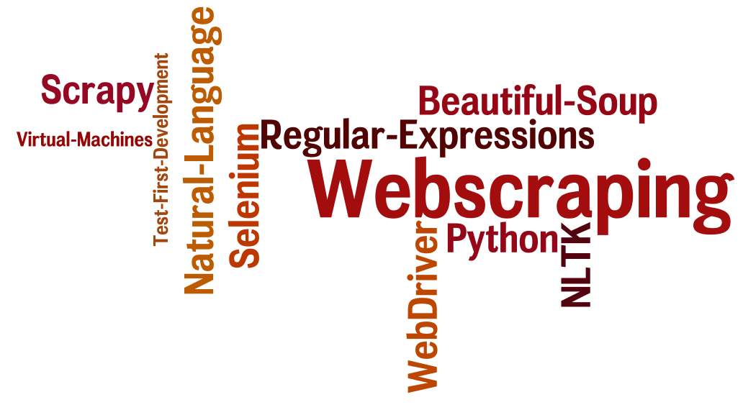
CSCE 590 Web Scraping: Lecture 2
Topics
Dictionaries
Object Oriented Python
Readings:
Python tutorial
January 10, 2017

Slide 2
Overview
Last Time – Lec01 all slides covered
Web applications overview
Python into: dynamic typing, strings, slices, lists, lists of lists, if, while, for w in wordlist:, def functions
Today
Class exercise – wordlists
Data Dictionaries
Libraries
Object Oriented Python
Beautiful Soup
Documentation
Testing & Test First Design

Slide 3
More Resources
Textbook:
Website
Code examples:
Python:
YouTube: Videos on python lists, dictionaries, classes etc.
https://www.youtube.com/playlist?list=PL8830E081324343F1

Slide 4
Python on YouTube

Slide 5
Homework: Due Sunday Midnight

Slide 6
List Methods
list.append(x) - Add an item to the end of the list. Equivalent to a[len(a):] = [x].
list.extend(L) - Extend the list by appending all the items in the given list. Equivalent to a[len(a):] = L.
list.insert(i, x) - Insert an item x at position i.
list.remove(x) - Remove the first item from the list whose value is x. It is an error if there is no such item.
list.pop([i]) - Remove the item at the given position in the list, and return it. If no index is specified, a.pop() removes and returns the last item in the list. (The square brackets around the i in the method signature denote that the parameter is optional
list.clear() - Remove all items from the list. Equivalent to del a[:].
Reference section 5.1 Python Tutorial

Slide 7
list.index(x[, start[, end]]) - Return zero-based index in the list of the first item whose value is x. Raises a ValueError if there is no such item. ...
list.count(x) - Return the number of times x appears in the list.
list.sort(key=None, reverse=False) - Sort the items of the list in place ...
list.reverse() - Reverse the elements of the list in place.
list.copy() - Return a shallow copy of the list. Equivalent to a[:]

Slide 8
Lists as stacks and Queues 5.1.1
Using Lists as a stack
stck = [23, 14, 55] // 55 is on top
stck. pop() // yields [23, 14] returns 55
stck. append(43) // yields [23, 14, 43]

Slide 9
Lists as Queues 5.1.1
Using Lists as Queues
Bad idea; not efficient
Use collections.deque “deal from both ends”
Optimized for inserting and removing from either end
>>> from collections import deque
>>> queue = deque(["Eric", "John", "Michael"])
>>> queue.append("Terry")
>>> queue.append("Graham")
>>> queue.popleft()
>>> queue.popleft()
>>> queue

Slide 10
5.1.3. List Comprehensions
List comprehensions provide a concise way to create lists
squares = list(map(lambda x: x**2, range(10)))
squares = [x**2 for x in range(10)]
[(x, y) for x in [1,2,3] for y in [3,1,4] if x != y]
from math import pi
[str(round(pi, i)) for i in range(1, 6)]

Slide 11
Tuples

Slide 12
Sets

Slide 13
Dictionaries
Dictionaries are sometimes found in other languages as “associative memories” or “associative arrays”.
Unlike sequences, which are indexed by a range of numbers,
dictionaries are indexed by keys,
The keys can be any immutable type;
strings and numbers can always be keys.
Tuples can be used as keys if they contain only strings, numbers, or tuples;
You can’t use lists as keys, since lists can be modified in place

Slide 14
Sample dictionary operations
tel = {'jack': 4098, 'sape': 4139}
tel['guido'] = 4127
tel['jack']
del tel['sape']
tel['irv'] = 4127
list(tel.keys())
sorted(tel.keys())
'guido' in tel //Test returns TRUE
'jack' not in tel //Test returns FALSE

Slide 15
dict() constructor
The dict() constructor builds dictionaries directly from sequences of key-value pairs:
>>> dict([('sape', 4139), ('guido', 4127), ('jack', 4098)])
{'sape': 4139, 'jack': 4098, 'guido': 4127}
dict comprehensions
>>> {x: x**2 for x in (2, 4, 6)}
{2: 4, 4: 16, 6: 36}
When the keys are simple strings, it is sometimes easier to specify pairs using keyword arguments:
>>> dict(sape=4139, guido=4127, jack=4098)

Slide 16
Looping through Dictionaries
knights = {'gallahad': 'the pure', 'robin': 'the brave'}
for k, v in knights.items():
print(k, v)

Slide 17
Coding Style
Use 4-space indentation, and no tabs.
Wrap lines so that they don’t exceed 79 characters.
Use blank lines to separate functions and classes, and larger blocks of code inside functions.
When possible, put comments on a line of their own.
Use docstrings.
Use spaces around operators and after commas, but not directly inside bracketing constructs: a = f(1, 2) + g(3, 4).

Slide 18
Coding Style (continued)
Name your classes and functions consistently; the convention is to use
CamelCase for classes and
lower_case_with_underscores (snake case?) for functions and methods.
Always use self as the name for the first method argument
Don’t use fancy encodings if your code is meant to be used in international environments. Python’s default, UTF-8, or even plain ASCII work best in any case.
Likewise, don’t use non-ASCII characters in identifiers if there is only the slightest chance people speaking a different language will read or maintain the code.

Slide 19
Classes – Python Tutorial Sec 9
9.3.1. Class Definition Syntax
The simplest form of class definition looks like this:
class ClassName:
<statement-1>
.
.
.
<statement-N>

Slide 20
__init__() method (constructor)
class Complex:
def __init__(self, realpart, imagpart):
self.r = realpart
self.i = imagpart
x = Complex(3.0, -4.5)
x.r, x.i

Slide 21
Instance Objects
x.counter = 1
while x.counter < 10:
x.counter = x.counter * 2
print(x.counter)
del x.counter

Slide 22
9.3.5. Class and Instance Variables
class Dog:
kind = 'canine' # class variable shared by all instances
def __init__(self, name):
self.name = name
d = Dog('Fido')

Slide 23
surprising effects with involving mutable objects
#shared data can have possibly surprising effects with involving mutable objects such as lists and dictionaries
class Dog:
tricks = [ ] # mistaken use of a class variable
def __init__(self, name):
self.name = name
def add_trick(self, trick):
self.tricks.append(trick)
>>> d = Dog('Fido')
>>> e = Dog('Buddy')
>>> d.add_trick('roll over')
>>> e.add_trick('play dead')
>>> d.tricks # unexpectedly shared by all dogs
['roll over', 'play dead']

Slide 24
Additional uses of self
class Bag:
def __init__(self):
self.data = []
def add(self, x):
self.data.append(x)
def addtwice(self, x):
self.add(x)
self.add(x)

Slide 25
Inheritance
Yes of course

Slide 26
Private Variables
Any identifier of the form __spam (at least two leading underscores, at most one trailing underscore) is textually replaced with _classname__spam, where classname is the current class name with leading underscore(s) stripped

Slide 27
# Iterators -- iter(element)
Implicity used in for w in […]
>>> s = 'abc'
>>> it = iter(s)
>>> it
<iterator object at 0x00A1DB50>
>>> next(it)
'a'
>>> next(it)
'b'
>>> next(it)
'c'
>>> next(it)
Traceback (most recent call last):
File "<stdin>", line 1, in ?
next(it)

