Slide 1
Test – 2 Review
CSCE 212 Computer Architecture
Topics
Test 2
Y86-64 PIPE implementation
Hazards
Stalls
forwarding
Cache overview
Virtual Memory overview
April 12, 2018

Slide 2
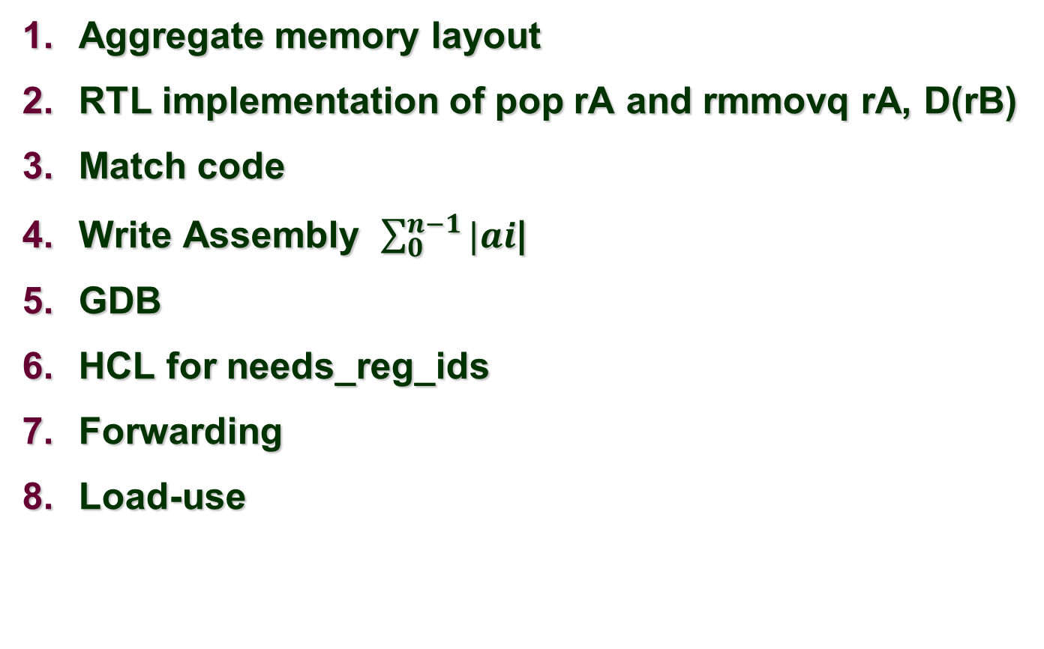
Test 2 Review Questions
Aggregate memory layout
RTL implementation of pop rA and rmmovq rA, D(rB)
Match code
Write Assembly $\sum_{0}^{n−1}{|ai}$|
GDB
HCL for needs_reg_ids
Forwarding
Load-use

Slide 3
Alignment rules
Alignment rules that the compiler uses:
Align ints and floats on word boundary (divisible by four which means address in binary ends in 00, in hex 0, 4, 8, C)
Shorts (length=2) align on halfword boundary (binary address ends in 0)
Doubles Assuming m86-64 or Windows 32 bit ➔ align doubles on double word boundary (binary address ends in 000)
For structures the entire structure is aligned to the boundary corresponding to its largest (non-array, non-structure) component
Pad to obtain alignments

Slide 4
Aggregate memory layout m86-64
Struct { | Address in decimal | Size | Offset from start of tweet | padding
char from[18] | 1000 | 18 | 0 | 2
int age; | 1020 | 4 | 20 | 0
char gender; | 1024 | 1 | 24 | 7 (or 3 Linux IA32)
double total; | 1032 | 8 | 32 | 0
char t[18] | 1040 | 18 | 40 | 0
char last[140] | 1058 | 140 | 58 | **2 (198→ 200 next doubleword boundary)
 | 1200

Slide 5
Linux IA32 – doubles on word boundary
Struct { | Address in decimal | Size | Offset from start of tweet | padding
char from[18] | 1000 | 18 | 0 | 2
int age; | 1020 | 4 | 20 | 0
char gender; | 1024 | 1 | 24 | 3 Linux IA32)
double total; | 1032 | 8 | 32 | 0
char t[18] | 1040 | 18 | 40 | 0
char last[140] | 1058 | 140 | 58 | **2
 | 1200

Slide 6
RTL implementation of pop rA and rmmovq rA, D(rB)
RTL implementation (Satge Computation)
of pop rA --- Lecture 13 slide 15
and rmmovq rA, D(rB) --- Lecture 13 slide 17

Slide 7
Stage Computation: popq
popq rA
Fetch
icode:ifun ← M₁[PC]
Read instruction byte
rA:rB ← M₁[PC+1]
Read register byte
valP ← PC+2
Compute next PC
Decode
valA ← R[%rsp]
Read stack pointer
valB ← R[%rsp]
Read stack pointer
Execute
valE ← valB + 8
Increment stack pointer
Memory
valM ← M₈[valA]
Read from stack
Write
back
R[%rsp] ← valE
Update stack pointer
R[rA] ← valM
Write back result
PC update
PC ← valP
Update PC
Use ALU to increment stack pointer
Must update two registers
Popped value
New stack pointer

Slide 8
RTL implementation rmmovq rA, D(rB)
Lecture 13 slide 15
Stage Computation: rmmovq
rmmovq rA, D(rB)
Fetch
icode:ifun ← M₁[PC]
Read instruction byte
rA:rB ← M₁[PC+1]
Read register byte
valC ← M₈[PC+2]
Read displacement D
valP ← PC+10
Compute next PC
Decode
valA ← R[rA]
Read operand A
valB ← R[rB]
Read operand B
Execute
valE ← valB + valC
Compute effective address
Memory
M₈[valE] ← valA
Write value to memory
Write
back
PC update
PC ← valP
Update PC

Slide 9
Match code
int
funasum(int n, int a[])
int i;
int sum =0;
for(i=0; i<n;==i){
sum = sum + a[i]
}
return(sum);
}

Slide 10
Match code
int
funsum2(int n, int a[])
if (I > 2)
return(a[0]+a[1]);
else
return 0;
}

Slide 11
Match code
int
funeven(int i, int a[])
if (i % 2 == 0)
return(a[i]);
else
return 1;
}

Slide 12
Write Assembly $\sum_{0}^{n−1}{|ai}$|
int
funabssum(int n, int a[])
int i;
int sum =0;
for(i=0; i<n;==i){
x = a[i]
if (x<0)
x = -1*x
sum = sum + x
}
return(sum);
}
No loop C

Slide 13
Assembly

Slide 14
GDB
GDB - in questions b-e below assume that the breakpoint in question 'a' has just been reached.
Give a commands to set a breakpoint at func1 and then run the program.
b func1
r
Assuming there are at least two arguments to func1(int, char*), i.e. the first argument is an int and the second is a pointer to a string, then give commands that will print out these arguments.
p /d $rdi
x /1s $rsi
What command will make gdb print the next assembly instruction everytime it stops?
display /i $rip
If a function has 9 arguments (all of length 4) give a command that will show the return address and arguments 7-9(and nothing extra).
x /5wx $rsp
What gdb Command single steps through assembly code not stepping into functions, i.e. executing function calls atomically?
ni

Slide 15
6. HCL for needs_reg_ids
bool need_regids =
icode in { IRRMOVQ, IOPQ, IPUSHQ, IPOPQ,
IIRMOVQ, IRMMOVQ, IMRMOVQ };
Lecture 13 – slide 33

Slide 16
Y86-64 Instruction Set #2
rrmovq
7
0
Byte
0
1
2
3
4
5
6
7
8
9
cmovle
7
1
halt
0
0
cmovl
7
2
nop
1
0
cmove
7
3
cmovXX rA, rB
2
fn
rA
rB
cmovne
7
4
irmovq V, rB
3
0
F
rB
V
cmovge
7
5
rmmovq rA, D(rB)
4
0
rA
rB
D
cmovg
7
6
mrmovq D(rB), rA
5
0
rA
rB
D
OPq rA, rB
6
fn
rA
rB
jXX Dest
7
fn
Dest
call Dest
8
0
Dest
ret
9
0
pushq rA
A
0
rA
F
popq rA
B
0
rA
F

Slide 17
Rest of today
Review data hazards and control hazards
Review stalls
Data forwarding
Cache overview
Virtual memory overview
Exam Spring 2016

Slide 18
Memory Allocation Example
not drawn to scale
Stack
char big_array[1L<<24]; /* 16 MB */
char huge_array[1L<<31]; /* 2 GB */
int global = 0;
int useless() { return 0; }
int main ()
{
void *p1, *p2, *p3, *p4;
int local = 0;
p1 = malloc(1L << 28); /* 256 MB */
p2 = malloc(1L << 8); /* 256 B */
p3 = malloc(1L << 32); /* 4 GB */
p4 = malloc(1L << 8); /* 256 B */
/* Some print statements ... */
}
Shared
Libraries
Heap
Data
Text
Where does everything go?

Slide 19
Example Memory Hierarchy
L0:
Regs
CPU registers hold words retrieved from the L1 cache.
Smaller,
faster,
and
costlier
(per byte)
storage
devices
L1:
L1 cache
(SRAM)
L1 cache holds cache lines retrieved from the L2 cache.
L2:
L2 cache
(SRAM)
L2 cache holds cache lines
retrieved from L3 cache
L3:
L3 cache
(SRAM)
L3 cache holds cache lines
retrieved from main memory.
Larger,
slower,
and
cheaper
(per byte)
storage
devices
L4:
Main memory
(DRAM)
Main memory holds disk blocks retrieved from local disks.
L5:
Local secondary storage
(local disks)
Local disks hold files retrieved from disks
on remote servers
L6:
Remote secondary storage
(e.g., Web servers)

Slide 20
Examples of Caching in the Mem. Hierarchy
Cache Type
What is Cached?
Where is it Cached?
Latency (cycles)
Managed By
Registers
4-8 bytes words
CPU core
0
Compiler
TLB
Address translations
On-Chip TLB
0
Hardware MMU
L1 cache
64-byte blocks
On-Chip L1
4
Hardware
L2 cache
64-byte blocks
On-Chip L2
10
Hardware
Virtual Memory
4-KB pages
Main memory
100
Hardware + OS
Buffer cache
Parts of files
Main memory
100
OS
Disk cache
Disk sectors
Disk controller
100,000
Disk firmware
Network buffer cache
Parts of files
Local disk
10,000,000
NFS client
Browser cache
Web pages
Local disk
10,000,000
Web browser
Web cache
Web pages
Remote server disks
1,000,000,000
Web proxy server

Slide 21
Intel Core i7 Cache Hierarchy
Processor package
Core 0
Core 3
L1 i-cache and d-cache:
32 KB, 8-way,
Access: 4 cycles
L2 unified cache:
256 KB, 8-way,
Access: 10 cycles
L3 unified cache:
8 MB, 16-way,
Access: 40-75 cycles
Block size: 64 bytes for all caches.
Regs
Regs
L1
d-cache
L1
i-cache
L1
d-cache
L1
i-cache
…
L2 unified cache
L2 unified cache
L3 unified cache
(shared by all cores)
Main memory

Slide 22
General Cache Concepts
Smaller, faster, more expensive
memory caches a subset of
the blocks
Cache
8
4
9
14
10
3
Data is copied in block-sized transfer units
4
10
Larger, slower, cheaper memory
viewed as partitioned into “blocks”
Memory
0
1
2
3
4
4
5
6
7
8
9
10
10
11
12
13
14
15

Slide 23
Direct Mapped Cache indexing
Direct mapped: One line per set
Assume: cache block size 8 bytes
Address of int:
v
tag
0
1
2
3
4
5
6
7
t bits
0…01
100
v
tag
0
1
2
3
4
5
6
7
find set
S = 2^{s} sets
v
tag
0
1
2
3
4
5
6
7
v
tag
0
1
2
3
4
5
6
7

Slide 24
Average Memory Access Time (AMAT)
Hit
Miss
MissRatio
Misspenalty

Slide 25
A System Using Virtual Addressing
Main memory
0:
CPU Chip
1:
Virtual address
(VA)
Physical address
(PA)
2:
CPU
MMU
3:
4
4:
4100
5:
6:
7:
8:
...
M-1:
Data word
Used in all modern servers, laptops, and smart phones
One of the great ideas in computer science

Slide 26
Enabling Data Structure: Page Table
A page table is an array of page table entries (PTEs) that maps virtual pages to physical pages.
Per-process kernel data structure in DRAM
Physical memory
(DRAM)
Physical page
number or
disk address
Valid
VP 1
PP 0
PTE 0
0
null
VP 2
1
VP 7
VP 4
PP 3
1
0
1
0
null
Virtual memory
(disk)
0
PTE 7
1
VP 1
Memory resident
page table
(DRAM)
VP 2
VP 3
VP 4
VP 6
VP 7

