Slide 1
Gnu Debugger (GDB)
CSCE 212Honors Computer Organization
Topics
Overview
Quick Reference Card
Readings: Quick Reference Card
February 20, 2018

Slide 2
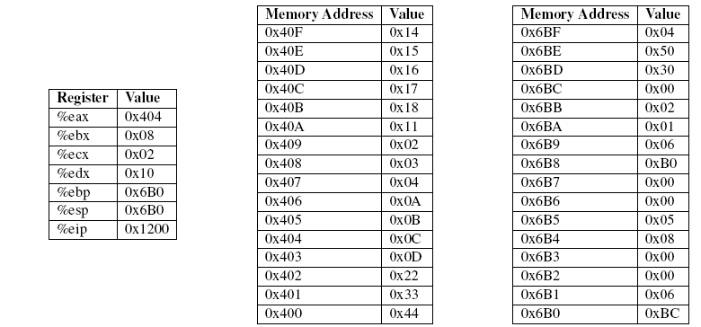
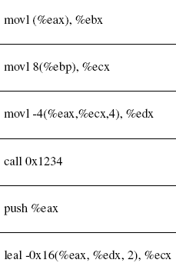
Class Exercise

Slide 3
Gnu compiler “gcc”: gcc –Og -S
cp $c/arith.c . // $c=/class/csce212-501/Code/
cp $c/rfact.c .
gcc –S arith.c //produces arith.s
gcc –Og –S arith.c //produces arith.s optimized
gcc –Og arith.c

Slide 4
Gnu DeBugger (GDB) Overview
Gnu (Gnu is not Unix) Free Software Foundation
Richard Stallman – emacs fame
Debuggers
Allows one to execute a program step by step and observe the changes made during execution
Dbx – Berkeley debugger
GDB – gnu debugger
Compile with the “-g” option
gcc –g source.c

Slide 5
GDB QUICK REFERENCE
Essential Commands
Starting GDB
Stop GDB
Getting Help
Executing your Program
run arglist
Shell Commands
Cd, pwd, make, etc
Breakpoints and Watchpoints
b line-number
Program Stack
bt (backtrace, i.e. showstack)
Execution Control
Display
Automatic Display
Expressions
Symbol Table
GDB Scripts
Signals
Debugging Targets
Controlling GDB
Working Files
Source Files
GDB under Emacs
http://refcards.com/refcards/gdb/index.html

Slide 6
GDB - Essential Commands
gdb program [core] debug program [using coredump core]
b func [file:] function set breakpoint at function [in file]
run [arglist] start your program [with arglist]
backtrace: display program stack
p expr display the value of an expression
c continue running your program
n next line, stepping over function calls
s next line, stepping into function calls
si next assembly instruction
info reg/args/locals

Slide 7
GDB - Display
print [/f ] [expr]
p [/f ] [expr]
show value of expr [or last value $]
according to format f:
call [/f ] expr like print but does not display void

Slide 8
GDB – Display Formats
x hexadecimal
d signed decimal
u unsigned decimal
o octal
t binary
a address, absolute and relative
c character
f floating point
(char *) null terminated string

Slide 9
GDB - Automatic Display
Automatic Display
display /f expr show the value of expr each time program stops according to format f
Formats – x d u t (binary) c f s (string) i (machine instr)
Examples
display /i $eip - show the machine instruction everytime gdb stops
display /x num show the value of the variable “num” …

Slide 10
GDB – eXamining Memory
x [/Nuf ] expr examine memory at address expr;
Optional format spec follows slash
Format
N count of how many units to display
u unit size; one of
b individual bytes
h halfwords (two bytes)
w words (four bytes)
g giant words (eight bytes)

Slide 11
GDB Example - fibonnaci
#include <stdio.h>
int fib(int n){
int nm1, nm2;
int temp, temp2;
printf("Calling fib(%d)\n", n);
nm1 = n-1;
nm2 = n-2;
if (n <= 1) return 1;
else{
temp = fib(nm1);
temp2 = fib(nm2);
return temp + temp2;
}
}
/* fibonnaci function written with lots of extra variables */
main(){
int i,j;
i = 4;
j = i+1;
i = fib(j);
}

Slide 12
Compiling and Running GDB
ares> gcc -g fib.c -o fib
ares> gdb fib
GNU gdb 6.3
Copyright 2004 Free Software Foundation, Inc.
GDB is free software, covered by the GNU General Public License, and you are
welcome to change it and/or distribute copies of it under certain conditions.
Type "show copying" to see the conditions.
There is absolutely no warranty for GDB. Type "show warranty" for details.
This GDB was configured as "i486-slackware-linux"...Using host libthread_db library "/lib/libthread_db.so.1".
(gdb)

Slide 13
GDB: Run, List
gdb > run
Starting program: /class/csce212-501/Examples/Lab04/fib
Calling fib(5)
Calling fib(4)
Calling fib(3)
Calling fib(2)
Calling fib(1)
Calling fib(0)
Calling fib(1)
Calling fib(2)
Calling fib(1)
Calling fib(0)
Calling fib(3)
Calling fib(2)
Calling fib(1)
Calling fib(0)
Calling fib(1)
Program exited with code 010.
(gdb) list 10,20
10
11 /* fibonnaci function written with lots of extra variables */
12 int fib(int n){
13 int nm1, nm2;
14 int temp, temp2;
15 printf("Calling fib(%d)\n", n);
16 nm1 = n-1;
17 nm2 = n-2;
18 if (n <= 1) return 1;
19 else{
20 temp = fib(nm1);

Slide 14
Setting Breakpoints and N, S, C commands
Setting breakpoint – b command
(gdb) b 17
Breakpoint 1 at 0x80483d5: file fib.c, line 17.
Running the program
(gdb) run
Starting program: /class/csce212-501/Examples/Lab04/fib
Calling fib(5)
Breakpoint 1, fib (n=5) at fib.c:17
Next command or just n
(gdb) n
18 if (n <= 1) return 1;
Continue command
(gdb) c
Continuing.
Calling fib(4)
Breakpoint 1, fib (n=4) at fib.c:17
17 nm2 = n-2;
(gdb) c
Continuing.
Calling fib(3)
Breakpoint 1, fib (n=3) at fib.c:17
17 nm2 = n-2;
(gdb) c

Slide 15
Backtrace – Show Activation Records
Backtrace (bt) show the stack of activation records
(gdb) bt
#0 fib (n=2) at fib.c:10
#1 0x080483e7 in fib (n=3) at fib.c:10
#2 0x080483e7 in fib (n=4) at fib.c:10
#3 0x080483e7 in fib (n=5) at fib.c:10
#4 0x08048441 in main () at fib.c:24
Up // move up one Activation Record in the stack
(gdb) up
#1 0x08048409 in fib (n=2) at …
(gdb) up
#2 0x080483f8 in fib (n=3) at …
p expr // Print the value of expr
(gdb) p nm2
$3 = 1
(gdb) p nm1
$4 = 2
(gdb)

Slide 16
What’s in the registers?
(gdb) info reg
eax 0x0 0
ecx 0x0 0
edx 0xf 15
ebx 0xb7fcdff0 -1208164368
esp 0xbffff510 0xbffff510
ebp 0xbffff528 0xbffff528
esi 0xbffff63c -1073744324
edi 0x1 1
eip 0x80483dc 0x80483dc <fib+56>
eflags 0x202 514
cs 0x73 115
ss 0x7b 123
ds 0x7b 123
es 0x7b 123
fs 0x0 0
gs 0x0 0
Note ebp – the frame pointer
Esp – the stack pointer
Eip – the program counter

Slide 17
A look at the stack using X (examine)
(gdb) x/30wx 0xbffff528 // the frame pointer (%ebp)
0xbffff528: 0xbffff558 0x080483e7 0x00000002 0x00000003
0xbffff538: 0xbffff63c 0x00000001 0xbffff558 0xb7ee88f0
0xbffff548: 0xb7fce7a0 0x08048554 0x00000001 0x00000002
0xbffff558: 0xbffff588 0x080483e7 0x00000003 0x00000004
0xbffff568: 0xbffff63c 0x00000001 0xbffff588 0xb7ee88f0
0xbffff578: 0xb7fce7a0 0x08048554 0x00000002 0x00000003
0xbffff588: 0xbffff5b8 0x080483e7 0x00000004 0x00000005
0xbffff598: 0xbffff5a8 0xb7eb90d5
ebp’s: 0xbffff528, 0xbffff558, 0xbffff588, 0xbffff5b8
Return addresses ebp+4
Argument1’s ebp+8

