Slide 1
A Dynamically Reconfigurable Automata Processor Overlay
Rasha Karakchi, Lothrop O. Richards, Jason D. Bakos
Department of Computer Science and Engineering
This material is based upon work supported by the National Science Foundation under Grant No. 1421059.
Heterogeneous and Reconfigurable Computing Group

Slide 2
Pattern Matching
Pattern matching historically a good fit for FPGAs
Pattern: ex. threat signatures,
network addresses
genomic seq.
preprocess
(slow)
TCAM
Bloom filter
automata
input sequence
pattern matches
(fast)

Slide 3
Nondeterministic Finite Automata (NFA)
Directed graph
Vertices => states for partial or complete sequence matches
Edges => input value
Multiple states may be active at one time
Parallelism exploited from the parallel evaluation of all next-state tables

Slide 4
Automata Processing
Recognize pattern: “ababc”
Input | Active States
 | 0
0
a
1
b
2
a
3
b
4
c
5

Slide 5
Automata Processing
Recognize pattern: “ababc”
Input: “a”
Input | Active States
 | 0
a | 0,1
0
a
1
b
2
a
3
b
4
c
5

Slide 6
Automata Processing
Recognize pattern: “ababc”
Input: “ab”
Input | Active States
 | 0
a | 0,1
b | 0,2
0
a
1
b
2
a
3
b
4
c
5

Slide 7
Automata Processing
Recognize pattern: “ababc”
Input: “aba”
Input | Active States
 | 0
a | 0,1
b | 0,2
a | 0,1,3
0
a
1
b
2
a
3
b
4
c
5
tracking pattern “a”
tracking pattern “aba”

Slide 8
Automata Processing
Recognize pattern: “ababc”
Input: “abab”
Input | Active States
 | 0
a | 0,1
b | 0,2
a | 0,1,3
b | 0,2,4
0
a
1
b
2
a
3
b
4
c
5
tracking pattern “ab”
tracking pattern “abab”

Slide 9
Automata Processing
Recognize pattern: “ababc”
Input: “ababa”
Input | Active States
 | 0
a | 0,1
b | 0,2
a | 0,1,3
b | 0,2,4
a | 0,3
0
a
1
b
2
a
3
b
4
c
5
tracking pattern “aba”
lost track

Slide 10
Automata Processing
Recognize pattern: “ababc”
Input: “ababab”
Input | Active States
 | 0
a | 0,1
b | 0,2
a | 0,1,3
b | 0,2,4
a | 0,3
b | 0,4
0
a
1
b
2
a
3
b
4
c
5
tracking pattern “abab”

Slide 11
Automata Processing
Recognize pattern: “ababc”
Input: “abababc”
Input | Active States
 | 0
a | 0,1
b | 0,2
a | 0,1,3
b | 0,2,4
a | 0,3
b | 0,4
c | 0,5 (accept)
0
a
1
b
2
a
3
b
4
c
5
accept

Slide 12
Hamming Distance
Reference seq. “abab”
Input seq. 1 “”
4
match
b
mis-match
3
a
b
2
b
a
b
1
a
b
a
b
0

Slide 13
Hamming Distance
Reference seq. “abab”
Input seq. 1 “a”
4
b
3
a
b
2
b
a
b
1
a
b
a
b
0

Slide 14
Hamming Distance
Reference seq. “abab”
Input seq. 1 “ab”
Input seq. 2 “b”
4
b
3
a
b
2
b
a
b
1
a
b
a
b
0

Slide 15
Hamming Distance
Reference seq. “abab”
Input seq. 1 “abb”
Input seq. 2 “bb”
Input seq. 3 “b”
4
b
3
a
b
2
b
a
b
1
a
b
a
b
0

Slide 16
Hamming Distance
Reference seq. “abab”
Input seq. 1 “abbb”
Input seq. 2 “bbb”
Input seq. 3 “bb”
4
b
3
a
b
2
b
a
b
1
a
b
a
b
0

Slide 17
Other Applications of NFAs
Snort NID
Motif finding
Association rule mining
Sequence distance
Brill tagging
Our approach: reusable NFA overlay
Similar to Micron Automata Processor

Slide 18
Micron Automata Processor (2013)
Built on a DRAM substrate
Basic element “State Transition Elements” (48K/chip)
FPGA-like switched programmable interconnect

Slide 19
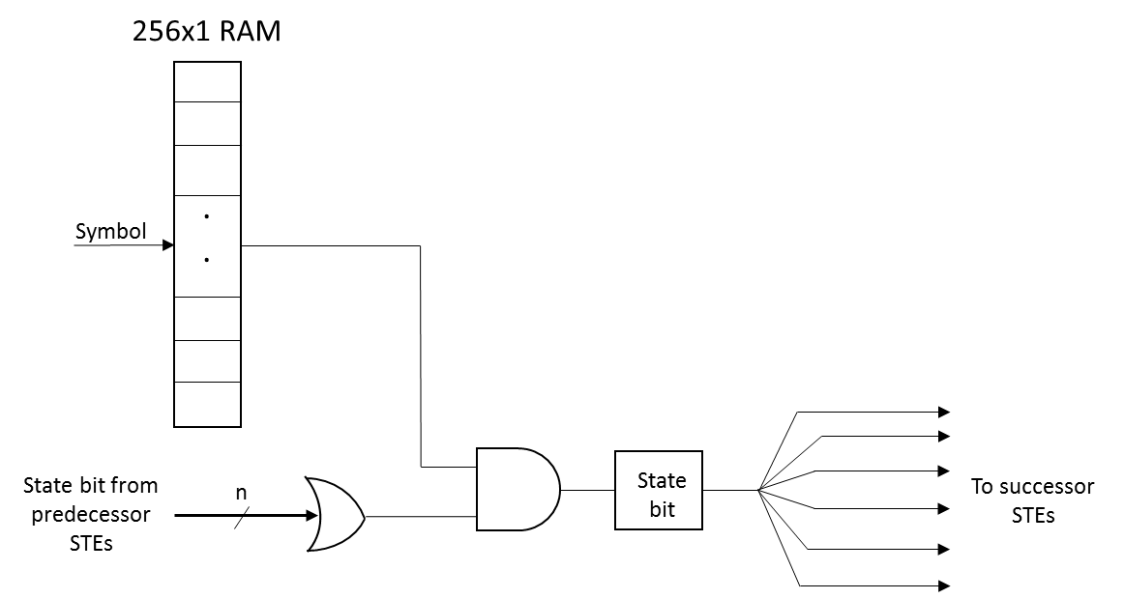
State Transition Element (STE)

Slide 20
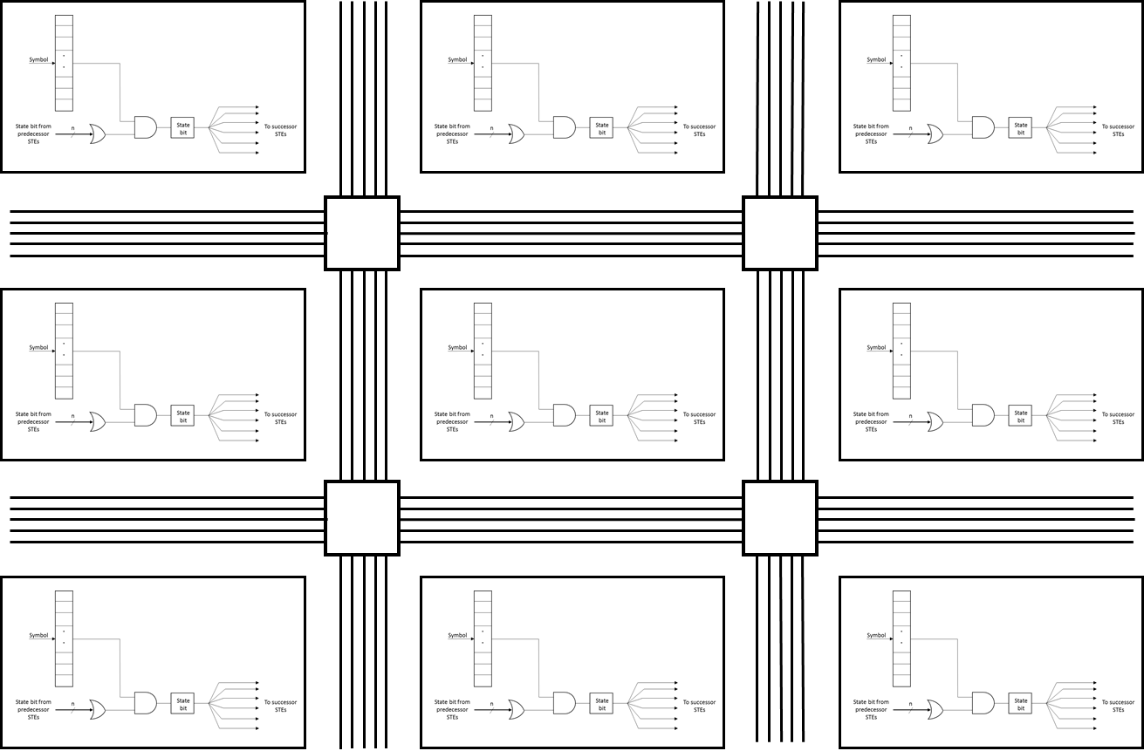
Interconnection Network: Micron AP

Slide 21
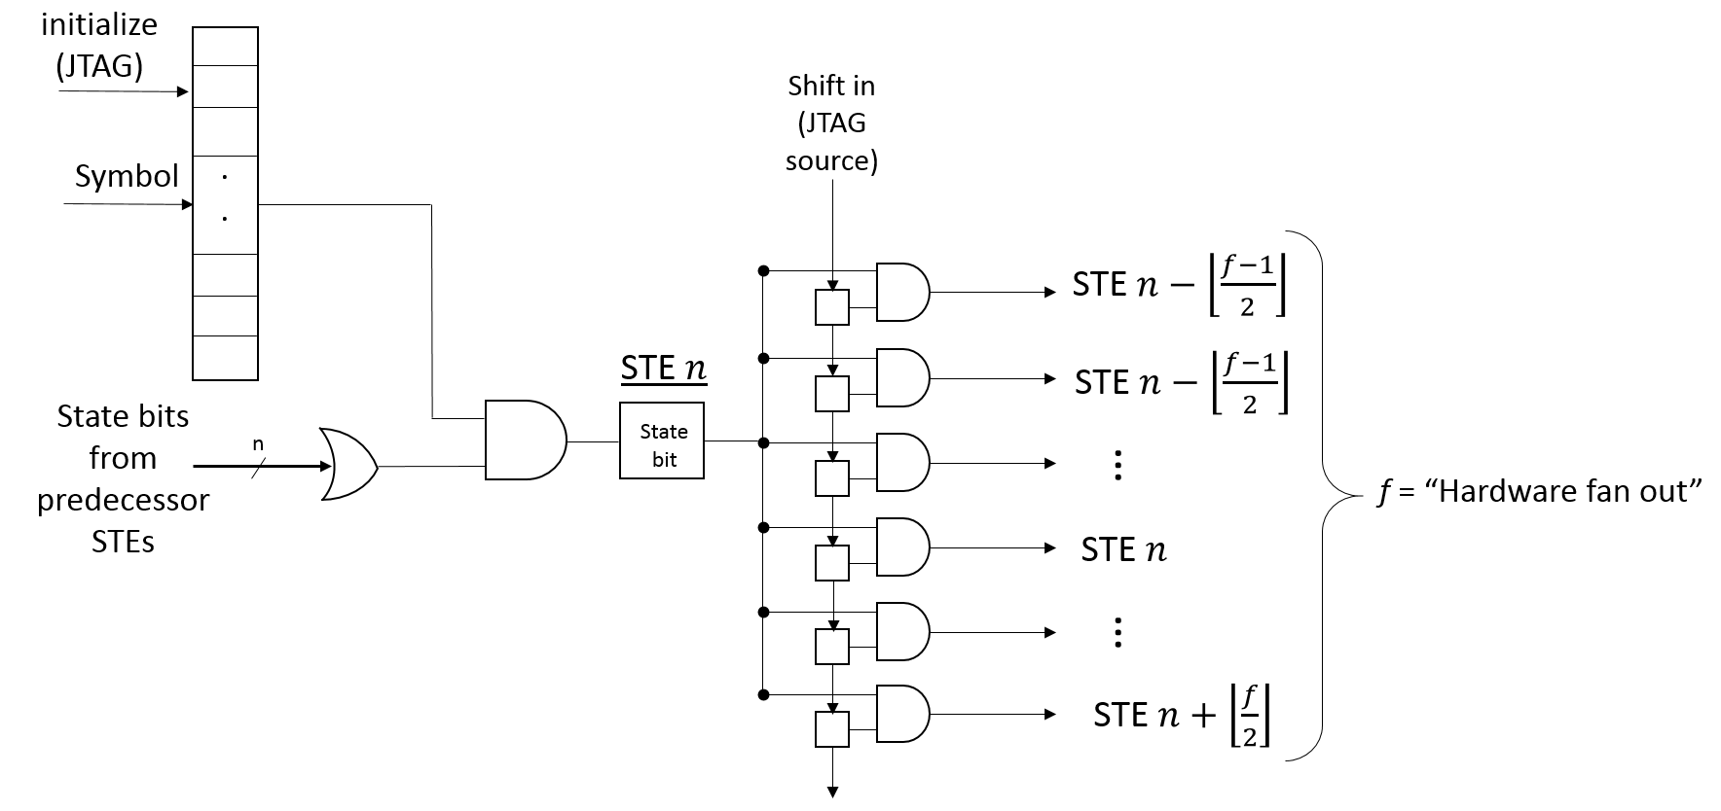
Overlay Interconnection Network
logical fan-out = 2
logical fan-in = 2

Slide 22
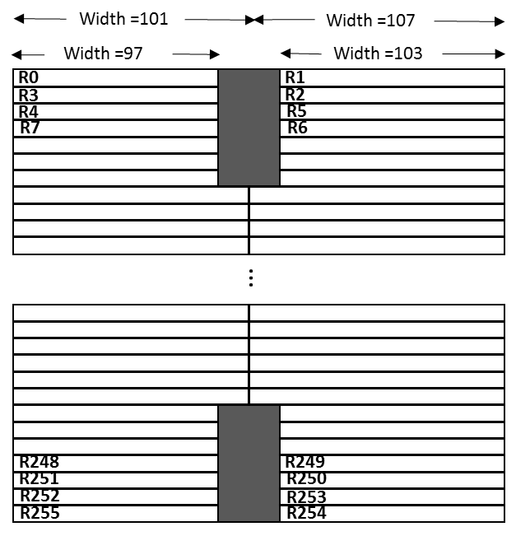
Location Constraints
Merge next state tables into 256 x N RAMs
Associate each group of N consecutive STEs with a location constraint
Assigned each group in a zig-zag pattern
Stratix 5 A7

Slide 23
Hardware Cost
STEs (K) | Max. H/W Fan-out | Fmax (MHz) | ALMs | MLAB mem. (Mbits) | Reg. (Kbits) | Total mem. (MB)
4 | 24 | 152 | 42% | 1 | 104 | 0.6
8 | 24 | 136 | 77% | 2 | 208 | 1.6
12 | 23 | 122 | 95% | 3 | 300 | 2.3
16 | 14 | 121 | 96% | 4 | 256 | 2.9
20 | 8 | 119 | 93% | 5 | 200 | 3.4
24 | 5 | 112 | 95% | 6 | 168 | 4.0

Slide 24
Hardware Cost (16K STEs)
H/W Fan-out | Block intrcon’t | Local interconnect | R24 | R3 | R6 | # LABs utilized
6 | 25% | 21% | 25% | 14% | 25% | 81%
10 | 34% | 25% | 33% | 18% | 35% | 94%
11 | 35% | 27% | 31% | 20% | 36% | 95%
12 | 42% | 29% | 38% | 29% | 46% | 97%
14 | 44% | 32% | 41% | 30% | 47% | 98%

Slide 25
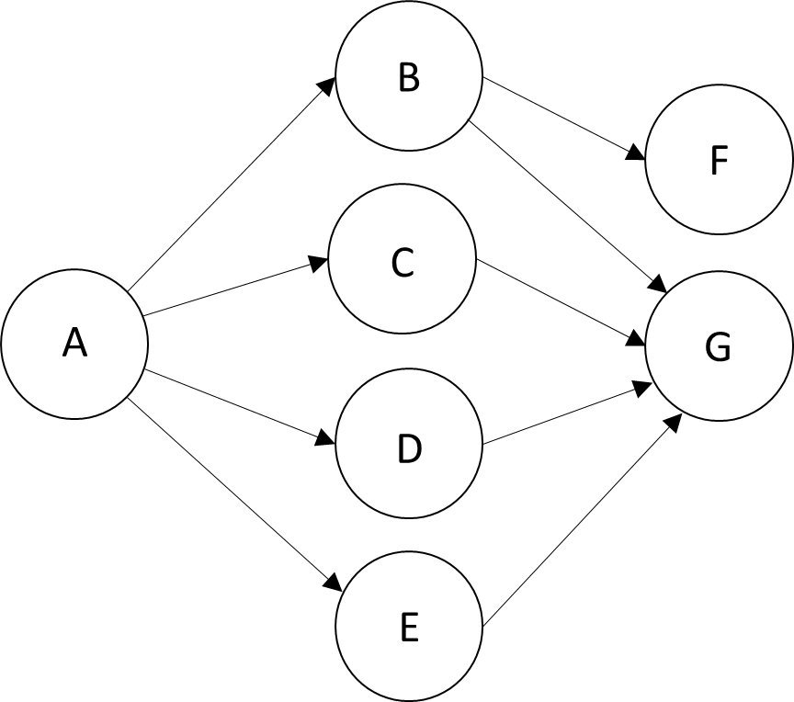
Physical Mapping
Logical fan-in = 4
Logical fan-out = 4
Hardware fanout = 9
range = [-4,4]
STE Mapping:
STE | State
0 | A
1 | B
2 | C
3 | D
4 | E
5 | F
6 | G

Slide 26
Physical Mapping
Logical fan-in = 4
Logical fan-out = 4
Hardware fanout = 9
range = [-4,4]
STE Mapping:
STE | State
0 | A
1 | B
2 | C
3 | D
4 | E
5 | F
6 | G

Slide 27
Mapping Algorithm
Initially map states to STEs in order listed in ANML file
For each edge S -> D , if there is a mapping violation, move either S or D in a way that minimizes the resulting score
STE | State
0 | A
1 | B
2 | C
3 | D
4 | E
5 | F
6 | G
Edge | Distance | Edge | Distance
A->B | 1 | B->G | 5
A->C | 2 | C->G | 4
A->D | 3 | D->G | 3
A->E | 4 | E->G | 2
B->F | 4
STE | State
0 | A
1 | C
2 | B
3 | D
4 | E
5 | F
6 | G
Edge | Distance | Edge | Distance
A->B | +1 | B->G | -1
A->C | -1 | C->G | +1 (5)
A->D | 0 | D->G | 0
A->E | 0 | E->G | 0
B->F | -1
Option 1:
Move B to STE 2
Relative score = -1
(but one new violation)

Slide 28
Mapping Algorithm
Initially map states to STEs in order listed in ANML file
For each edge S -> D , if there is a mapping violation, move either S or D in a way that minimizes the resulting score
STE | State
0 | A
1 | B
2 | C
3 | D
4 | E
5 | F
6 | G
Edge | Distance | Edge | Distance
A->B | 1 | B->G | 5
A->C | 2 | C->G | 4
A->D | 3 | D->G | 3
A->E | 4 | E->G | 2
B->F | 4
STE | State
0 | A
1 | C
2 | D
3 | B
4 | E
5 | F
6 | G
Edge | Distance | Edge | Distance
A->B | +2 | B->G | -2
A->C | -1 | C->G | +1 (5)
A->D | -1 | D->G | +1
A->E | 0 | E->G | 0
B->F | -2
Option 2:
Move B to STE 3
Relative score = -2
(but one new violation)

Slide 29
Mapping Algorithm
Initially map states to STEs in order listed in ANML file
For each edge S -> D , if there is a mapping violation, move either S or D in a way that minimizes the resulting score
STE | State
0 | A
1 | B
2 | C
3 | D
4 | E
5 | F
6 | G
Edge | Distance | Edge | Distance
A->B | 1 | B->G | 5
A->C | 2 | C->G | 4
A->D | 3 | D->G | 3
A->E | 4 | E->G | 2
B->F | 4
STE | State
0 | A
1 | B
2 | C
3 | D
4 | E
5 | G
6 | F
Edge | Distance | Edge | Distance
A->B | 0 | B->G | -1
A->C | 0 | C->G | -1
A->D | 0 | D->G | -1
A->E | 0 | E->G | -1
B->F | +1 (5)
Option 6:
Move G to STE 5
Relative score = -3
(but one new violation)

Slide 30
Mapping Algorithm
Initially map states to STEs in order listed in ANML file
For each edge S -> D , if there is a mapping violation, move either S or D in a way that minimizes the resulting score
STE | State
0 | A
1 | B
2 | C
3 | D
4 | E
5 | F
6 | G
Edge | Distance | Edge | Distance
A->B | 1 | B->G | 5
A->C | 2 | C->G | 4
A->D | 3 | D->G | 3
A->E | 4 | E->G | 2
B->F | 4
STE | State
0 | G
1 | A
2 | B
3 | C
4 | D
5 | E
6 | F
Edge | Distance | Edge | Distance
A->B | 0 | B->G | -3
A->C | 0 | C->G | -1
A->D | 0 | D->G | +1
A->E | 0 | E->G | +3 (5)
B->F | 0
Option 11:
Move G to STE 0
Relative score = 0
(but one new violation)

Slide 31
Mapping Algorithm
Movement | Relative Score | # violations | Movement | Relative Score | # violations
State B from STE 1 to STE 2 | -1 | 1 | State G from STE 6 to STE 5 | -3 | 1
State B from STE 1 to STE 3 | -2 | 1 | State G from STE 6 to STE 4 | -5 | 2
State B from STE 1 to STE 4 | -3 | 1 | State G from STE 6 to STE 3 | -5 | 2
State B from STE 1 to STE 5 | -3 | 2 | State G from STE 6 to STE 2 | -3 | 2
State B from STE 1 to STE 6 | -4 | 1 | State G from STE 6 to STE 1 | 0 | 1
 |  |  | State G from STE 6 to STE 0 | 0 | 1

Slide 32
Results
ANML Benchmarks | #STEs | Maximum Logical Fan-in | Maximum Logical Fan-out | Minimum Hardware Fan-out Achieved
Brill | 26668 | 4 | 4 | 42
Clam AM | 49538 | 11 | 2 | 22
Levenshtein | 2784 | 8 | 5 | 22
Hamming | 11346 | 4 | 2 | 85
SPM | 100500 | 3 | 2 | 22
EntityResolution | 95136 | 28 | 5 | 200
RandomForest | 75340 | 2 | 2 | 7
PowerEN | 40513 | 4 | 3 | cannot place

Slide 33
Results
ANML Benchmarks | #STEs | Maximum Logical Fan-in | Maximum Logical Fan-out | Minimum Hardware Fan-out Achieved
Snort (after removing special elements) | 69029 | 19 | 19 | cannot place
Fermi | 40783 | 2 | 2 | 27
DotStar (after removing special elements) | 96438 | 2 | 2 | cannot place
Protomota (after removing special elements) | 42061 | 3 | 9 (optimized) | cannot place

Slide 34
Conclusions
AP overlay on moderate-sized FPGA (Stratix-5 GX A7) can fit ~1/2 the STEs on a Micron AP ASIC, using 95% of its LAB/MLAB resources
Abstracted programmable interconnect is non-switched, point-to-point, relies on mapping algorithm to resolve routing constraints
Proposed mapping algorithm maps most ANMLZoo benchmarks but generally requires more interconnect complexity than is feasible
Future work: improve mapping algorithm, leverage NFA partitioning

