Slide 1
Chronological review of Markov property for multivariate regression chain graphs
Mohammad Ali Javidian
11/10/2017
Hypergraph & Bayesian Network Seminar

Slide 2
Overview
Cox and Wermuth
  Linear Dependencies Represented by Chain Graphs (1993)
  Multivariate Dependencies-Models, Analysis and Interpretation (1996)
  Joint response graphs and separation induced by triangular systems (2004)
Richardson and Spirtes
  Ancestral graph Markov models (2002)
Drton, Marchetti, and Lupparelli
  Marchetti & Lupparelli (2008). Parameterization and Fitting of a Class of Discrete Graphical Models
  Marchetti & Lupparelli (2011). Chain graph models of multivariate regression type for categorical data
  Drton (2009). Discrete chain graph models.

Slide 3
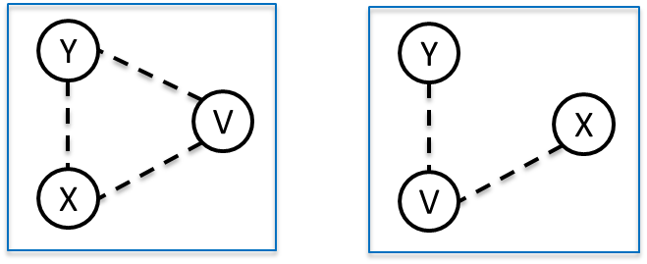
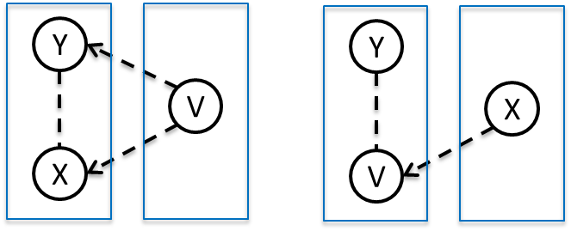
Cox and Wermuth
Covariance graphs:
Multivariate regression graphs:
Linear Dependencies Represented by Chain Graphs (1993)
Notes:
covariance graph is a single box graph in which all edges are undirected dashed lines
a multivariate regression graph is a two-box graph in which all edges are dashed, being lines within and arrows between boxes, as in Figure and if in which the right-hand box has two lines around it, the distribution of its components being fixed

Slide 4
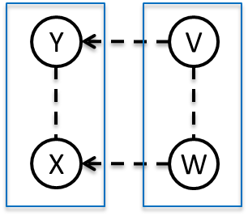
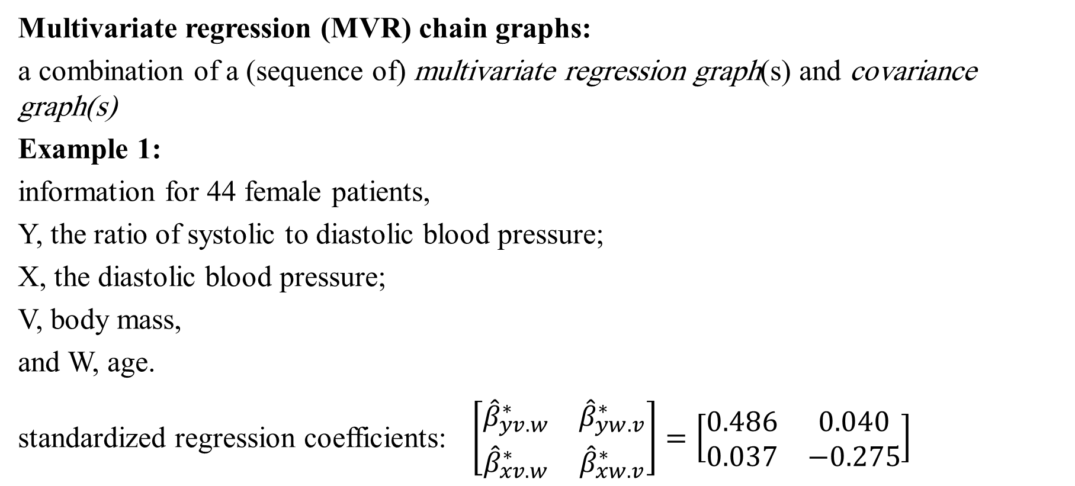
Cox and Wermuth
Multivariate regression (MVR) chain graphs:
a combination of a (sequence of) multivariate regression graph(s) and covariance graph(s)
Example 1:
information for 44 female patients,
Y, the ratio of systolic to diastolic blood pressure;
X, the diastolic blood pressure;
V, body mass,
and W, age.
standardized regression coefficients: $\left[\begin{matrix}{\hat{β}}_{yv.w}^{∗} & {\hat{β}}_{yw.v}^{∗} \\ {\hat{β}}_{xv.w}^{∗} & {\hat{β}}_{xw.v}^{∗}\end{matrix}\right]=\left[\begin{matrix}0.486 & 0.040 \\ 0.037 & −0.275\end{matrix}\right]$
Linear Dependencies Represented by Chain Graphs (1993)
Notes:
X,Y both measured in logarithmic scale
Body mass, that is, weight relative to height
the standardized regression coefficients in a saturated multivariate regression (a graphical model having all possible two-factor effects) of Y, X on V,W display possible independencies of interest.
They show close agreement with $Y⫫W|V$ and $X⫫V|W$
This model gives as interpretation that diastolic blood pressure increases just with age after controlling for an increase in body mass and that the ratio of systolic to diastolic blood pressure is higher the lower the body mass for persons of the same age. But again, the model does not directly suggest a stepwise process by which the data could have been generated.

Slide 5
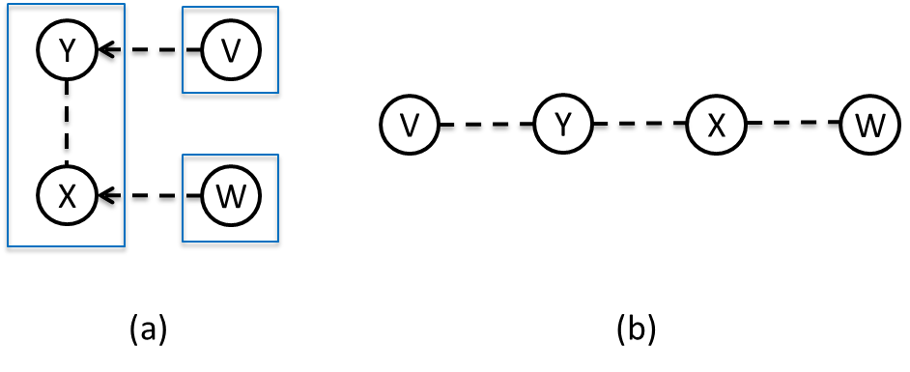
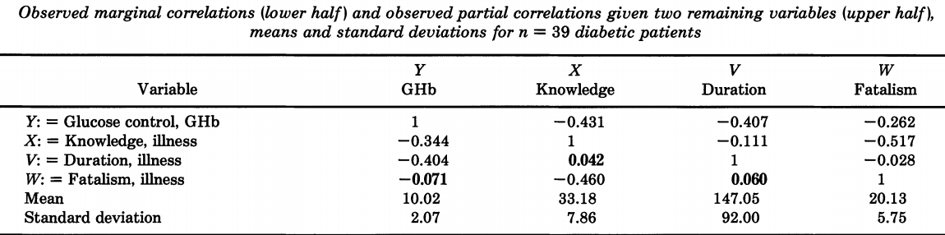
Cox and Wermuth
Example 2:
information for 39 diabetic patients, who had at most 10 years of formal schooling
Y, glucose control GHb;
X, score for knowledge about the illness;
V, the duration of illness in months,
and W, external fatalism.
Linear Dependencies Represented by Chain Graphs (1993)
Notes:
W, a questionnaire score measuring the patients external attribution to "chance" of the occurrence of events related to the illness; an attitude called external fatalism
The correlations in Table suggest a structure of the form: $Y⫫W, X⫫V$, and $V⫫W$, see also Figure. One interpretation is that duration of illness and external fatalism are independent explanatory variables in two seemingly independent regressions, where metabolic adjustment is better (low values of GHb) the longer the duration of the illness, knowledge about the illness is lower the higher the external fatalism of a person, and after conditioning on duration and fatalism the metabolic adjustment is still better the higher the knowledge

Slide 6
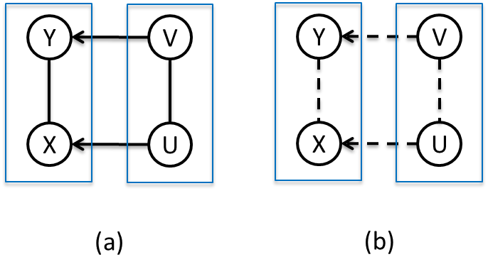

Cox and Wermuth
Joint-response chain graphs:
Figure (a) shows a joint-response chain graph with variables U, V as explanatory to X, Y, Y regressed on X, U, V and X regressed on Y, U, V. In this graph, $Y⫫U|(X,V)$ and $X⫫V|(Y,U)$. Figure (b) shows a joint-response chain graph where Y is the response to V and X is the response to U. In this graph, $Y⫫U|V$ and $X⫫V|U$.
  Multivariate Dependencies (1996)
Notes:
a graphical model in which the nodes can be arranged in a line of boxes from left to right that generally there is several nodes within each box. Within each box there is either a full-line concentration graph (i.e. a single box graph in which all edges are undirected full lines) or a dashed-line covariance graph
Today, full-edge joint-response chain graphs are known as chain graph under the Lauritzen-Wermuth-Frydenberg (LWF) interpretation, and dashed-edge joint-response chain graphs are known as multivariate regression (MVR) chain graphs.

Slide 7
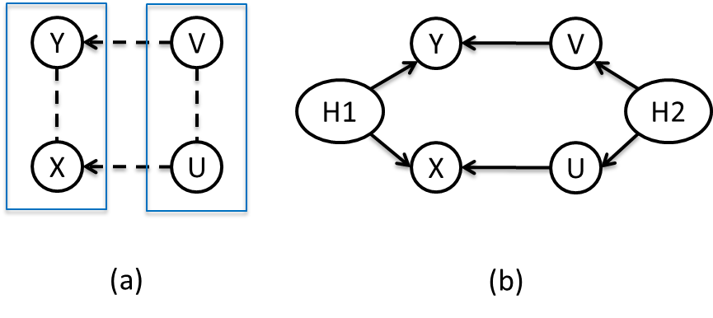
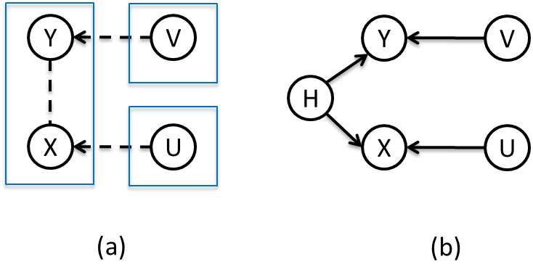
Cox and Wermuth
Cox and Wermuth claim
If we start with any dashed-line joint-response chain graph we can obtain a synthetic directed acyclic graph, i.e. one in which specified nodes represent variables over which marginalization occurs.
Example 3: Example 4:
  Multivariate Dependencies (1996)

Slide 8
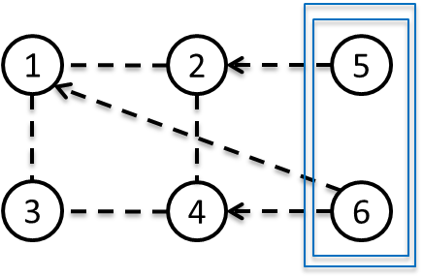
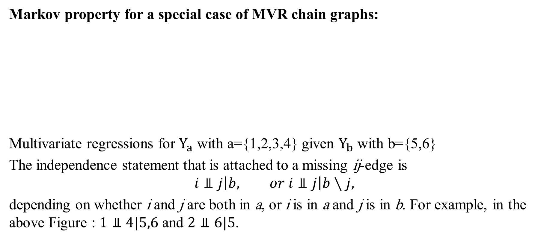
Cox and Wermuth
Markov property for a special case of MVR chain graphs:
Multivariate regressions for $Y_{a}$ with a={1,2,3,4} given $Y_{b}$ with b={5,6}
The independence statement that is attached to a missing ij-edge is
$$i⫫j\left|b, or i⫫j\right|b∖j,$$
depending on whether i and j are both in a, or i is in a and j is in b. For example, in the above Figure : $1⫫4|5,6$ and $2⫫6|5$.
  Joint response graphs and … (2004)

Slide 9
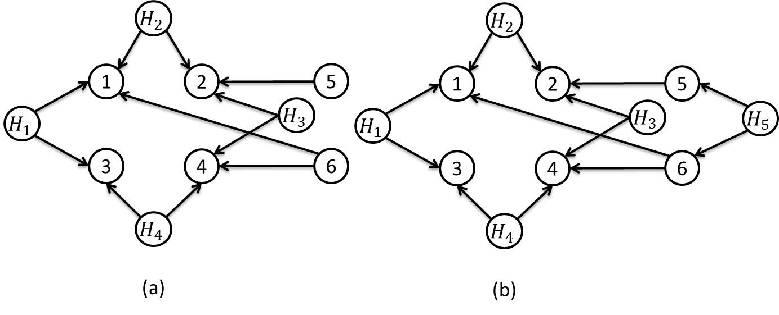

Cox and Wermuth
In both graphs (a) and (b): $2⫫3$ and $1⫫4|6$, while in the MVR chain graph: : $1 4|6$ and $2 3$, which is inconsistent with the Cox and Wermuth claim (1996).
  Joint response graphs and … (2004)

Slide 10
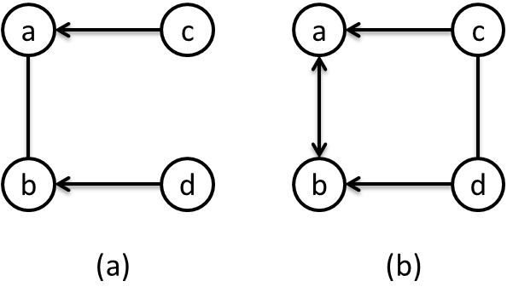
Richardson and Spirtes
Definition (Ancestors and anterior vertices). A vertex α is said to be an ancestor of a vertex β if either there is a directed path α→· · ·→β from α to β, or α = β.
A vertex α is said to be anterior to a vertex β if there is a path μ from α to β on which every edge is either of the form γ −δ, or γ →δ with δ between γ and β, or α = β.
Definition. An ancestral graph G is a mixed graph in which the following conditions hold for all vertices α in G:
(i) if α and β are joined by an edge with an arrowhead at α, then α is not anterior to β.
(ii) there are no arrowheads present at a vertex which is an endpoint of an undirected edge.
☒
☑
  Ancestral graph Markov models (2002)
Notes:
Anterior: that is, there are no edges γ $⟷$δ and there are no edges γ ←δ pointing toward α.
A mixed graph is a graph containing three types of edge, undirected (−), directed (→) and bidirected (↔).
Condition (i) implies that if α and β are joined by an edge with an arrowhead at α, then α is not an ancestor of β. This is the motivation for terming such graphs “ancestral.”

Slide 11
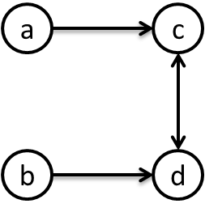
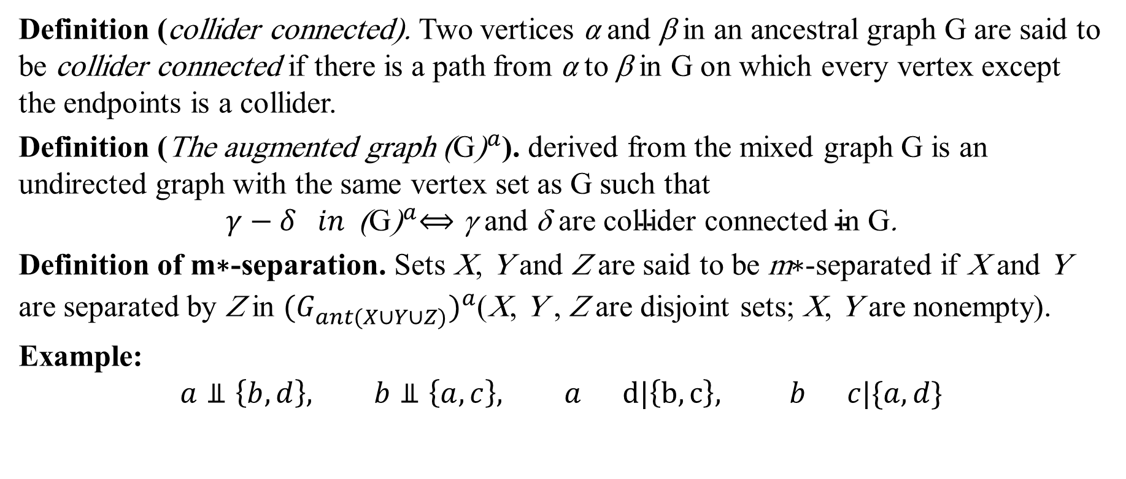
Richardson and Spirtes
Definition (collider connected). Two vertices α and β in an ancestral graph G are said to be collider connected if there is a path from α to β in G on which every vertex except the endpoints is a collider.
Definition (The augmented graph ${\text{(}\text{G}\text{)}}^{a}$). derived from the mixed graph G is an undirected graph with the same vertex set as G such that
$$γ−δ in {\text{(}\text{G}\text{)}}^{a}⟺\text{γ} \text{and} \text{δ} \text{are} \text{collider} \text{connected} \text{in} \text{G}\text{.}$$
Definition of m∗-separation. Sets X, Y and Z are said to be m∗-separated if X and Y are separated by Z in ${(G_{ant(X∪Y∪Z)}^{})}^{a}$(X, Y , Z are disjoint sets; X, Y are nonempty).
Example:
$$a⫫\left\{b,d\right\}, b⫫\left\{a,c\right\}, a d|\left\{b,c\right\}, b c|\{a,d\}$$
  Ancestral graph Markov models (2002)
Notes:
Note that if there is a single edge between α and β in the graph then α and β are collider connected.

Slide 12
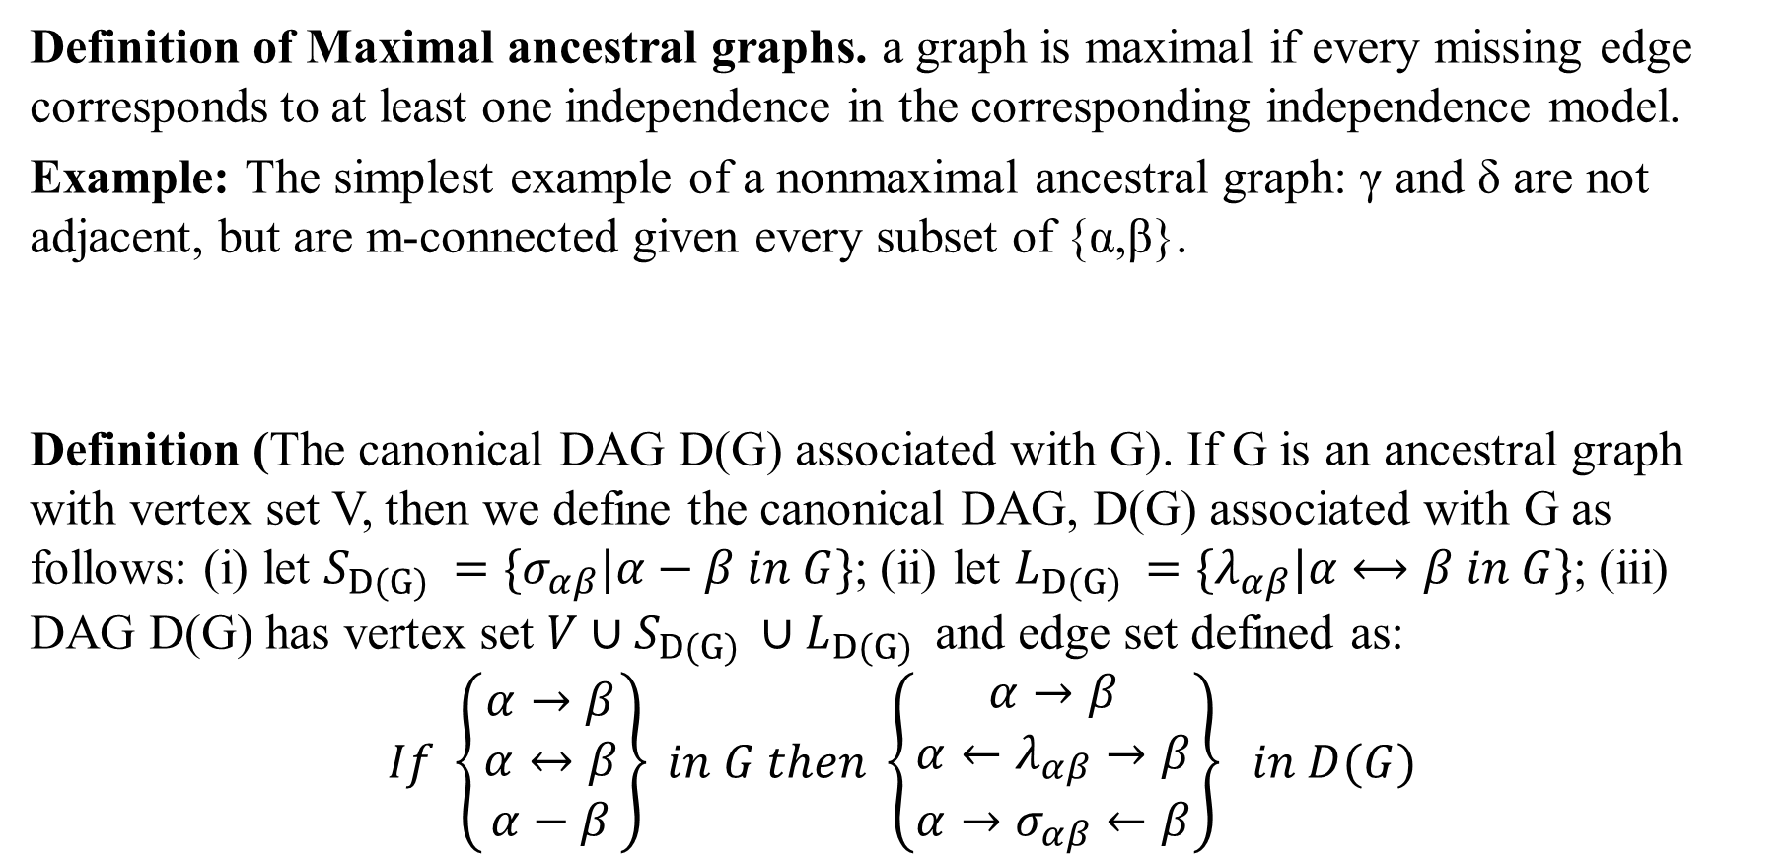
Richardson and Spirtes
Definition of Maximal ancestral graphs. a graph is maximal if every missing edge corresponds to at least one independence in the corresponding independence model.
Example: The simplest example of a nonmaximal ancestral graph: γ and δ are not adjacent, but are m-connected given every subset of {α,β}.
Definition (The canonical DAG D(G) associated with G). If G is an ancestral graph with vertex set V, then we define the canonical DAG, D(G) associated with G as follows: (i) let $S_{D(G) }=\{σ_{αβ}|α−β in G\}$; (ii) let $L_{D(G) }=\{λ_{αβ}|α⟷β in G\}$; (iii) DAG D(G) has vertex set $V∪S_{D(G) }∪L_{D(G) }$ and edge set defined as:
$$If \left\{\begin{matrix}α→β \\ α↔β \\ α−β\end{matrix}\right\} in G then \left\{\begin{matrix}α→β \\ α←λ_{αβ}→β \\ α→σ_{αβ}←β\end{matrix}\right\} in D(G)$$
  Ancestral graph Markov models (2002)

Slide 13
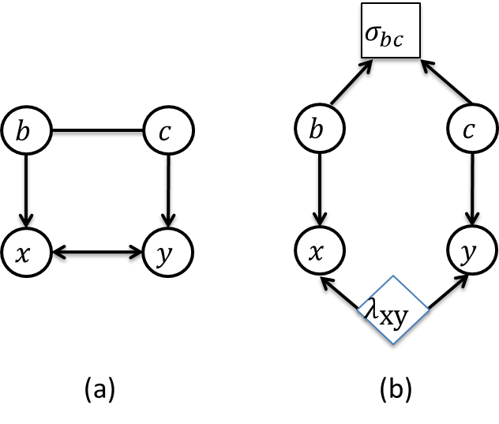
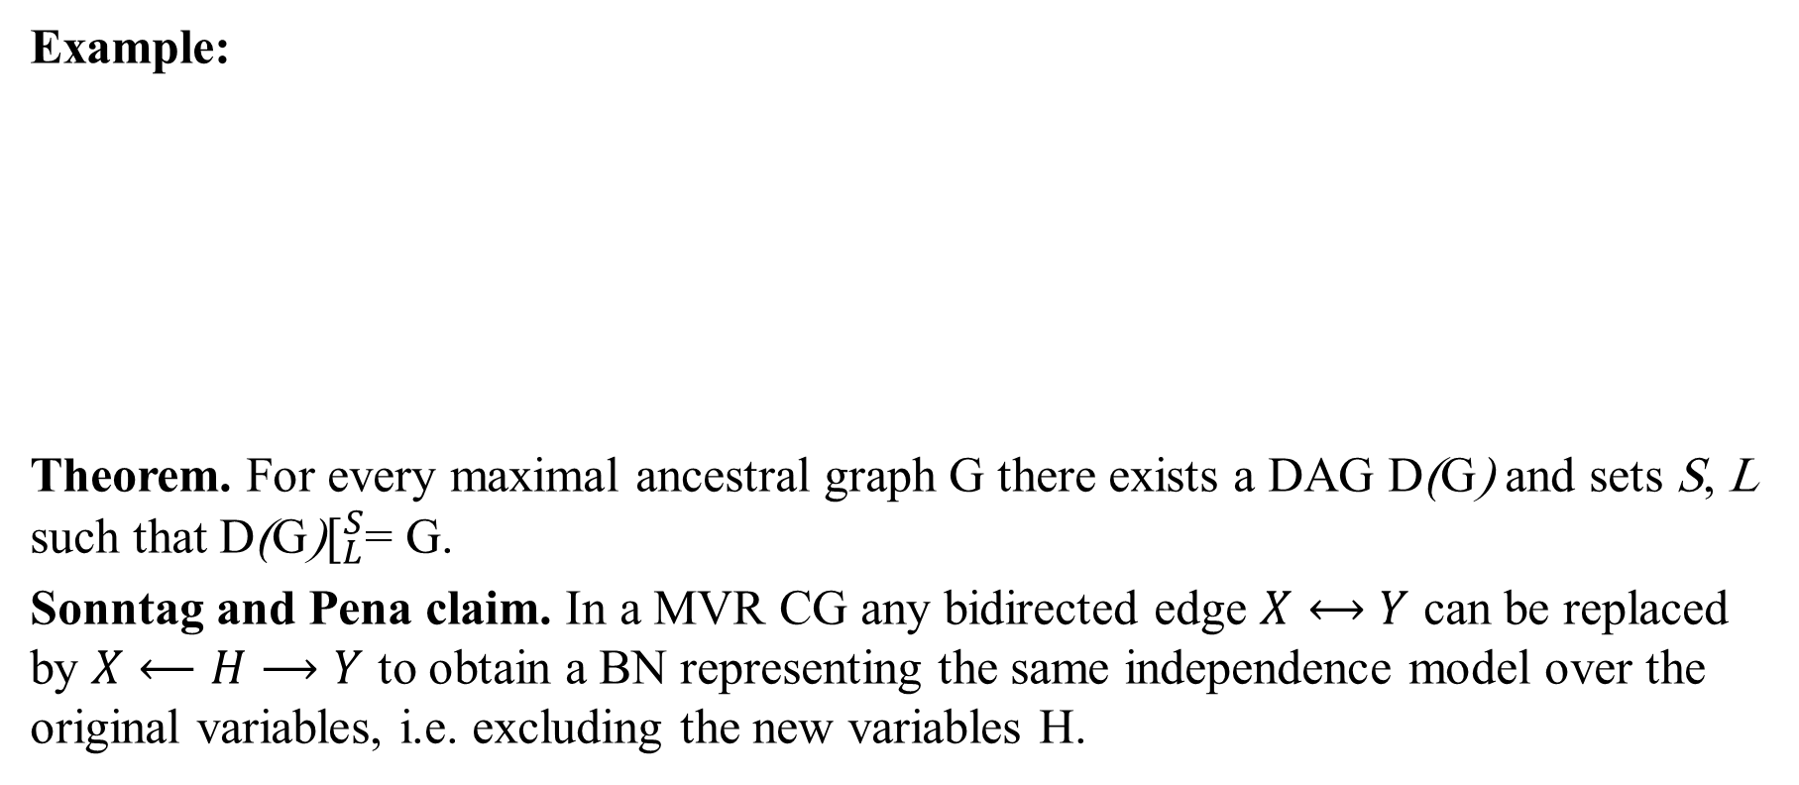
Richardson and Spirtes
Example:
Theorem. For every maximal ancestral graph G there exists a DAG D(G) and sets S, L such that D(G)$[_{L}^{S}$= G.
Sonntag and Pena claim. In a MVR CG any bidirected edge $X⟷Y$ can be replaced by $X⟵H⟶Y$ to obtain a BN representing the same independence model over the original variables, i.e. excluding the new variables H.
  Ancestral graph Markov models (2002)
Notes:
Pena claim: MVR CGs are a subset of maximal ancestral graphs without undirected edges, every MVR CG represents the independence model represented by a DAG under marginalization

Slide 14
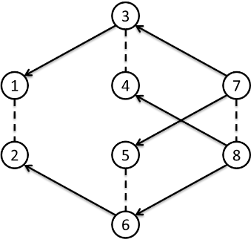
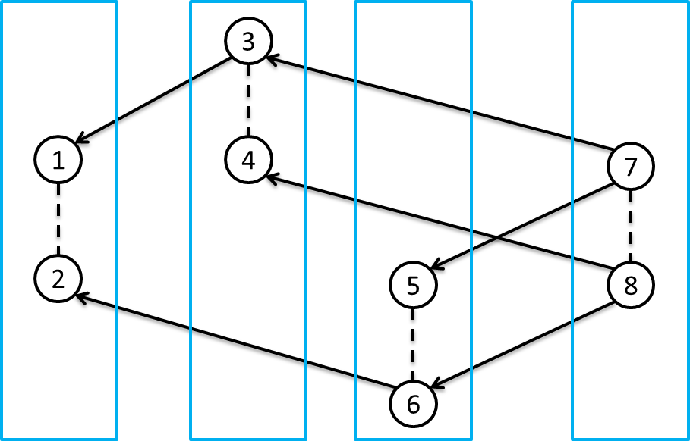
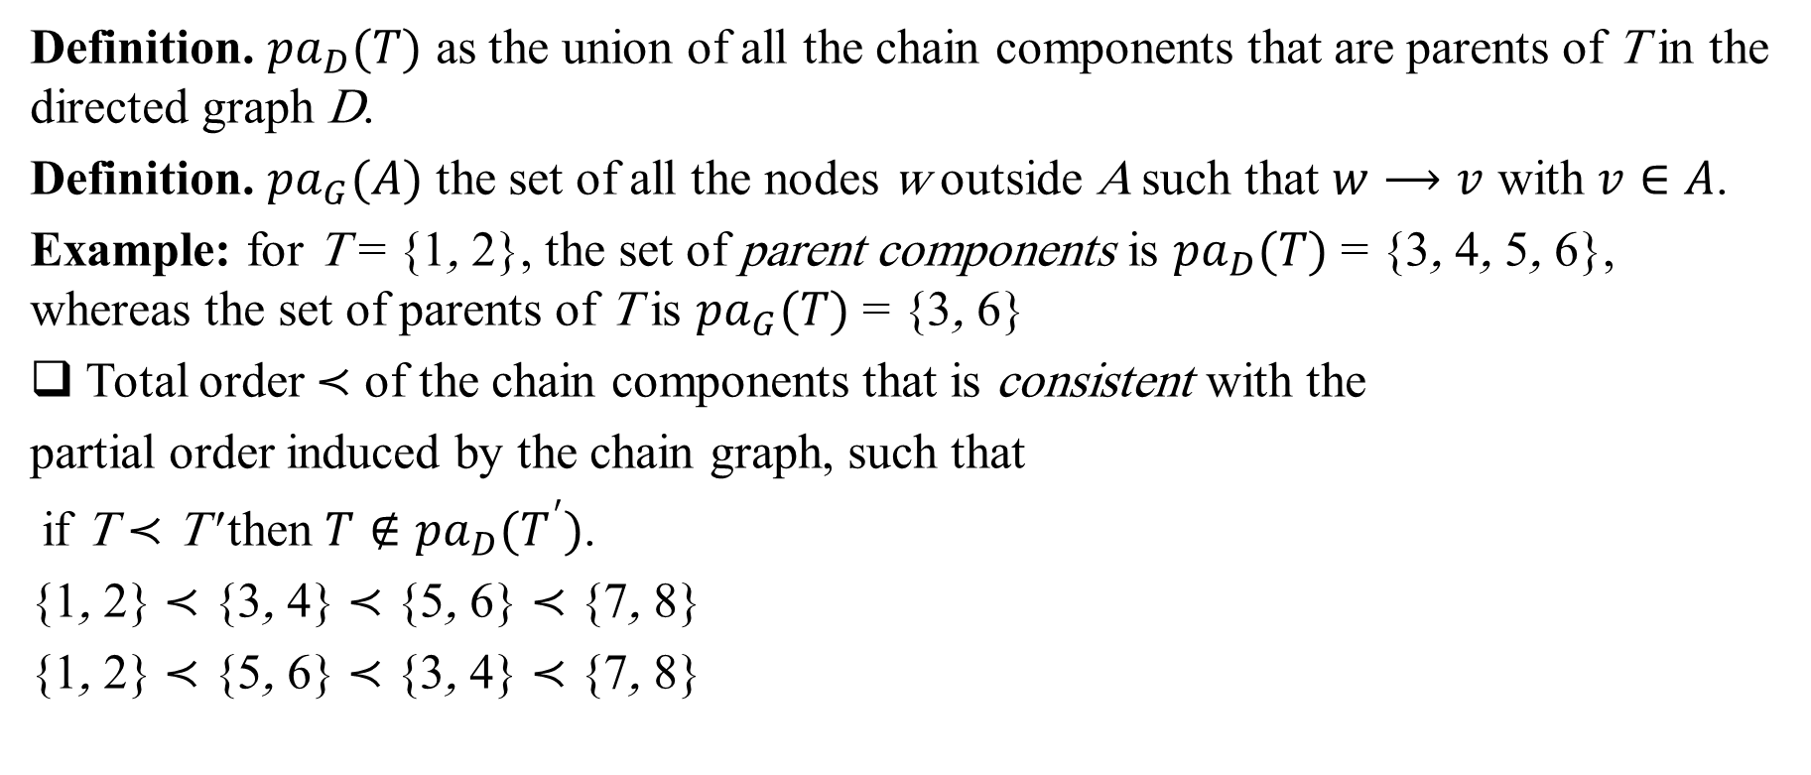
Marchetti and Lupparelli
Definition. ${pa}_{D}(T)$ as the union of all the chain components that are parents of T in the directed graph D.
Definition. ${pa}_{G}(A)$ the set of all the nodes w outside A such that $w⟶v$ with $v∈A$.
Example: for T = {1, 2}, the set of parent components is ${pa}_{D}(T)$ = {3, 4, 5, 6}, whereas the set of parents of T is ${pa}_{G}(T)$ = {3, 6}
Total order ≺ of the chain components that is consistent with the
partial order induced by the chain graph, such that
if T ≺ T' then $T∉{pa}_{D}(T^{′})$.
{1, 2} ≺ {3, 4} ≺ {5, 6} ≺ {7, 8}
{1, 2} ≺ {5, 6} ≺ {3, 4} ≺ {7, 8}
  Chain graph models of multivariate regression type(2008-11)
Notes:
Note that the chosen total order of the chain components is in general not unique

Slide 15
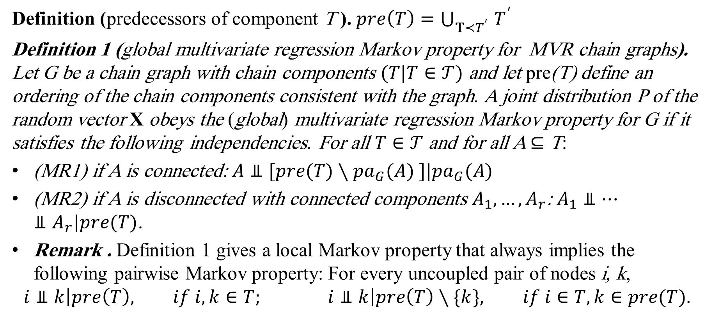
Marchetti and Lupparelli
Definition (predecessors of component T ). $pre\left(T\right)=\bigcup_{T≺T^{′} }{T^{′}}$
Definition 1 (global multivariate regression Markov property for MVR chain graphs). Let G be a chain graph with chain components $(T|T∈𝒯)$ and let pre(T) define an ordering of the chain components consistent with the graph. A joint distribution P of the random vector X obeys the (global) multivariate regression Markov property for G if it satisfies the following independencies. For all $T∈𝒯$ and for all A ⊆ T:
(MR1) if A is connected: $A⫫[pre(T)∖{pa}_{G}(A) ]|{pa}_{G}(A)$
(MR2) if A is disconnected with connected components $A_{1}, …, A_{r}$: $A_{1}⫫…⫫A_{r}|pre(T)$.
Remark . Definition 1 gives a local Markov property that always implies the following pairwise Markov property: For every uncoupled pair of nodes i, k,
$$i⫫k\left|pre\left(T\right), if i,k∈T; i⫫k\right|pre\left(T\right)∖\{k\}, if i∈T, k∈pre(T).$$
  Chain graph models of multivariate regression type(2008-11)
Notes:
The set pre(T ) captures the notion of all the potential explanatory variables of the response variables within T .

Slide 16
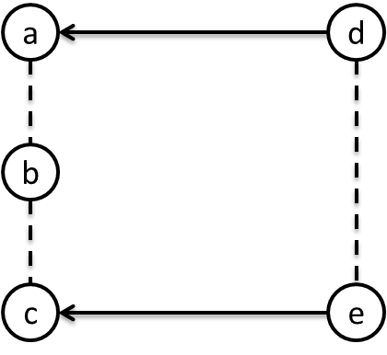
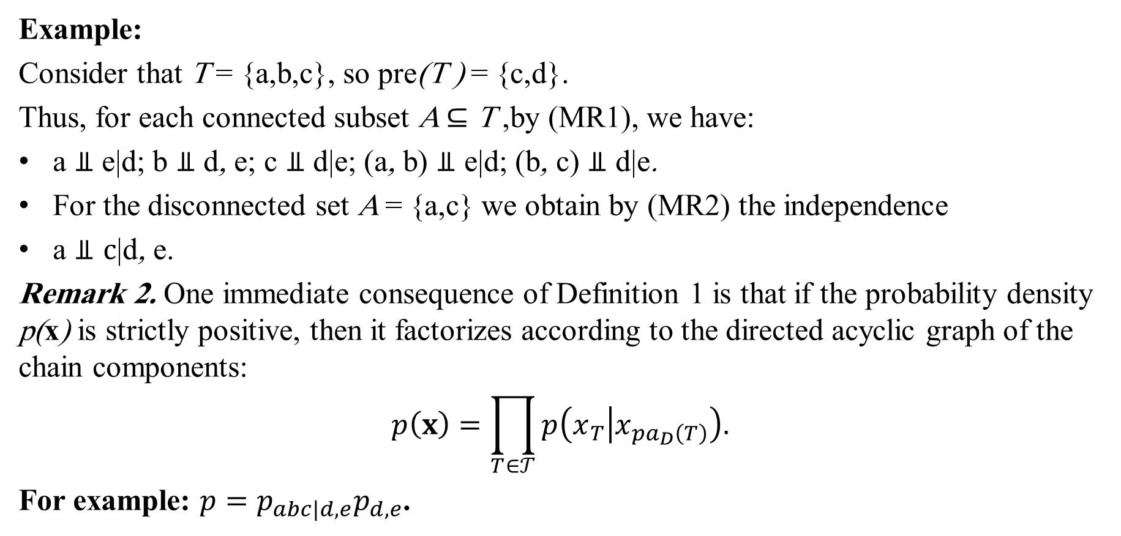
Marchetti and Lupparelli
Example:
Consider that T = {a,b,c}, so pre(T ) = {c,d}.
Thus, for each connected subset A ⊆ T ,by (MR1), we have:
a $⫫$ e|d; b $⫫$ d, e; c $⫫$ d|e; (a, b) $⫫$ e|d; (b, c) $⫫$ d|e.
For the disconnected set A = {a,c} we obtain by (MR2) the independence
a $⫫c$|d, e.
Remark 2. One immediate consequence of Definition 1 is that if the probability density p(x) is strictly positive, then it factorizes according to the directed acyclic graph of the chain components:
$$p\left(x\right)=\prod_{T∈𝒯}{p\left(x_{T} | x_{{pa}_{D}\left(T\right)}\right).}$$
For example: ${p=p}_{abc|d,e}p_{d,e}$.
  Chain graph models of multivariate regression type(2008-11)

Slide 17
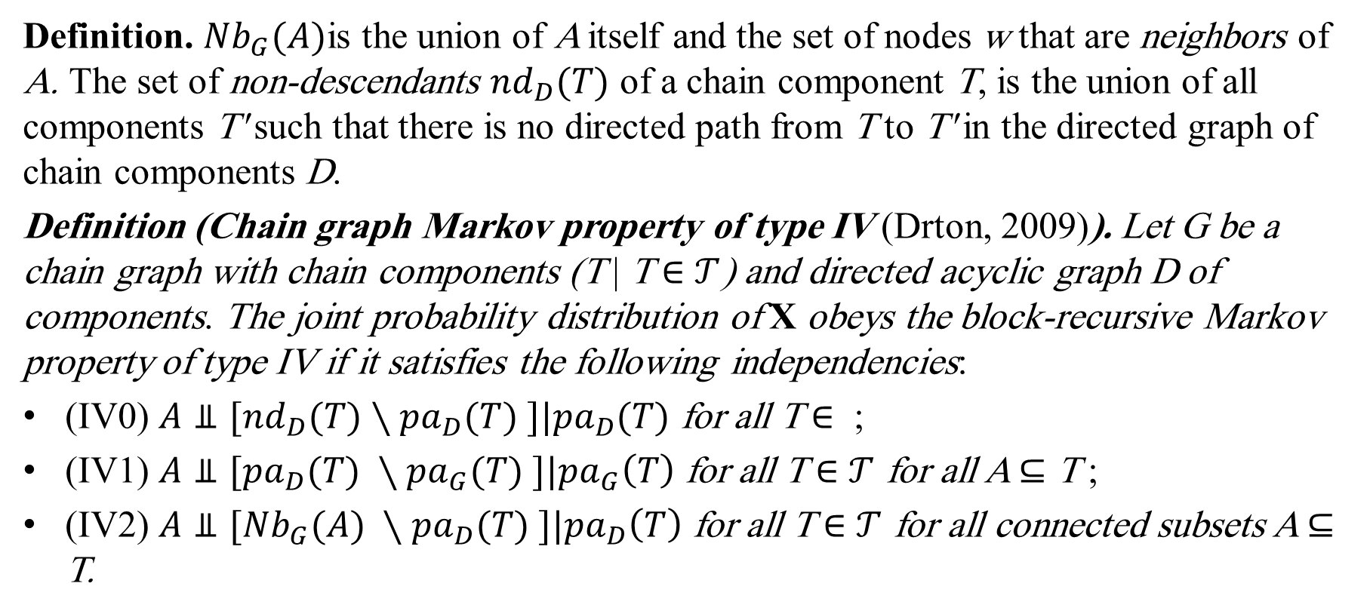
Drton
Definition. ${Nb}_{G}(A)$is the union of A itself and the set of nodes w that are neighbors of A. The set of non-descendants ${nd}_{D}(T)$ of a chain component T, is the union of all components T' such that there is no directed path from T to T' in the directed graph of chain components D.
Definition (Chain graph Markov property of type IV (Drton, 2009)). Let G be a chain graph with chain components (T | T ∈ $𝒯$) and directed acyclic graph D of components. The joint probability distribution of X obeys the block-recursive Markov property of type IV if it satisfies the following independencies:
(IV0) $A⫫[{nd}_{D}(T)∖{pa}_{D}(T) ]|{pa}_{D}(T)$ for all T ∈ ;
(IV1) $A⫫[{pa}_{D}(T) ∖{pa}_{G}(T) ]|{pa}_{G}\left(T\right)$ for all T ∈ $𝒯$ for all A ⊆ T ;
(IV2) $A⫫[{Nb}_{G}(A) ∖{pa}_{D}(T) ]|{pa}_{D}\left(T\right)$ for all T ∈ $𝒯$ for all connected subsets A ⊆ T.
  Discrete chain graph models (2009)
Notes:
Drton discussed four different block-recursive Markov properties for chain graphs, of which we discuss here those with the Markov property of type IV (Drton, 2009).

Slide 18
Drton, Marchetti, and Lupparelli
Theorem . Given a chain graph G, the multivariate regression Markov property is equivalent to the block-recursive Markov property of type IV (Marchetti & Lupparelli, 2011).
Drton, Marchetti, and Lupparelli proposed a Markov property for MVR chain graphs which is in concordance with (Wermuth & Cox, 2004), but in contrast with Cox and Wermuth claim part (a), (Cox & Wermuth, 1993), and (Richardson & Spirtes, 2002).

Slide 19
References
Cox, D., & Wermuth, N. (1993). Linear Dependencies Represented by Chain Graphs. Statistical Science, 8(3), 204-218.
Cox, D., & Wermuth, N. (1996). Multivariate Dependencies-Models, Analysis and Interpretation. London: Chapman and Hall.
Drton, M. (2009). Discrete chain graph models. Bernoulli Volume 15, Number 3, 736-753.
Marchetti, G. M., & Lupparelli, M. (2011). Chain graph models of multivariate regression type for categorical data. Bernoulli Volume 17, Number 3, 827-844.
Marchetti, G., & Lupparelli, M. (2008). Parameterization and Fitting of a Class of Discrete Graphical Models. COMPSTAT 2008: Proceedings in Computational Statistics. P. Brito. Heidelberg, Physica-Verlag HD, 117-128.

Slide 20
Peña, J. M. (2015). Every LWF and AMP Chain Graph Originates from a Set of Causal Models. Symbolic and Quantitative Approaches to Reasoning with Uncertainty: 13th European Conference, ECSQARU 2015, Compiègne, France, July 15-17, 2015. Proceedings. S. Destercke and T. Denoeux. Cham, Springer International Publishing, 325-334.
Richardson, T., & Spirtes, P. (2002). Ancestral graph Markov models. Ann. Statist. Volume 30, Number 4, 962-1030.
Sonntag, D. (2014). A Study of Chain Graph Interpretations (Licentiate dissertation). Linköping: https://doi.org/10.3384/lic.diva-105024.
Wermuth, N., & Cox, D. (2004). Joint response graphs and separation induced by triangular systems. Journal of the Royal Statistical Society: Series B (Statistical Methodology), 66, 687–717.

Slide 21



