Slide 1
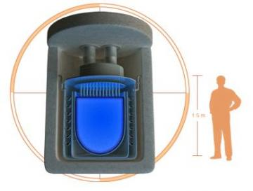
Formatting Tips (36 pt) Your name: Ed Gatzke (20 pt)
Use bullets (28 pt)
Basic concept (24 pt)
Not sentences, no end punctuation
Capitalize first letter only
Include:
Basic technology overview
Include image or schematic
Advantages / Disadvantages
Economic / efficiency information
Cost / W capital
Cost / kWh production
http://www.physorg.com/news145561984.html (9pt)
Cite images you “borrow” from internet
If URL is too long, use goo.gl or other redirect
Try to include original too, like:
www.npr.org http://goo.gl/Wx9MM

Slide 2
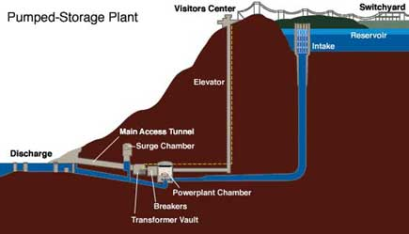
Pumped Hydro Storage Ed Gatzke
Use electricity to pump water uphill to reservoir
Water runs down hill to turn turbine
99% of all world storage
20 GW in US (~20% world tot.)
Advantages
Simple design
70-87% Efficient
Disadvantages
Not available in all locations
http://bravenewclimate.com/2010/04/05/pumped-hydro-system-cost/

Slide 3
Small Nuclear Reactors Ed Gatzke
Traditional fission device with control rods
Buried underground, lead/bismuth cooled
20-50 MW
Heats water for steam
Advantages
Simple design
Underground
Low capital cost
Easier to dispose of
No CO₂ emissions
No powered cooling, few moving parts for maintenance
www.npr.org http://goo.gl/Wx9MM

Slide 4
Small Nuclear Reactors Ed Gatzke
Disadvantages
Potential for accident
Nuclear waste
Weapons proliferation
Permitting process
Image / fear of nuclear power
Overhyped (5 years out 4 years ago)
Economics
$1 to $4 per Watt ($2,500 / home)
Limited production / fuel cost
http://www.physorg.com/news145561984.html

