Slide 1
Supervisory Control and Data Acquisition (SCADA) system security

Slide 2
Reading
Nicholson et al.’ 2012. SCADA security in the light of
Cyber-Warfare. 2012. Computers & Security,
Volume 31, Issue 4, June 2012.,
http://www.sciencedirect.com/science/article/pii/S0167404812000429
S. McLaughlin and P. McDaniel. 2012.
  SABOT: specification-based payload generation for
  programmable logic controllers.
  In Proceedings of the 2012 ACM conference on
  Computer and communications security (CCS '12).
  ACM, New York, NY, USA, 439-449.
  http://dl.acm.org/citation.cfm?id=2382244

Slide 3
Supervisory Control And Data Acquisition (SCADA)
Real time industrial process control systems to monitor and control remote or local industrial equipment
Vital components of most nation’s critical infrastructures
Risk of deliberate attacks!

Slide 4
SCADA Systems
1990: mainframe computer supervision
1970: general purpose operating systems
1990: off the shelf computing
Highly distributed with central control
Field devices control local operations

Slide 5
SCADA Components
Corporate network segment
  Typical IT network
SCADA network segment
  Servers and workstations to interact with field devices
  Human-machine interfaces
  Operators
  Software validation
Field devices segment
  Programmable Logic Controllers (PLC)
  Remote Terminal Units (RTU)
  Intelligent Electronic Devices (IED)

Slide 6
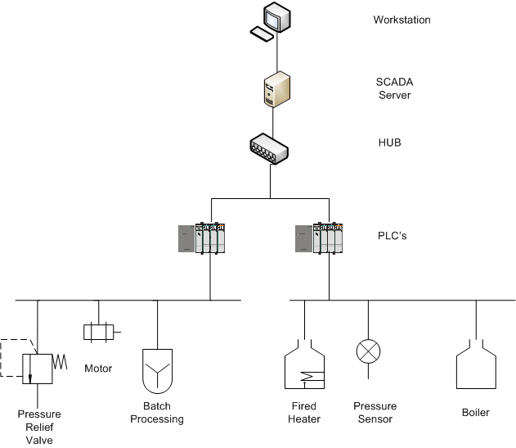
SCADA and PLC Overview

Slide 7
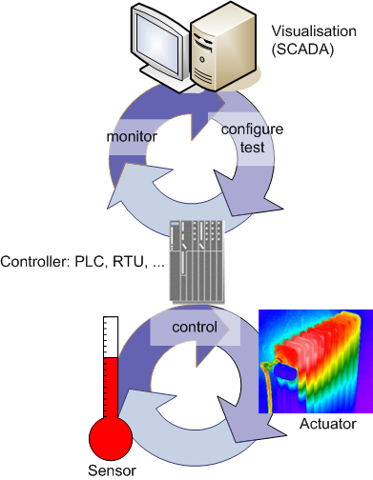
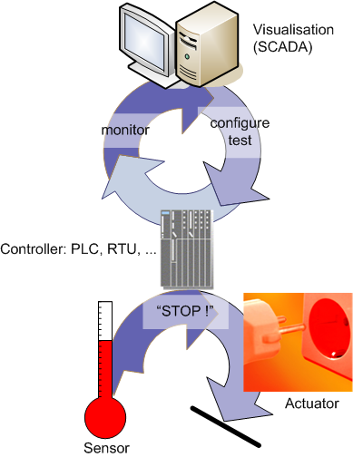
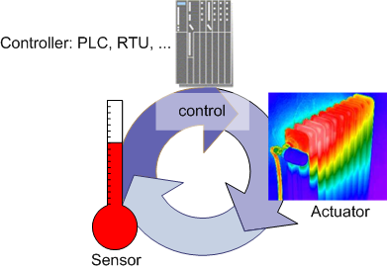
Process Control System (PCS)
Safety System
Source: www.clcert.cl/seminario/
US-CERT_Chile_2007-FINALv2.ppt

Slide 8
SCADA and PLC Overview
Ladder logic overview
  What is ladder logic?
  Why is it the programming language of choice for automated control systems?

Slide 9
SCADA Incidents
Flaws and mistakes
1986: Chernobyl Soviet Union
  56 direct death, 4000 related cancer death
1999: Whatcom Creeks Washington US pipeline rupture
  Spilling 237,000 gallons of gasoline that ignited, 3 human life and all aquatic life
2003: North East Blackout of US and Canada
  Affected 55 million people, 11 death
2011: Fukushima Daiichi nuclear disaster Japan
  Loss of human lives, cancer, psychological distress

Slide 10
Who would attack SCADA?

Slide 11
Attackers
Script kiddies
Hackers
Organized crime
Disgruntled insiders
Competitors
Terrorists
Hactivists
Eco-terrorists
Nation states

Slide 12
SCADA Security
Perimeter Protection
  Firewall, IPS, VPN, AV
  Host IDS, Host AV
  DMZ
Interior Security
  Firewall, IDS, VPN, AV
  Host IDS, Host AV
  NAC
  Scanning
Monitoring
Management

Slide 13
Programmable Logic Controllers
Computer based solid state devices
Control industrial equipment and processes
Regulate process flow
  Automobile assembly line
Have physical effect

Slide 14
Related Work
Security working groups for the various infrastructure sectors of water, electricity and natural gas
US Departments of Energy and Homeland
Security: investigation into the
problem domain of SCADA systems

Slide 15
Related Work
Traditionally vendors focused on functionality and used physical security measures
An attempt was made to try to “match” physical security mechanisms online
Vulnerabilities:
  Classification by affected technology
  Classification by error or mistakes
  Classification by enabled attack scenario

Slide 16
SCADA and PLC Security
Increased risk to SCADA systems, introduces another element of risk to the PLC and all of the control elements
  PLC’s dictate the functionality of the process
  PLC programming software and SCADA control software can be housed on the same machine
The newest PLC hardware devices allow for direct access to the PLC through the network

Slide 17
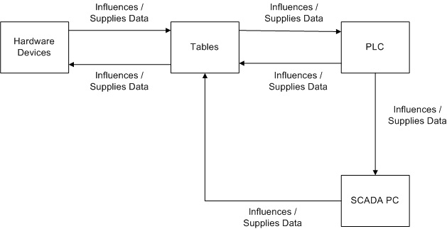
SCADA and PLC Security
SCADA System Control Flow

Slide 18
SCADA and PLC Security
Prior to the Stuxnet attack (2010): it was believed any cyber attack (targeted or not) would be detected by IT security technologies
Need: standard be implemented that would allow both novice and experience PLC programmers to verify and validate their code against a set of rules.
How do we show that PLC code and be verified and validated to assist in the mitigation of current and future security risks (errors)?

Slide 19
Application of Touchpoints
External Review
3. Penetration
Testing
6. Security Requirements
1. Code Review
(Tools)
4. Risk-Based
Security Tests
2. Risk Analysis
7. Security
Operations
5. Abuse cases
2. Risk Analysis
Requirement and
Use cases
Architecture
and Design
Test Plans
Code
Tests and
Test Results
Feedback from
the Field
16

Slide 20
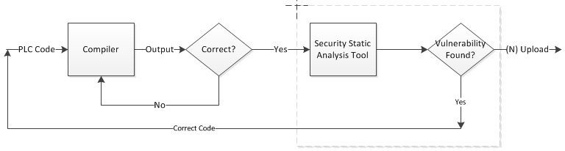
PLC Security Framework (PLC-SF)
Static Analysis Tool: Compiler Workflow

Slide 21
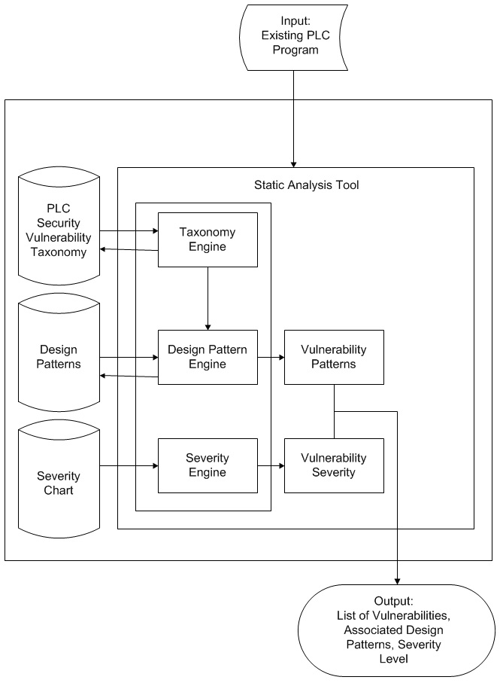
PLC Security Framework (PLC-SF)

Slide 22
PLC Security Framework (PLC-SF)
Components:
  PLC Security Vulnerability Taxonomy
  Design Patterns
  Severity Chart
Engines:
  Taxonomy Engine
  Design Pattern Engine
  Severity Engine

Slide 23
Vulnerabilities Analysis
Attack Severity Analysis
Building the Vulnerability Taxonomy
Potential Exploitation of Coding Errors
Modeling PLC Vulnerabilities

Slide 24
Attack Severity Analysis – Severity Chart
Each row of the Severity Chart represents a different level of security risk, within the PLC error found
The error levels range from A – D, with A being the most severe and D being the least severe
Each column represents the effects which can occur in the PLC and those that can occur in the SCADA system PC

Slide 25
Attack Severity Analysis – Severity Chart
Severity | Effects in PLC | Effects in SCADA
A | PLC Code will not perform the desired tasks | Will not allow for remote operation of the process
B | Serious hindrance to the process | The process could experience intermittent process failure
C | Adversely effects PLC code performance. A minimal cost effect to the project, but a “quick fix” is possible | Data shown on the SCADA screen is most likely false
D | Effects the credibility of the system, but the PLC code is operable | Incorrect data could be randomly reported, cause a lack of confidence in the system

Slide 26
Attack Severity Analysis – Severity Chart
Severity Classifications:
  Severity Level A: Could potentially cause all, or part, of a critical process to become non-functional.
  Severity Level B: Could potentially cause all, or part, of a critical process to perform erratically.
  Severity Level C: Denote a “quick fixes”
  Severity Level D: Provide false or misrepresented information to the SCADA terminal.

Slide 27
Building the Vulnerability Taxonomy
Purpose:
  To aid the process of detecting these vulnerabilities in the PLC code
Intended to be extensible
  Created such that it can be expanded as:
    Future versions of PLC’s are created
    New errors are found

Slide 28
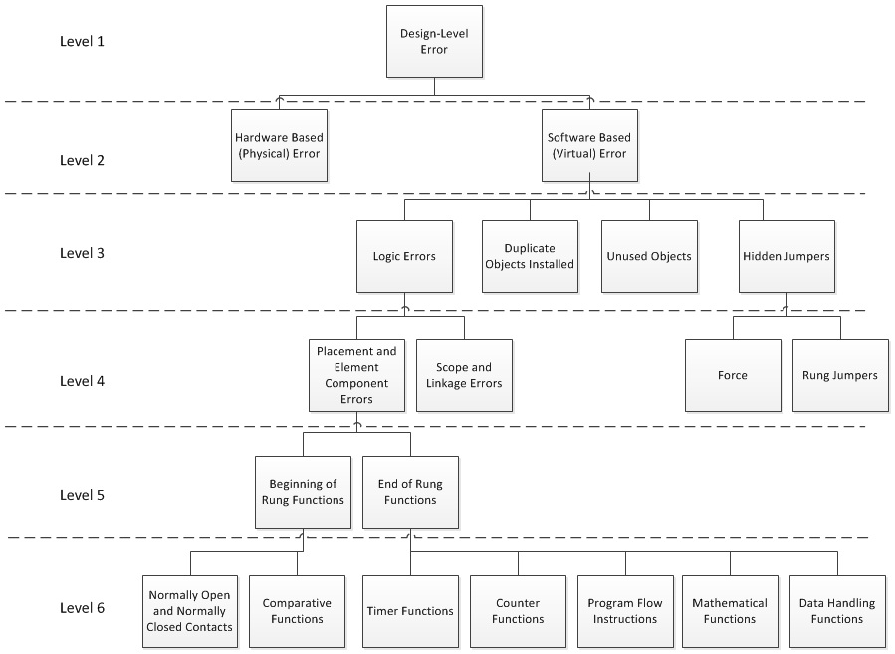
Building the Vulnerability Taxonomy

Slide 29
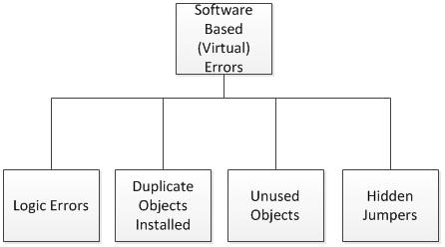
Building the Vulnerability Taxonomy
Vulnerability Taxonomy: Software Based (Virtual) Errors

Slide 30
Potential Exploitation of Coding Errors
Error Type | Taxonomy Classification | Malicious User Opportunity
Process Critical / Nuisance | Duplicate Objects Installed | Alterations of one or more of the duplicate objects
Process Critical | Unused Objects | Pre-loaded variables allow for an immediate entry point into the system
Process Critical | Scope and Linkage Errors | Installation of jump to subroutine command which would alter the intended file to file interaction
Process Critical | Logic Errors | Immediate entry point to logic level components such as timers, counters, and arithmetic operations
Process Critical / Nuisance | Hidden Jumpers | Would allow for a placement point for a system bypass

Slide 31
SABOT Impact on PLC Attacks
Software-based exploits of SCADA
Understanding of industrial control systems
Specification-based Attacks againts Boolean Operations and Timers (SABOT)

Slide 32
SABOT Attack
Encode understanding of the plant’s behavior into a specification
SABOT downloads existing control logic from the victim
SABOT finds mapping between the specific devices and the variables within the control logic
SABOT generates malicious PLC payload

