Slide 1
A User-Centric Router for Home IoT Device Security
Sarah Darley (sdarley@email.sc.edu)
John Lee (jml4@email.sc.edu)
Steven Maxwell (sem15@email.sc.edu)
Graham McDonald (mcdonag@email.sc.edu)
Shash Ravi (sravi@email.sc.edu)
Andrew Sauer (ajsauer@email.sc.edu)
Reed Segars (jrsegars@email.sc.edu)
Notes:
0.5 minute: Security problem and your credentials to solve the problem – layman's terms only

Slide 2
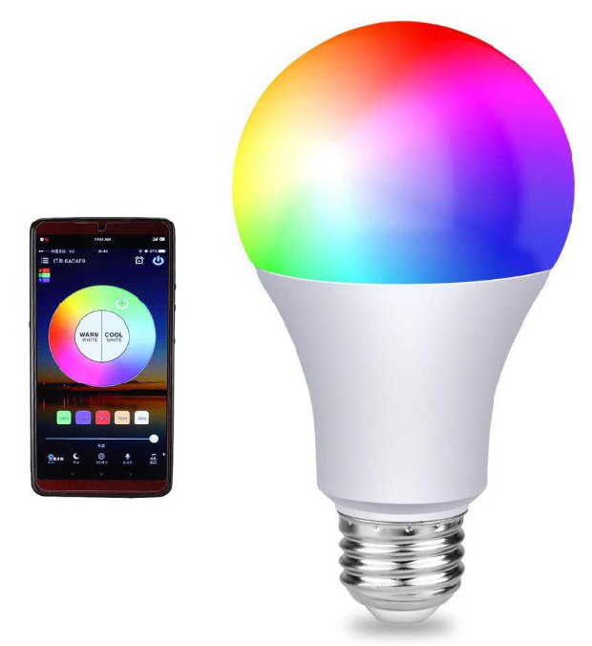
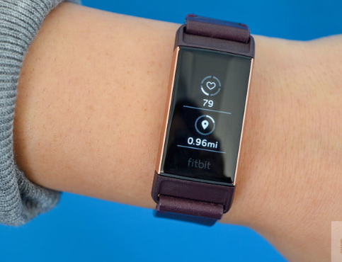
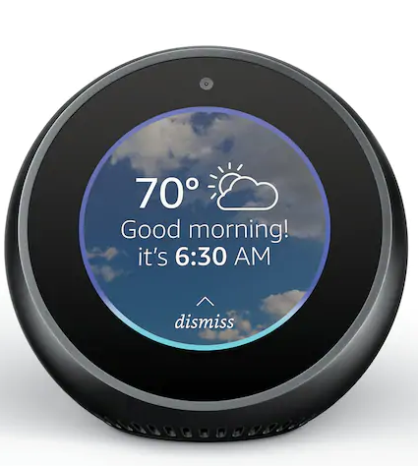
Home IoT Device Security
43% IoT growth
Wide variety of devices
Functionality
Capability
Lack of standard security methods
Notes:
1 minute: importance of the problem and the impact of the technology you are proposing – layman's terms only

Slide 3
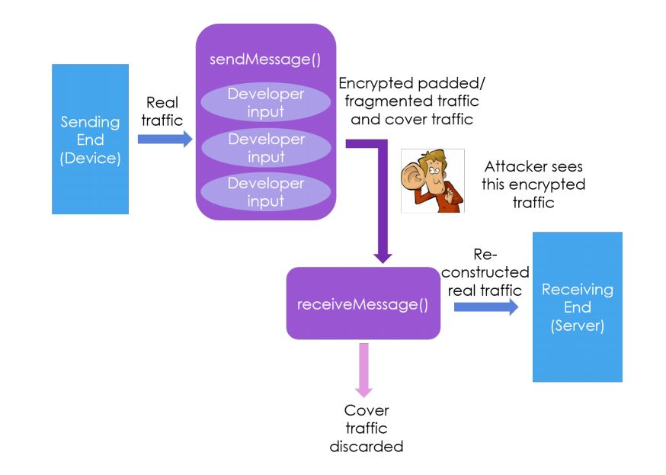
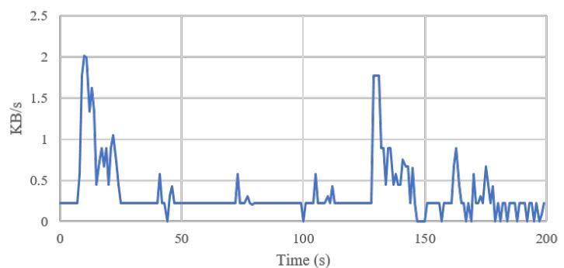
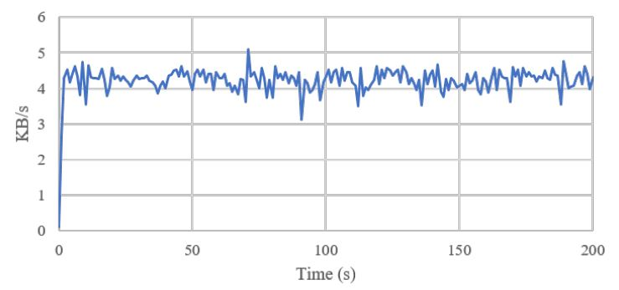
Traffic Obfuscation
No one's home – time to break in!
?????????
ILP
Before
After
Source: "A Developer-Friendly Library for Smart Home IoT
Privacy-Preserving Traffic Obfuscation", Datta et. al, 2018
Notes:
2 minutes: list 3 most challenging aspects of your proposed solutions and how you overcome these challenges – can be technical
You can have up to 3 slides.

Slide 4
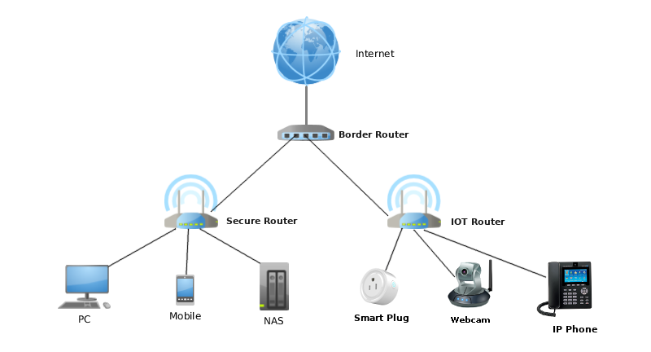
Router
Operates with software that runs on a router
Database with lists of bad IP addresses
Users can operate on different mode (advanced/ normal)
Anon. 2018. Beyond Three Dumb Routers. (August 2018). Retrieved December 3, 2019 from https://www.pcwrt.com/2018/06/beyond-three-dumb-routers/
Notes:
2 minutes: list 3 most challenging aspects of your proposed solutions and how you overcome these challenges – can be technical
You can have up to 3 slides.

Slide 5
z
Conclusion
Wide variety of devices with no security standards
Isolate devices onto a secure network via a centralized router
Notes:
0.5 minute: recap your contribution and emphasize your contributions– layman's terms only

