Slide 1
The Difficulty in Testing IOT Security
Joshua Mulliken - joshuasm@email.sc.edu
Nicholas Leonhardt - leonhan@cec.sc.edu
Pranav Minasandram - PranavM@email.sc.edu
Hardik Anand - hanand@email.sc.edu
Jake Bukuts - jbukuts@email.sc.edu
Jeremy Duncan - duncanjj@email.sc.edu
Talin Arya - tarya@email.sc.edu

Slide 2
Credentials
Current education status
Senior Computer Science/Computer Information Systems students
Professional experience
Several internships in Cybersecurity
Multiple internships in Software Engineering
Extra curriculars
Cyber security club members
ACM club members

Slide 3
Importance
Privacy / Safety
Very personal information is held within many of these devices
Losing control of smart devices can cause personal harm
If an attacker gained access to a smart door lock they could easily break into a home
If an attacker gained access to a camera they could spy on users
Customer satisfaction
Customers want their products to work as advertised
Customer dissatisfaction pushes customers toward the competition

Slide 4
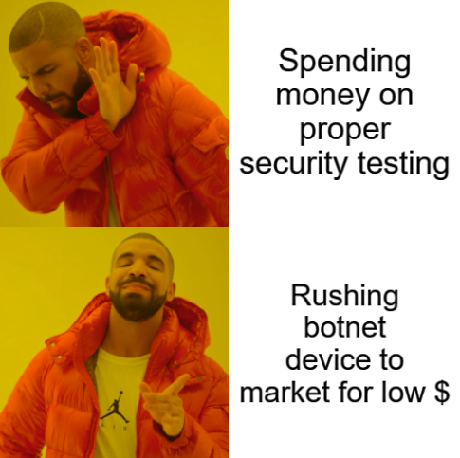
Main Limitations
Manufacturer Implementation
Cost might dissuade some manufacturers from implementing any security testing
“Security by Obscurity,” though weak, is often used as a cheap substitute for more secure practices
Patching difficulty may lead to many devices not being updated
Diversity of Devices
The needs of security on all devices is different making it hard to create standardized guidelines
Increase in open source methodologies and designs might remove this

Slide 5
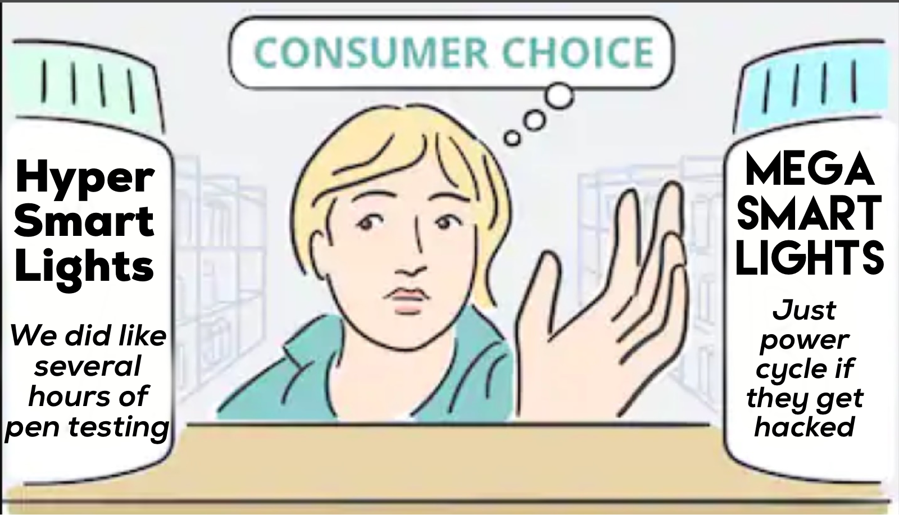
Main Limitations (cont.)
Lack of Standards
There is no accepted standard to test and rank IoT device security.
Most devices carry untested promises of security in the absence of any real standard.
“Military grade encryption”

Slide 6
Main Contributions
Testing Toolkit:
Sharing of open source testing methodologies via an open forum in the same manner as the OWASP project.
Sharing of open source hardware designs for creating testing tools.
Sharing of open source software tools to test devices.
Education Platform for Teaching Proper IoT Hygiene
Educational wiki for end users with basic security guides
Setting secure passwords, Disabling UPnP and segmenting network, etc.
Notification service for commonly used devices to alert for availability of new patches
Password vulnerability and data breach notification service

Slide 7
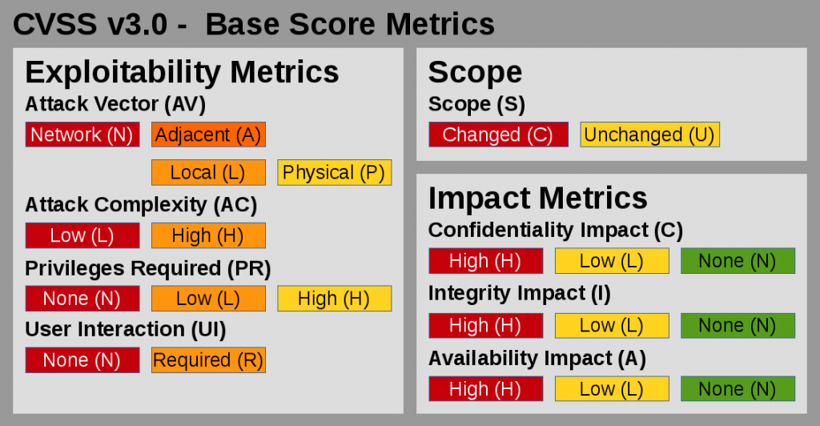
Main Contributions (cont.)
Standardized Ranking:
Use CVSS v3 to rank specific vulnerabilities.
Rank attack surface by number of exposed services and enumerable APIs.

Slide 8
Conclusions/Future Work
Main conclusions
It is difficult but not impossible to test security in IoT devices
Future work
Expansion of methodologies and increased coverage for a variety of devices and protocols
Researching practices for ranking/understanding risk in the IoT space
Develop communication tools that assist security professionals in working with company leadership

Slide 9
Questions?

