Slide 1
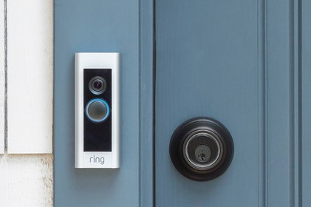
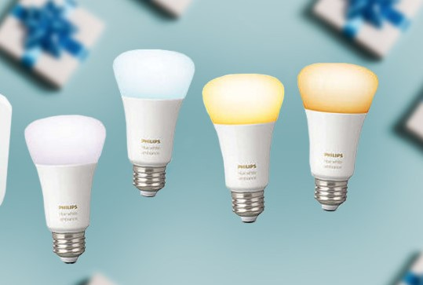
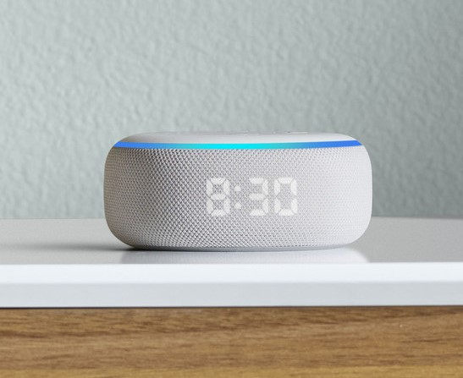
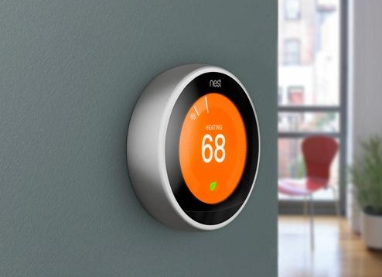
Improving Privacy in Smart Home Device Networks with Privacy Education and Awareness
Zari Case zkcase@email.sc.edu
Garrett Erven gerven@email.sc.edu
Kevin Hagan kmhagan@email.sc.edu
Geniese James gjames@email.sc.edu
Olivia Monty omonty@email.sc.edu
Sierra Stewart sierrais@email.sc.edu
Donyelle Wallace dw15@email.sc.edu
Notes:
0.5 minute: Security problem and your credentials to solve the problem – layman's terms only

Slide 2
Internet of Things & Big Data
Much of the personal data collected by smart home devices you own is stored on devices you don’t own.
Some examples of smart home devices that collect, store, and share your personal data:
Notes:
1 minute: importance of the problem and the impact of the technology you are proposing – layman's terms only
Smart devices are becoming a huge part of everyday life, and large amounts of data being stored by these devices is a direct result of this. A lot of the data being taken is private and sensitive. Current technology and data regulations have made it difficult for people like us to know what happens with our data when it is recorded by our devices or even how long manufacturers can have it.

Slide 3
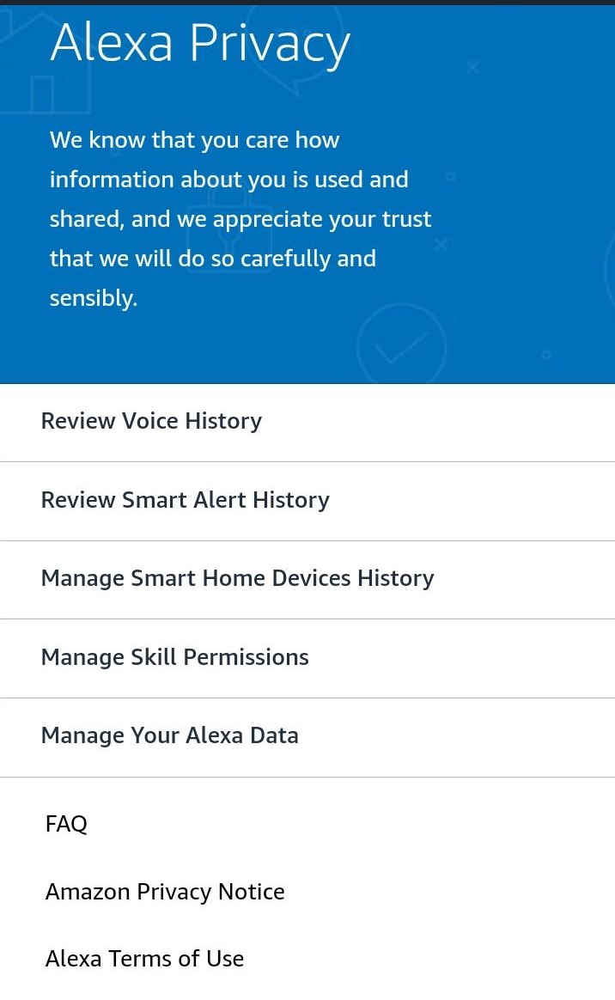
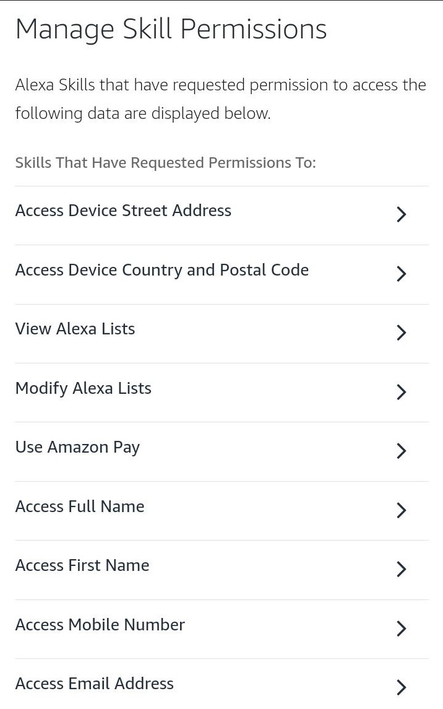
Challenge: Privacy Setting Configuration
Solution: Use a standard privacy profile system to establish user privacy setting preferences upon device setup which remain consistent across all devices the user owns.
Most Private Configuration
Least Custom
Experience
P1
P2
P3
Most Custom Experience
Least Private Configuration
A standard privacy profile system would be dramatically easier to use than searching and scrolling through a giant list of privacy settings on every device.
(Courtesy of the Amazon Alexa app for Android)
Notes:
2 minutes: list 3 most challenging aspects of your proposed solutions and how you overcome these challenges – can be technical
You can have up to 3 slides.

Slide 4
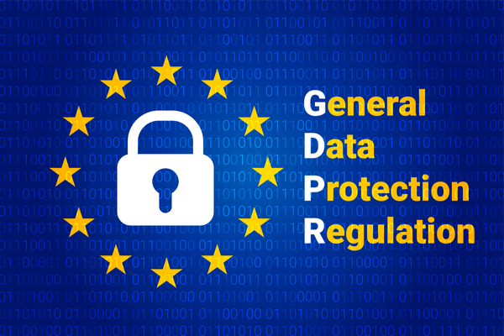
Challenge: Opt-In Vs. Opt-Out Policy
Opt-In: Users begin opted-out from all services by default and can opt-in to services as they desire.
Opt-Out: Users begin opted-in to all services by default and can manually opt-out of services as they desire.

Slide 5
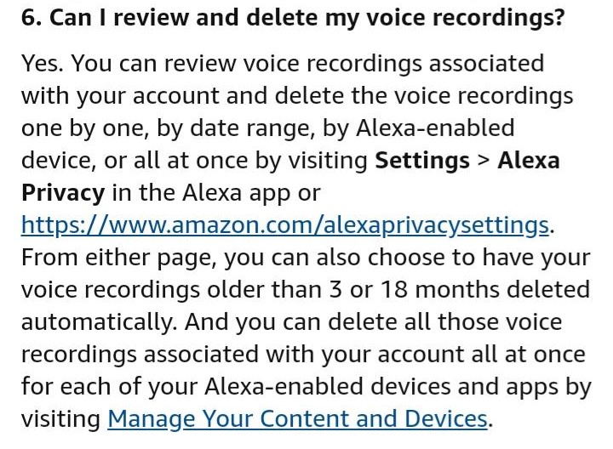
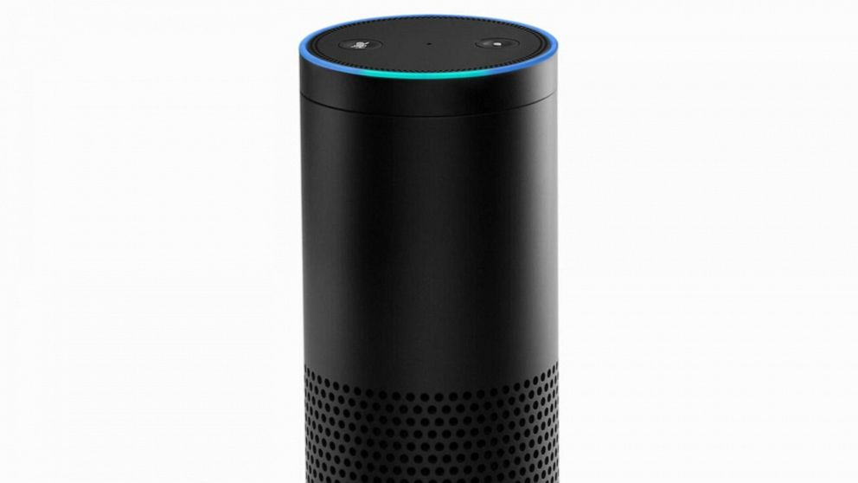
Challenge: Data Storage & Retention
Solution: Setting expiration dates for stored stored. For example, collected data has a lifetime of 45 days after which it is permanently deleted.
(Courtesy of the Amazon Alexa app for Android)

Slide 6
End-User License Agreement
We suggest a standard EULA (End-User License Agreement) for smart home devices that requires at minimum standard privacy profile configurations, an opt-in policy, and a data storage expiration policy. This solution will dramatically increase the transparency of how companies collect, store, and use data as well as raise awareness and educate users on the importance of privacy.
Notes:
0.5 minute: recap your contribution and emphasize your contributions– layman's terms only

