Slide 1
Privacy for Smart Devices
Miguel Zambrano - miguelz@email.sc.edu, Victor Botteicher - victorjb@email.sc.edu, Wade Morgan - wpmorgan@email.sc.edu, Brett Noltkamper - brettn@email.sc.edu, Everett Bishop - eabishop@email.sc.edu William Simmons - wsimmons@email.sc.edu
Chase O’Connor - chasero@email.sc.edu
Notes:
0.5 minute: Security problem and your credentials to solve the problem – layman's terms only

Slide 2
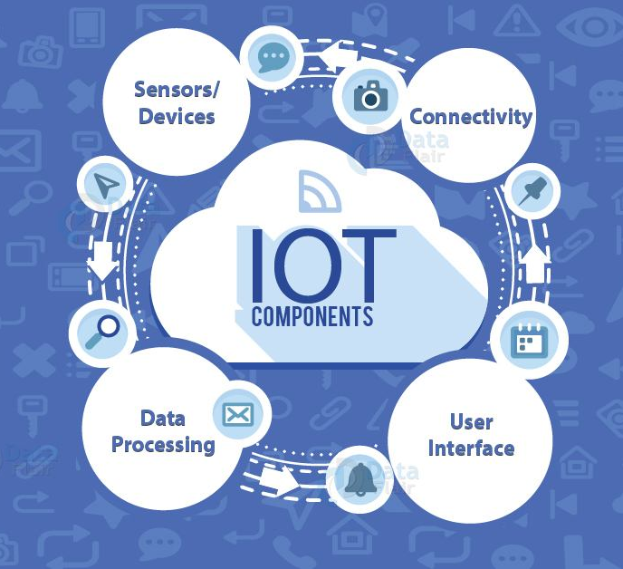
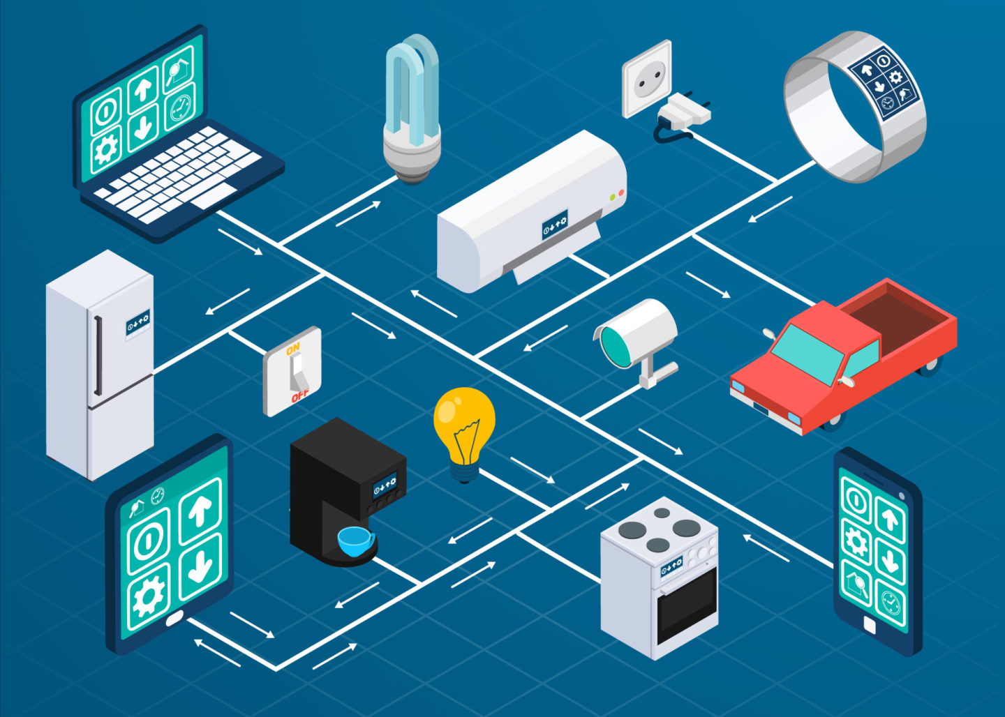
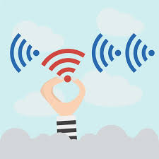
Privacy for Smart Devices
Internet
Interconnected devices
Data recorded and transferred over the internet
Third Parties
Includes: smartphones, laptops, tablets, smart watches, car infotainment systems, smart kitchen and house appliances, etc.
User Data
Unsecure data can be eavesdropped or manipulated by hackers or 3rd party services and companies
Notes:
1 minute: importance of the problem and the impact of the technology you are proposing – layman's terms only

Slide 3
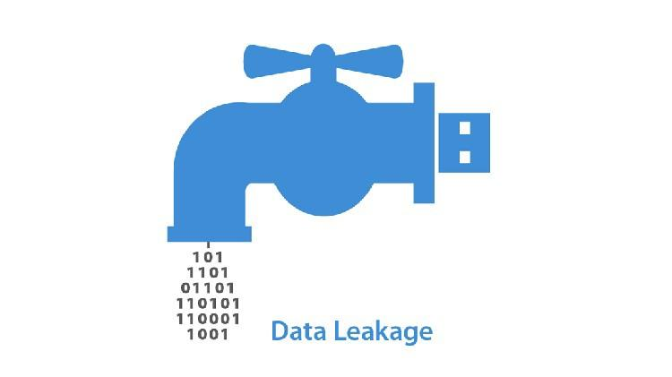
Data Leakage
Smart medical devices
Cleartext information easily compromised
Lacking awareness/funds/regulations
Encryption must be a requirement
Proposed Solution
Allocate funds within hospital budgets for patient data encryption from smart device to smart device
A secure system regulating all patient data flowing from smart devices on a hospitals medical network, only allowing authorized personnel to view sensitive info.
Notes:
Challenge #1 and proposed Solution
Data Leakage - specifically in smart medical devices
Some, though not all, smart medical devices transmit patient data in cleartext
The problem is there is not enough awareness/funds/regulations on transmitting patient info via smart medical devices.

Slide 4
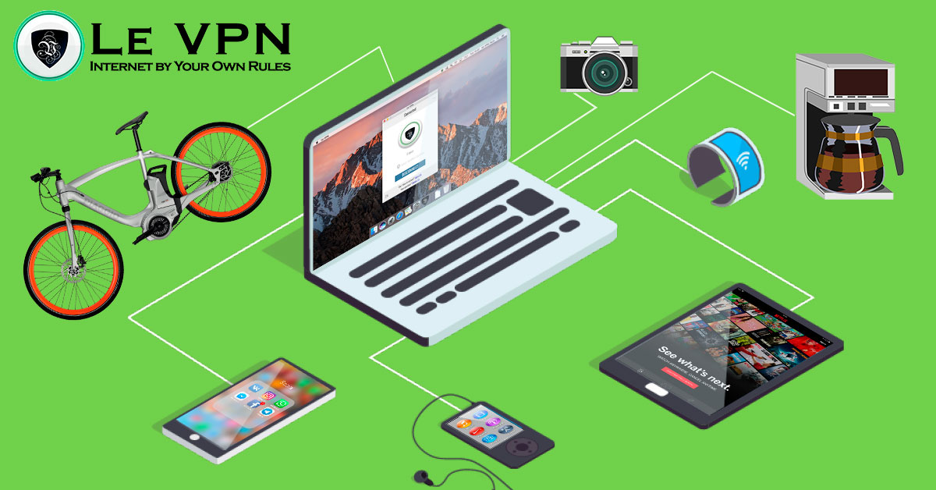
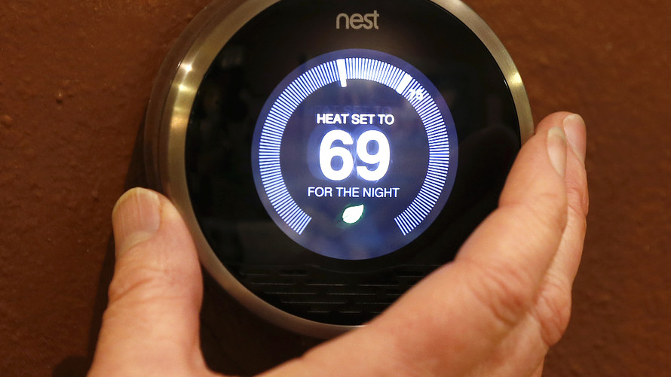
Compromised Access
Problems:
Preventing user access
Obtaining functionality/control of smart device(s)
Interrupting user commands
Solutions:
Make sure software on devices is regularly updated
Stronger user authentication
Securing endpoints of IoT network connections
Notes:
Preventing users from utilizing their own devices; Accessing speakers, microphones, cameras, thermostat, smart toaster to start fire… etc. Story about nest hack; Disrupting connection of user commands to device.

Slide 5
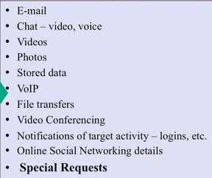
Data Exploitation
Both data leakage and compromised access can lead to exploitation of data
Third parties can acquire user data and:
Compile a profile of users’ metadata
Deliver specific ads that fit users interests
Share or sell information with additional third parties
Unfortunately privacy is somewhat nonexistent
NSA Mass Surveillance Programs (Ex: Prism)
Proposed Solution:
Universal software for smart devices to monitor/shut off the different channels that are sending/receiving data
Notes:
Challenge #3 and proposed solution -can be technical

Slide 6
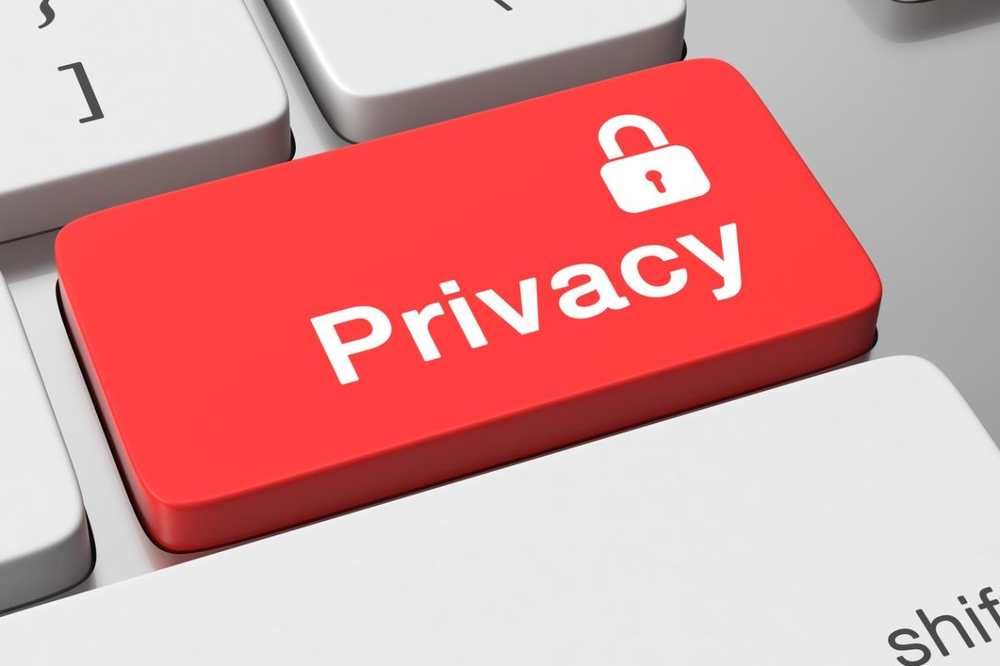
Recap
Largely connection based
Bluetooth, wireled, wireless
Currently --
52% of companies cannot detect if one of their IoT devices has suffered a breach
34% suggest that collecting large amounts of IoT data is an obstacle to security
Major Problems:
Data Leakage
Soln-- Allocate budget for better data encryption between devices
Compromised Access
Soln-- Focused on constant software updates and stronger authentication methods
Data Exploitation
Soln-- Universal software to manage different channels for transfering data
Notes:
0.5 minute: recap your contribution and emphasize your contributions– layman's terms only

