Slide 1
IoT Malware Detection Addressing Resource Optimization
Nathan Pavlovsky: pavlovsn@email.sc.edu
Conor Babin: cbabin@email.sc.edu
Thahimum Hassan: thassan@email.sc.edu
Brandon Ryder: bryder@email.sc.edu
Steven Edwards: stevenge@email.sc.edu
Luke Imholz: limholz@email.sc.edu
Notes:
CREDENTIALS: All of us have been studying the current state of IoT security for the past 1.5 months and previously had a large interest in security before taking this class.
An ever-growing range of internet-connected appliances are becoming widely used. This has led to a proliferation of malware targeting IoT devices and the increasing need to detect them. However, IoT devices have limited memory and power, making balancing detection algorithms’ efficiency, accuracy, and resource usage a significant issue

Slide 2
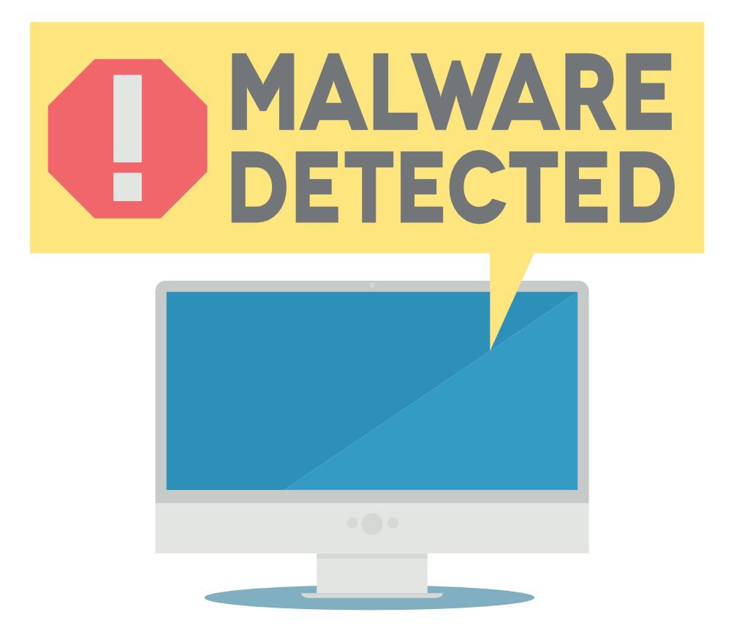
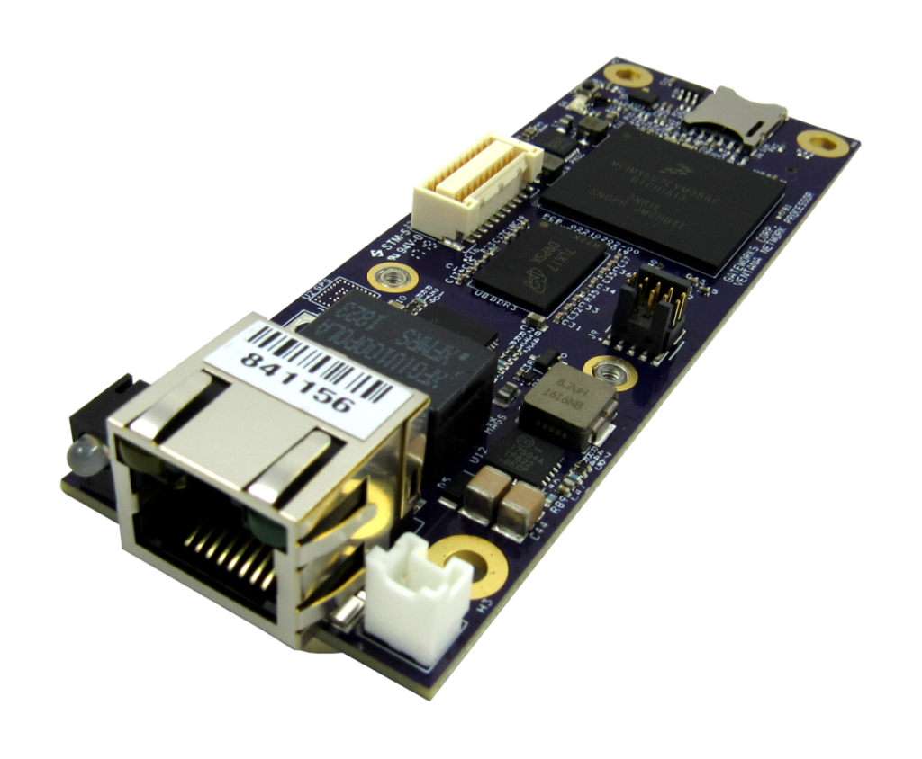
Addressing the problem
IoT devices have limited memory and power, making balancing malware detection algorithms’ efficiency, accuracy, and resource usage a significant issue.
Notes:
Their expansion, along with the fact that many manufacturers are rushing to roll out new products quickly, at the expense of integrating and testing proper security measures, has led to an explosion of malware targeting them. This along with the limited computing resources of many IoT devices leaves an opening for malware vulnerabilities

Slide 3
Challenging Aspect: Internet Connectivity
Overcoming Connectivity Issues
Malware detection systems that require internet connectivity faces the issue of failure without internet. This impedes the usage of a centralized cloud-based algorithm for continuous detection process.
One Time Classifier
Resolved by using a one-time classifier that only needs to update when server connectivity is available
We propose a CNN neural network classifier; is trained on binaries that are converted to gray-scale images
Notes:
The cloud server is used to train a neural network model using a list of known malicious packages. The server then broadcasts a one-time classifier to all listening IoT devices to use as a detection strategy. This allows the IoT devices to use a lightweight static detection strategy that can be updated by the server as new information is obtained.

Slide 4
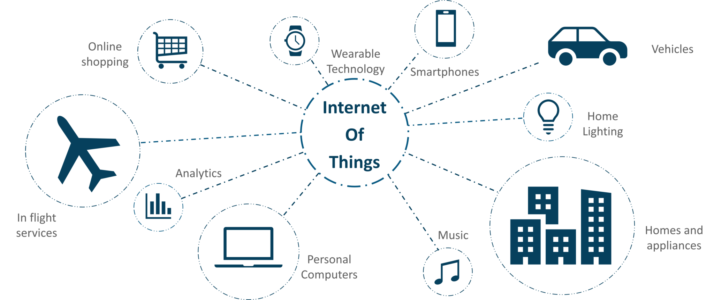
Challenging Aspect: Heterogeneous OSes
Problem: large fragmentation of the IoT market among different operating systems and hardware configurations
Security Interpreter (SECI)
Creates a lightweight virtual environment on machines
Limited architecture
Little memory & power used
For most important OSes
Notes:
To address the fragmentation and memory constraint issues, researchers proposed a security interpreter (SECI). It creates a lightweight virtual environment on devices with a limited instruction set architecture. It would use relatively little memory and computing resources and could be distributed throughout an IoT network to act as a uniform intrusion detection system. SECI will be used to create a standard virtual operating system that would allow every device to run the same detection sotware.

Slide 5
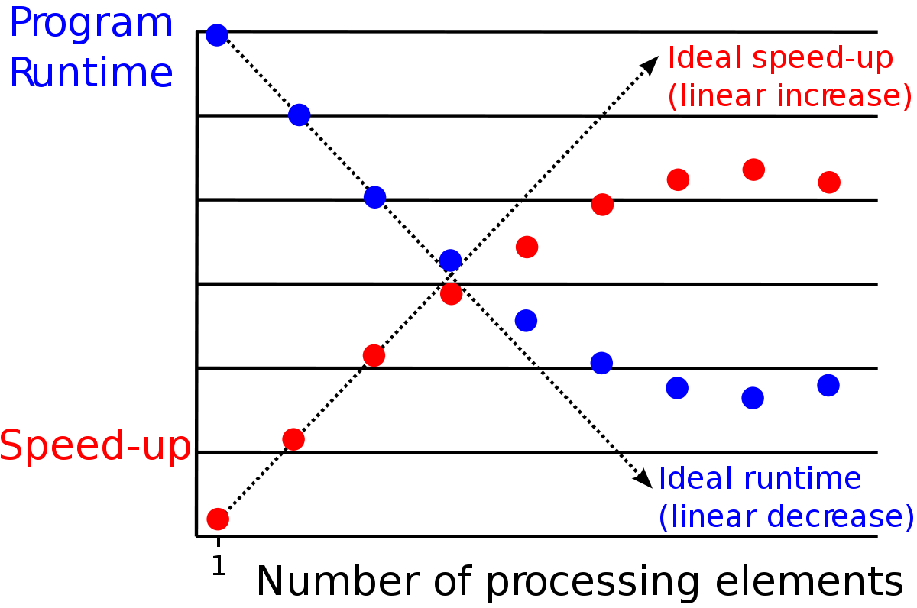
Challenging Aspect:
Limited Memory and Processing Power
Main training of classifier is offloaded to the server.
Harnessing GPU processing power and parallelization techniques will help power classifier execution on end hosts
Limited computational resources restricts IoT devices from using resources for the purpose of malware detection.
Notes:
Using parallelization techniques to divide the work between the CPU and GPU would harness the GPU’s power, increase processing speed, and consume less energy overall. During testing on a mobile device, GPU parallelization was found to have a 19% gain in performance and run three times faster than the original serial version. It should be noted that many devices don’t have any graphical interfaces and thus no GPU. Therefore, our proposal necessitates checking upon SECI execution for a GPU and determining if parallel processing is viable before taking any such measures

Slide 6
Conclusion and Future Work
It is estimated that this approach can result in an affordable, robust, scalable, and commercially-viable product for market deployment in two years.
Further work can be done to determine if it is sufficient to train one overall malware-detection model or if multiple models for different malware families need to be trained.
GOAL: maintain at least 95% detection accuracy
Notes:
Our solutions success will be evaluated in several ways. The first is that the product and any updated classifiers will be tested extensively on an extensive database of known malware in a lab environment before release. The tests will give a preliminary detection rate, which will be used to determine whether the system is ready for release. The goal is to have an effective detection rate of at least 95%

