Slide 1
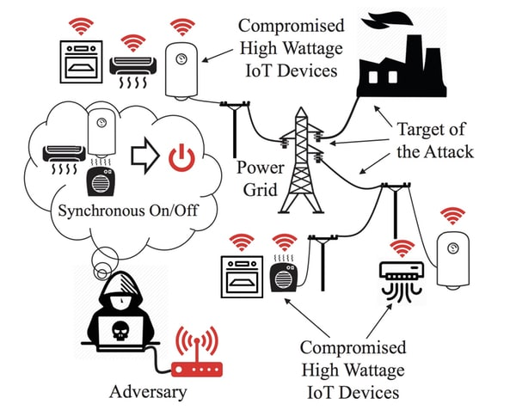
Analysis of IoT Botnet Attack Models
Ryder Henderson - ryderh@email.sc.edu
Noah Shaw - ncshaw@email.sc.edu
Jack Stemper - jstemper@email.sc.edu
Jahred Danker - jdanker@email.sc.edu
Edward Perreyclear - perreyce@email.sc.edu
Joseph O’Neill - jtoneill@email.sc.edu
Luke Whittle - whittlel@email.sc.edu
Notes:
Need to talk about your credentials to solve this problem (or someone else’s in the group) - layman’s terms only

Slide 2
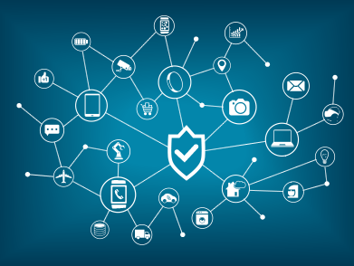
Importance of the Botnet Problem
IoT Botnet Attack Models
Spreads quickly
Billions of IoT devices to compromise
Consumers do not think that IoT devices need to be secured
Challenging to stop once it begins spreading
What kind of vulnerabilities do all IoT attack models exploit?
Default logins and passwords
If 1 device was unprotected on a network, there are likely many others
1 device’s vulnerability leads to the entire IoT network being compromised
Known vulnerabilities that should have been patched
Notes:
Keep it in layman’s terms only

Slide 3
Challenges
Enforcement through Consistent Regulation of IoT Vendors
Hold Vendors to a standard or ethical code
Supply consumers with a way to know if a certain vendor follows certain guidelines or not
This will force vendors into following standards or lose business
Requires an organization to enforce guidelines
Consumers that are Technologically Illiterate
Up-to-date and detailed user manuals included with every device, especially ones that don’t have user interfaces
Step-by-step setup process for devices that have user interfaces
Produce devices that do not require technology literacy
Have technologically literate workers install larger products like smart fridges
Consumers lack of device updating
Force internet connected devices to be updated before allowing online smart use
Example: Playstation system updates: can’t log in online without updating system
Notes:
This can get technical

Slide 4
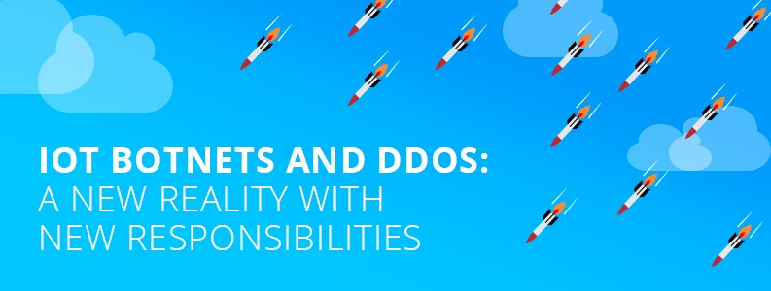
Our Feasible Solutions
Required Change of Factory Default Password During Onboarding
Regular Firmware and Security Updates for Existing IoT Devices

Slide 5
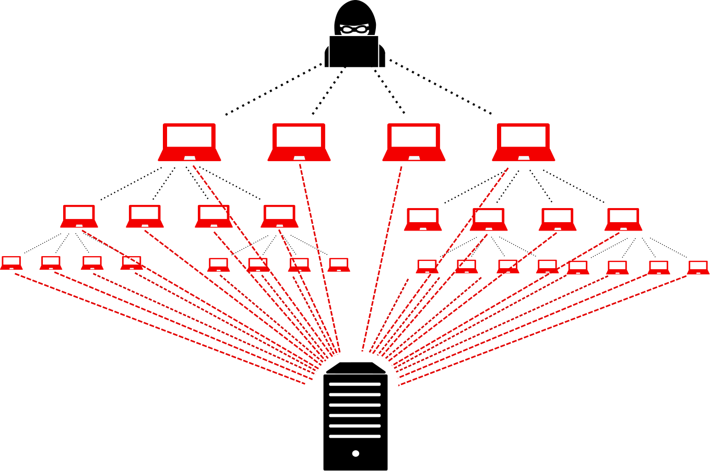
Conclusion
Impact of our solution:
Simple
Easy to implement
Cost-effective
No major changes to the current manufacturing process
Keeps up with the fast growing rate of technology
Doesn’t leave it to the consumer to hopefully implement security for their devices
Overall, botnets are a very dangerous threat model with the increasing number of IOT devices that will come online over the next few years. These botnets could cause serious problems, so we need to look into doing something about it now.
Notes:
Our unique proposed solution to solve the IoT botnet issue. Aka our best solution

