Slide 1
User Authentication for Smart Home Devices
Kristina Matthews – kkm1@email.sc.edu
Chaz Servance – Chaz@email.sc.edu
Matt Zaleski – mzaleski@email.sc.edu
James Milton – jmilton@email.sc.edu
Halee Aiken – haiken@email.sc.edu
Jack Primiani – Primiani@email.sc.edu
Nicholas Gause – ngause@email.sc.edu
Notes:
0.5 minute: Security problem and your credentials (computer science students, own these devices, familiar with their vulnerabilities) to solve the problem – layman's terms only

Slide 2
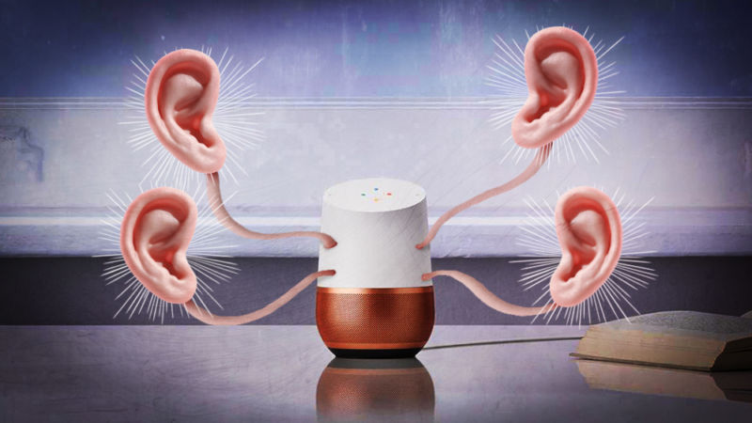
Problem
With current technology, anyone/any other device in the vicinity can control the smart speaker
https://arstechnica.com/author/aurich-lawson/
Notes:
1 minute: importance of the problem and the impact of the technology you are proposing – layman's terms only
//problem: anyone/other devices can make commands to alexa - privacy and security concern

Slide 3
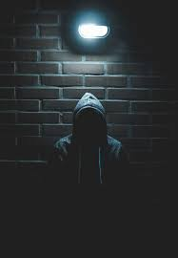
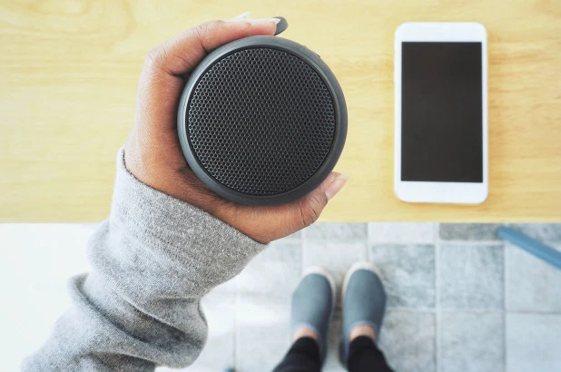
Challenges
Protection against both physical unauthorized users and devices controlled by remote users
https://unsplash.com/s/photos/criminal
https://nypost.com/2019/11/15/bluetooth-devices-can-be-hacked-due-to-design-flaw-study/
Notes:
2 minutes: list 3 most challenging aspects of your proposed solutions and how you overcome these challenges – can be technical
You can have up to 3 slides.
sources : https://www.google.com/url?sa=i&source=images&cd=&ved=2ahUKEwiJrauGz5jmAhVCZN8KHY9xBD0QjRx6BAgBEAQ&url=https%3A%2F%2Fwww.channelfutures.com%2Fsecurity%2Fis-it-time-to-invest-in-a-password-manager&psig=AOvVaw1KS0Imoc15aYuHq7GkZivw&ust=1575432841977247
https://www.google.com/url?sa=i&source=images&cd=&cad=rja&uact=8&ved=2ahUKEwia2d_Uz5jmAhUSnOAKHaAsBFwQjRx6BAgBEAQ&url=%2Furl%3Fsa%3Di%26source%3Dimages%26cd%3D%26ved%3D%26url%3Dhttps%253A%252F%252Fwww.wired.com%252F2015%252F09%252Fopm-now-admits-5-6m-feds-fingerprints-stolen-hackers%252F%26psig%3DAOvVaw1_eUvXroGM0wdiLiRAAcn8%26ust%3D1575433063480734&psig=AOvVaw1_eUvXroGM0wdiLiRAAcn8&ust=1575433063480734
https://www.google.com/url?sa=i&source=images&cd=&ved=2ahUKEwi026jfz5jmAhVnn-AKHXeFAjUQjRx6BAgBEAQ&url=https%3A%2F%2Fphys.org%2Fnews%2F2015-12-graphene-wearable-devices.html&psig=AOvVaw0o619xLQs9R529iIX2-sRy&ust=1575433087811072

Slide 4
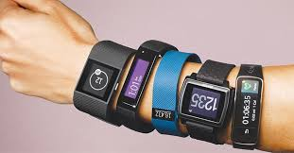
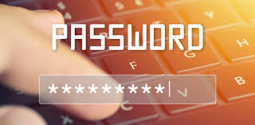
Challenges
One single form of authentication is not enough
Tradeoff between convenience and security
https://www.channelfutures.com/security/is-it-time-to-invest-in-a-password-manager
https://www.business-standard.com/article/technology/get-over-fitness-tracking-wearable-devices-may-soon-forecast-sickness-118102300231_1.html
https://www.daon.com/biometrics/voice

Slide 5
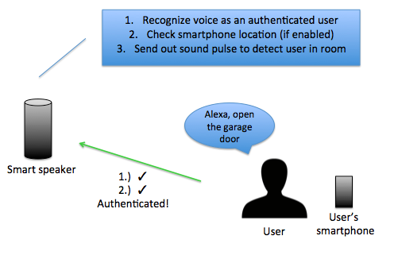
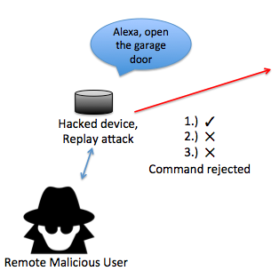
Proposed Technology to Overcome Challenges: Multifactor Authentication
http://clipart-library.com
Notes:
Voice authentication: requires training after purchase of device
Geofencing: smartphone location, similar to some smart thermostats
Sonar based technology: uses machine learning and feature selection to distinguish between user presence and absence (requires training at beginning)

Slide 6
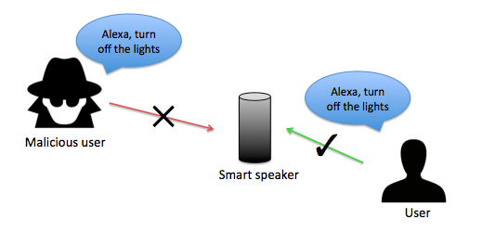
Conclusion
Our technology plans to:
Eliminate the numerous security risks posed by smart devices
Do so in a way that is convenient for the user
http://clipart-library.com
Notes:
0.5 minute: recap your contribution and emphasize your contributions– layman's terms only
Future plans :
Look to have 100% success rate on authentication
Look to improve upon the shortcomings of our current technology.

