Slide 1
Diagnosing Agrosilvopastoral practices using Bayesian Networks
Alireza Nasiri
CSCE 582
Spring 2016

Slide 2
Agrosilvopastoral Systems (ASP)
Relating to agriculture that features crops, forestry and the pasturage of animals
Previous works tended to use categorical regression models focusing on a single technology or practice

Slide 3
Previous Studies
Farmer characteristics like family income, farm size, education and age
Historical increase in tree domestication because of declining supply of tree resources, increased subsistence and commercial demand for tree products (Scherr 1995)
Adopting soil conservation technologies in the initial stages because of non-economic variables like perception of soil erosion problem, but in later stages the main reason is economic factors (Garcia 2001)

Slide 4
Previous Studies (contd.)
Adoption of live hedges and traditional practices utilized to protect home gardens from animals (Ayuk 1997)
Adoption of water and soil conservation methods and level of information on the head of rural households and some household socio-economic factors (Berthe et al. 1999)

Slide 5
Previous Studies (contd.)
Factors affecting adoption and non-adoption of live fences in the Segou region, Mali. (Levasseur et al. 2009). the key factors determining non-adoption of live fences:
  Insecure land ownership
  Lack of sufficient labor
  Resource-poor nature of the households

Slide 6
The Difference
Dominant modelling approach has been regression-based logit model with a single practice as a dependent variable
In this study: modelling adoption of multiple ASP technologies, using Bayesian networks

Slide 7
In this paper
Use of BNs on ASP adoption for tactical employment(decision support models account for repeated observations and are good for short-term predictions) in both a deductive (scenario) and inductive (diagnostic) sense
Deductive: to answer questions regarding the probability of implementation of practices
Inductive: to identify potential participants

Slide 8
Study Area & Data
39 villages located in the Dioro and Farakou Massa rural communes in Segou region hosting more than 70000 people
8 research villages designated for data collection to document progress in achieving the Millennium Development Goals
3 focus groups were identified: crop growers, pastoralists and women
ASP practices: Food banks, Protective live fences, Boundary live fences, Village woodlots, Family woodlots

Slide 9
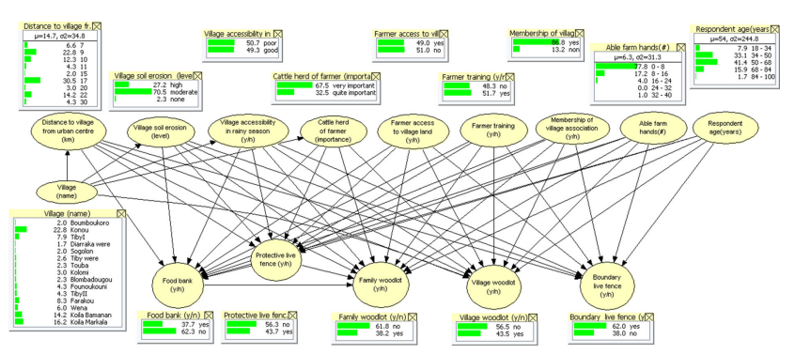
The BN

Slide 10
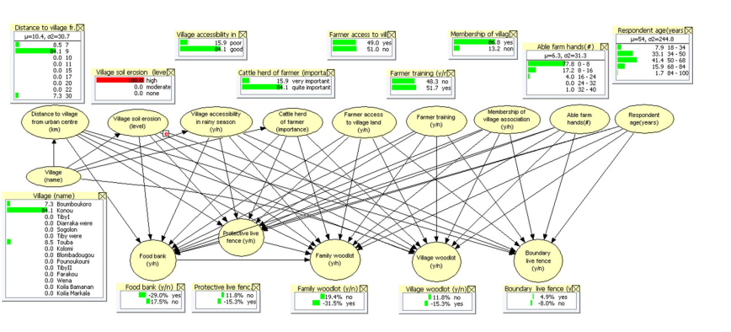
The BN – Deductive Reasoning

Slide 11
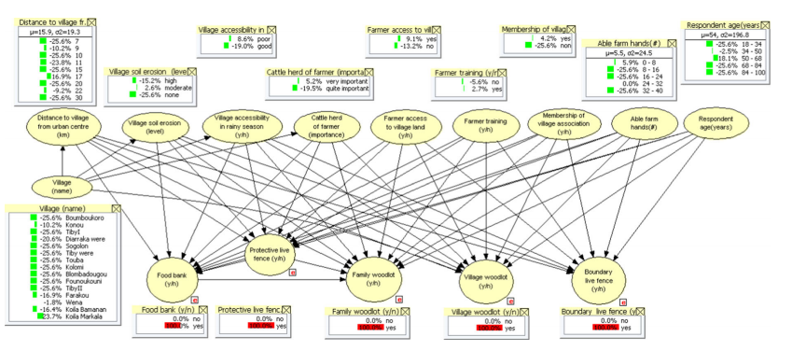
The BN – Inductive Analysis

Slide 12
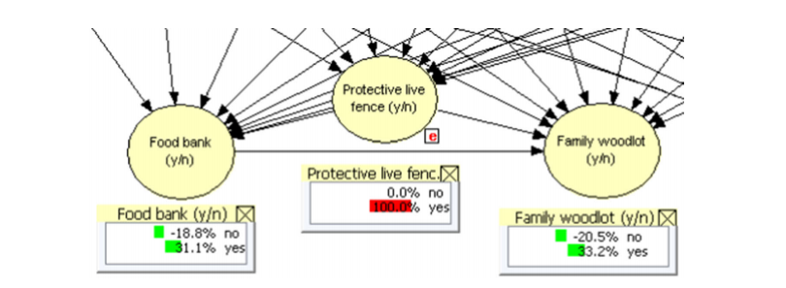
The BN - Correlation

Slide 13
Discussion - Findings
households adopting practices are more likely to live in villages with somewhat degraded soils
household access to land is the factor most likely to increase adoption rates
households with relatively few working hands in the household are more likely to adopt all conservation practices
Practices condition one another

Slide 14
Discussion – BN vs. Logistic Regression
BNs’ graphical user inter-face (GUI) provides assistance to the modeller in evaluating network structure
BN’s other advantage is the possibility to deﬁne hierarchical structural models with explicit hypotheses about the direction of causality (ex. Village location determines farm characteristics which in turn determine adoption probabilities)
BNs allow for explicit correlation between explanatory variables, whereas a logit regression assumes independence of explanatory variables
Once a BN has been implemented, it can be used ‘live’

Slide 15
Conclusion
BNs allow non-parametric modelling of
  Multiple practices implemented jointly in farms
  Correlation between the probability of implementing of those practices
  Correlation between household and farm characteristics
BNs can be used for deductive ‘what-if’ reasoning
BNs can also be used inductively to answer questions regarding the types of households that are most likely to adopt speciﬁc practices or combinations of practices

Slide 16
Questions?

