Slide 1
Envisioning Uncertainty in Geospatial Information
Kathryn Laskey
Edward J. Wright
Paulo C.G Da Costa
Presented by Michael Helms and Hanin Omar for CSCE 582, Spring 2012
Kathryn Blackmond Laskey, Edward J. Wright, Paulo C.G. da Costa, "Envisioning uncertainty in geospatial information,” International Journal of Approximate Reasoning, Volume 51, Issue 2, January 2010, Pages 209-223, ISSN 0888-613X, 10.1016/j.ijar.2009.05.011.
(http://www.sciencedirect.com/science/article/pii/S0888613X0900098X)
Notes:
Michael Helms and Hanin Omar, April 19, 2012:
Kathryn Blackmond Laskey, Edward J. Wright, Paulo C.G. da Costa,
"Envisioning uncertainty in geospatial information,"
<i>International Journal of Approximate Reasoning</i>,
Volume 51, Issue 2, January 2010, Pages 209-223,
ISSN 0888-613X, 10.1016/j.ijar.2009.05.011.
(http://www.sciencedirect.com/science/article/pii/S0888613X0900098X)

Slide 2
Introduction
In a battlefield, through interactions with the map, the commander and staff collaborate to build a common operating picture which displays the needed information.

Slide 3
The map and overlays are stored in the computer as data structures
They are processed by algorithms that can generate products instantly
And can be sent instantly to relevant consumers anywhere on the Global Information Grid (GIG)(the information processing infrastructure of the United States Department of Defense (DoD)).

Slide 4
Advanced automated geospatial tools (AAGTs) transform commercial geographic information systems (GIS) into useful military services for network-centric operations.

Slide 5
Widespread enthusiasm for AAGTs has created a demand for geospatial data that exceeds the capacity of agencies that produce data.
As a result, geospatial data from a wide variety of sources is being used, often with little regard for quality.

Slide 6
All geospatial data contain errors:
positional error,
feature classification error,
poor resolution
attribute error
data incompleteness
lack of currency
and logical inconsistency

Slide 7
Scientifically-based methodologies are required to:
assess data quality
to represent quality as metadata associated with GIS systems
to propagate it correctly through models for data fusion, data processing and decision support
and to provide end users with an assessment of the implications of uncertainty in the data on decision-making.

Slide 8
Example:
A Bayesian analysis plugin, based on the GeNIe/SMILE1 Bayesian network system, has recently been released for the open-source MapWindowTM GIS system.
Applications of BNs to geospatial reasoning include avalanche risk assessment , locust hazard modeling , watershed management, and military decision support

Slide 9
This paper focuses on improving decisions by representing, propagating through models, and reporting to users the uncertainties in geospatial data.

Slide 10
Cross Country Mobility (CCM)
Evaluates the feasibility and desirability of friendly and enemy courses of action
CCM tactical decision aid predicts the speed that a particular vehicle can travel across a given terrain
Two common types of data used for military GIS:
  Feature data – array of digital vectors
  Elevation Data – array of elevation values

Slide 11
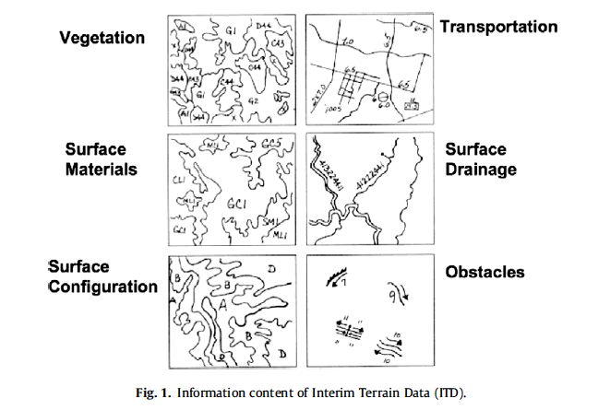

Slide 12
Cross Country Mobility
CCM models typically used by military
CCM models can be generated for specific vehicles, vehicle classes, or military unit types
Many sources of uncertainty in CCM estimates
  Data is imperfect
  Decision making can be improved by considering uncertainty

Slide 13
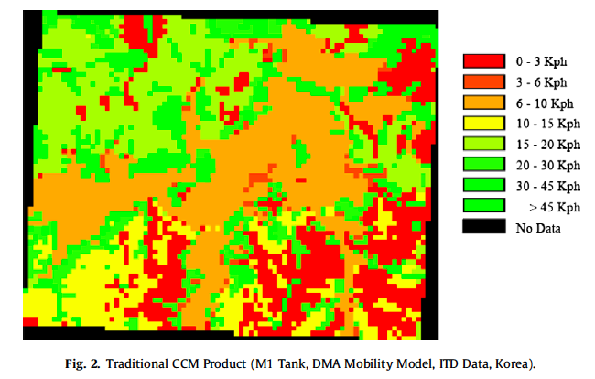

Slide 14
Representing Uncertainty
Data elements in a GIS are imperfect estimates of an uncertain reality
Uncertain data can be represented as a probability distribution across possible states
Consider soil type example:
    Uncertainty of soil type in every geospatial database
    Reported values are imperfect estimates of true soil type

Slide 15
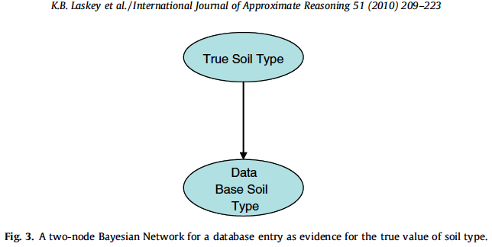
Remember the Pregnancy Test Example?

Slide 16
Representing Uncertainty
To function, this model needs:
  Prior distribution on the soil type
  Conditional Probability Distribution
How can we obtain this information?
Run a classification algorithm on geographical data to obtain an error matrix.

Slide 17
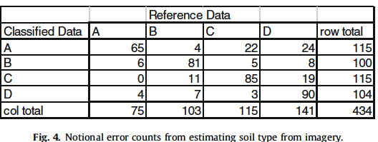
Representing Uncertainty
Reference Data – the true soil type
Classified Data – the estimated soil type

Slide 18
Representing Uncertainty
What if we have two data layers?
Can we extend the previous model?
Should evidence of soil type in one database effect the other database?

Slide 19
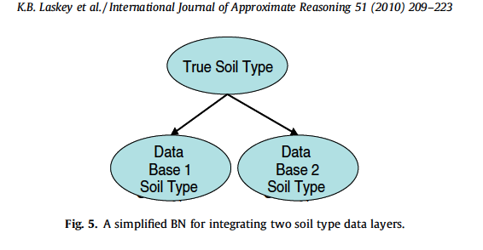
Extended Soil Type Model

Slide 20
Representing Uncertainty
What if we want to convert to a different classification system?
No such thing as “crisp” conversion between classification systems
Need a way to represent the uncertainty in the conversion process

Slide 21
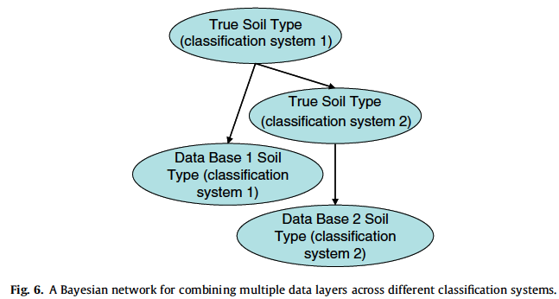

Slide 22
Representing Uncertainty
Military typically uses geographical data estimate effects of the environment on military operations
Geospatial models estimate the effect as a function of one or more geographic variables
The true values of the variables are often unknown
  This results in uncertainty

Slide 23
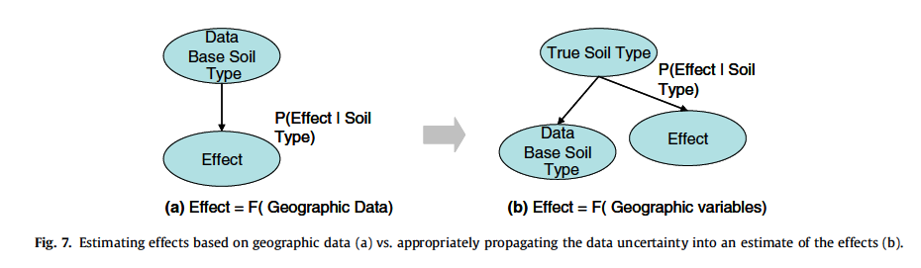

Slide 24
Propagating Uncertainty
Uncertainty in some variables should be propagated to other variables
For example, Soil type might influence what kind of vegetation to expect

Slide 25
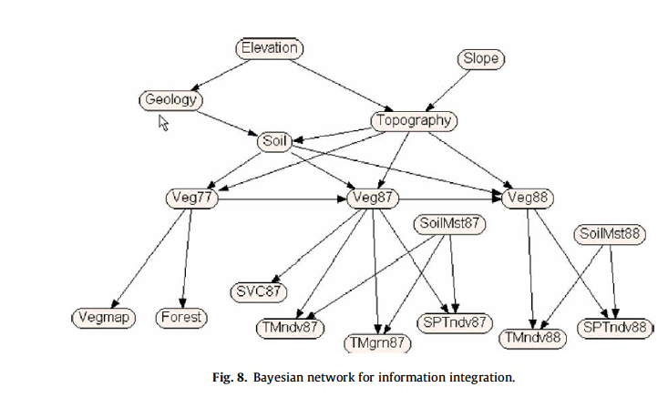
Vegetation Cover Map

Slide 26
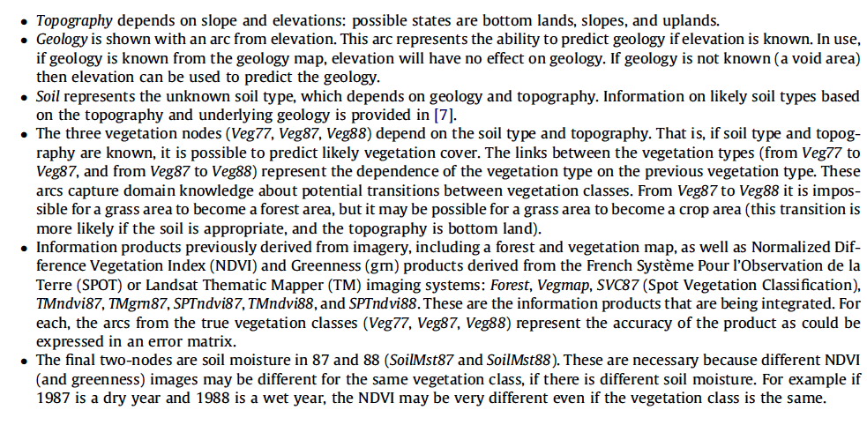

Slide 27
Propagating Uncertainty
The Bayesian Network applies to a single pixel, replicated for each pixel
Custom application was used to apply this BN to each pixel in a geological database
  Today there is a Bayesian plugin to MapWindowTM
Does this work if errors in the pixels are not independent?

Slide 28
Propagating Uncertainty
All information sources, such as geology and topography, must have relevant data quality information
Sources must describe appropriate structure
  Relationships between themes, common image sources
How can we represent this metadata?

Slide 29
Probabilistic Ontologies
Represents types of entities in a domain, attributes of each type of entity, and relationships between entities
Can represent probability distributions, conditional dependencies, and uncertainty
PR-OWL: Ontology that allows representation of relational uncertainty

Slide 30
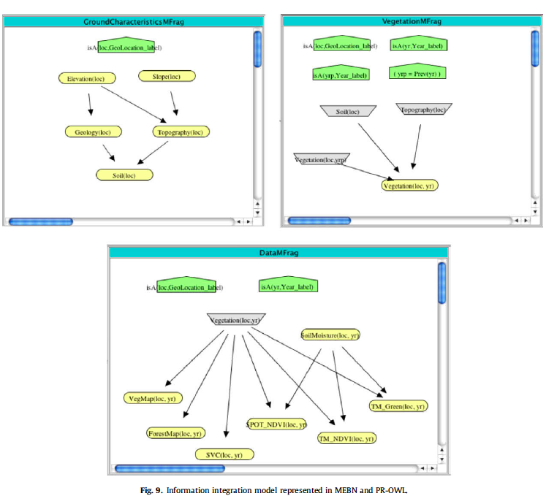

Slide 31
Ontologies
Green Pentagons – context random variables, which represent assumptions under which the distributions are valid
Gray Trapezoids – input random variables, point to random variables whose distributions are defined in other Mfrags
Yellow Ovals – resident random variables

Slide 32
Ontologies
Automated system can store probabilistic knowledge as metadata in a probabilistic ontology
Use a reasoning tool like UNBBayes-MEBN to construct a BN for each pixel
In short, probabilistic ontologies provide means to express complex statistical relationships

Slide 33
Visualizing Uncertainty
Visualization of uncertainty in GIS products is essential to communicating uncertainties to decision makers.
Methods for visualizing uncertainty in geospatial data pose a difficult research challenge. Why?

Slide 34
Examples of uncertainty visualization
The figure below shows a fused vegetation map that displays the results of applying the Bayesian network discussed in the previous section to each pixel.
The display shows color-coded highest probability classifications, and provides the ability to drill down to view the uncertainty associated with the fused estimate.

Slide 35
Fig. 10. Fused Vegetation Map for 1988.

Slide 36
Examples of uncertainty visualization
Lets consider the cross country mobility example :
The CCM display was developed using a traditional CCM algorithm called the ETL algorithm . This simple algorithm has well-known limitations. So why use it?

Slide 37
Fig. 11. ETL Cross-Country Mobility (CCM) model.

Slide 38
If we implement this algorithm as a Bayesian network, and then add additional nodes and arcs to represent the uncertain relationship between the true values of terrain variables and the database values.
The resulting Bayesian network is shown below

Slide 39
Vegetation Stem Spacing
Ground roughness
Soil moisture
Slope
Vegetation Stem Diameter
Soil Type
Soil Strenght

Slide 40
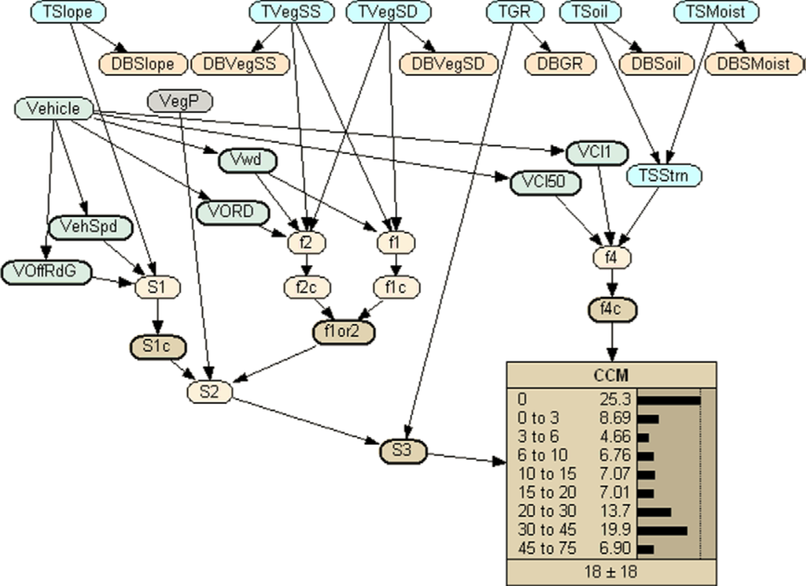
Soil moisture
Slope
Vegetation Stem Spacing
Ground roughness
Soil Type
Vegetation Stem Diameter
Boolean flag

Slide 41
vehicle width
vehicle Cone Index for one pass
and for 50 passes
Override diameter
top speed on level ground
Off road grade ability

Slide 42
can knock
degree
can maneuver
vehicle speed
final result
intermediate variables
modifies S1c by f1or2
larger
modifies S2 by ground roughness

Slide 43
The BN above uses deterministic CPTs to express the mathematical operations of the algorithm:
Database terrain values are accepted as evidence
Uncertainty is propagated through the network to the CCM node.
The result reflects the impact of the uncertainty in the terrain data on the estimated CCM results.

Slide 44
This example demonstrates that transforming a deterministic geospatial algorithm into a Bayesian network is straightforward, provided that the information needed to construct the CPDs is available and is captured as part of the metadata.
Additional modeling is required when required inputs are not available.

Slide 45
The figure below shows a visual display of a CCM product with associated uncertainty.
This display was created by applying the BN of the previous example to each pixel.
CCM uncertainty is shown in two ways:
through the display coloring
interactive histograms that the user can control.

Slide 47
The predicted CCM speed range is coded by color.
The quality of the color represents the quality of the prediction: bright colors represent low uncertainty, and muddy colors represent high uncertainty.

Slide 48
The popup histograms are useful to illustrate how the legend works

Slide 49
The prediction quality color (legend row) was selected based on the range of speed bins with probability equal or greater than 10%.

Slide 50
The pixel color (legend column) was selected that corresponds to the highest probability speed bin.

Slide 51
The top row, right histogram is for a bright green pixel, indicating that the predicted speed is reasonably fast, and there is little uncertainty.

Slide 52
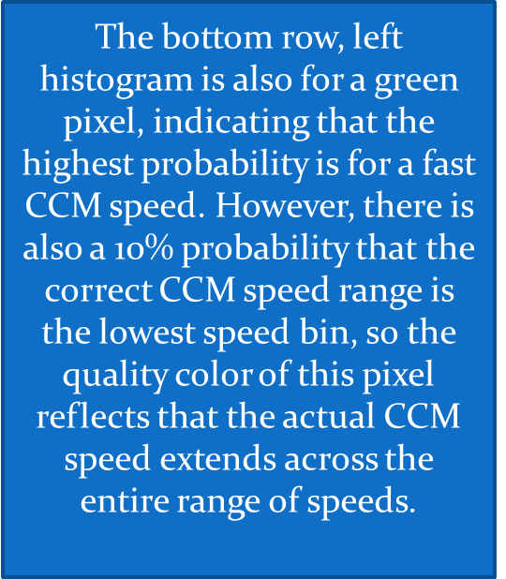

Slide 53
Consider the case where the decision maker is interested in reducing the uncertainty in the CCM predictions – perhaps by allocating reconnaissance resources to collect additional terrain data, then he would like to know the influence of individual terrain factors on the total uncertainty in the CCM prediction.

Slide 54
‘‘what terrain factor contributes the most to the uncertainty in the predicted CCM speed?”
The figure below shows an additional visualization that makes it possible to answer this query.

Slide 55
The figure represents the uncertainty in the values of the terrain factors for one specific point on the terrain, as well as a graphical depiction of the impact of each of the individual factors.
The probability distributions are used in a Monte Carlo technique to associate variation in terrain inputs with variation in predicted CCM speed.

Slide 56
curve of terrain value
vs. CCM speed

Slide 57
random variation of the terrain
parameter

Slide 58


Slide 59
the total
distribution of predicted CCM speeds based on the combined variation of all the terrain inputs

Slide 60
Vital issue
The ability of geospatial systems to meet the specific knowledge requirements of different types of user.
An approach to addressing this challenge might be to employ an ontology conveying knowledge of patterns of system usage, which would trace characteristics related to each type of user to the particular aspects regarding the situation in which a given service is being requested.

Slide 61
This system would be able to predict parameters such as:
the user’s decision level
precision
timeliness
expected granularity of information
most important factors for CCM predictions

Slide 62
In the military domain, the Department of Defense has mandated a new doctrine of network-centric operations.
The objective of network-centric operations is to translate information superiority into a competitive military advantage

Slide 63
Discussion and future work
It is important to represent, manage, and communicate to decision makers information about uncertainty in the GIS products used for military planning.
Also, techniques must be available to propagate uncertainty of the data through GIS algorithms to estimate the uncertainty in the product

Slide 64
A number of issues need to be addressed to address limitations in the methods described here.
First, additional research is needed on usability of displays that incorporate uncertainty.
Second, additional research is needed to assess the true costs of ignoring uncertainty in typical kinds of problems encountered in applications.

Slide 65
Third, additional research is needed on a number of modeling and computational issues, such as (research on the impact of simplifying assumptions, models and algorithms for relaxing simplifying assumptions made here,..etc).

Slide 66
Presented by:
Hanin Omar
Michael Helms

