Slide 1
Applications of HUGIN to Diagnosis and Control of Autonomous Vehicles
Authors: Anders L. Madsen and Uffe B. Kjærulff
Darren Harton
4/18/2016
CSCE 582

Slide 2
Overview
ADVOCATE II Project Background
VORTEX AUV
BART AGV
DeepC AUV
Discussion

Slide 3
Introduction: ADVOCATE II Project
ADVOCATE Project: Advanced On-board Diagnosis and Control of Autonomous Systems
  Objective: increase the performance of unmanned vehicles in terms of availability, efficiency, reliability and safety
ADVOCATE II Project
  Objectives
    Design and develop a general purpose software architecture for AUVs and AGVs
      AUV: Autonomous Underwater Vehicle
      AGV: Autonomous Ground Vehicle
    Develop software-based systems that increase their automation, efficiency and reliability

Slide 4
Introduction: ADVOCATE II Project
ADVOCATE II Project
  Objective 1: Design and develop a general purpose software architecture for AUVs and AGVs
    Highly modular architecture allows for easy incorporation of different AI techniques and versatility among robotic platforms
  Objective 2: Develop software-based systems that increase AUVs and AGVs automation, efficiency and reliability
    Add AI to control software to diagnose and recover from dysfunction or failure situations
    Use HUGIN to apply LIMIDs that solve complex reasoning and decision making problems inherent to the operation of autonomous vehicles
      LIMID: Limited Memory Influence Diagram

Slide 5
HUGIN
HUGIN is a general purpose tool for constructing and calculating probabilistic graphical models
HUGIN Graphical User Interface
  Implemented in Java
  Highly portable
HUGIN Decision Engine
  Has API’s in 4 languages: C, C++, Java, Visual Basic for Applications
  Highly efficient and interoperable

Slide 6
Problem Domain
Transition of AUV’s and AGVs from experimental research tools to real applications increases the need for reliable and safe performance
  Includes detection, avoidance and recovery from dysfunction
ADVOCATE II Project focused on providing diagnoses and recovery actions for energy level and sonar image quality problems

Slide 7
Architecture
ADVOCATE II Project uses a distributed architecture based on a generic communication protocol
  Modular and easy to evolve/adapt
  Consists of 4 different types of interacting modules
Purpose: to assist the piloting system in managing fault detection, risk assessment and recovery plans under uncertainty

Slide 8
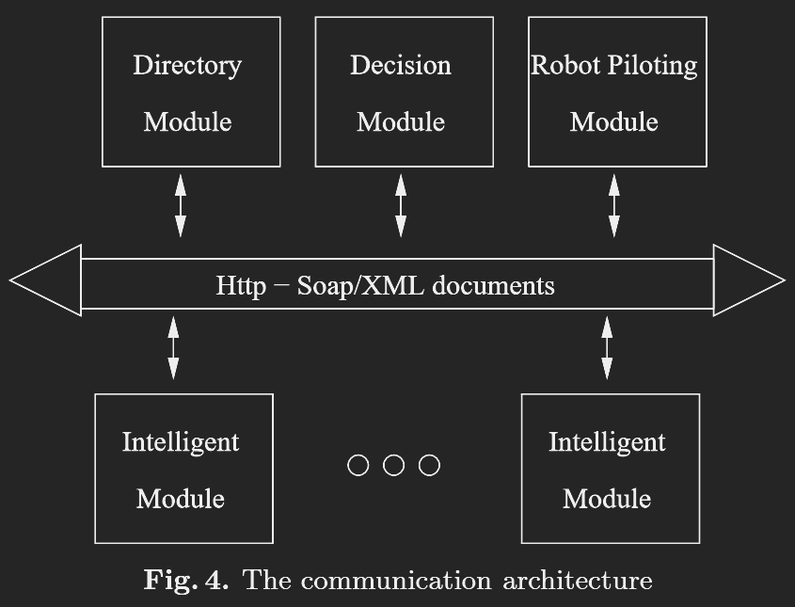
Architecture
Directory Module
Central point of communication
Maintains a list of registered and on-line modules

Slide 9
Architecture
Decision Module
Manages the diagnosis and recovery action process
Translates recovery actions into recovery plans given information from the intelligent modules

Slide 10
Architecture
Robot Piloting Module
Manages mission plans
Communicates directly with the vehicle’s sensors and actuators
Implements recovery plans received from the
decision module

Slide 11
Architecture
Intelligent Modules
Encapsulate a knowledge base for a specific problem domain
Robot piloting module supplies the intelligent modules with data
Provide possible
diagnoses and suggest recovery actions to the decision module
May be multiple intelligent modules in the ADVOCATE II software architecture

Slide 12
Influence Diagram
Bayesian Network that includes decision variables and utility functions
Used to represent and solve a selected set of diagnoses and recovery action problems
Solution of an influence diagram is the optimal strategy for the decision maker

Slide 13
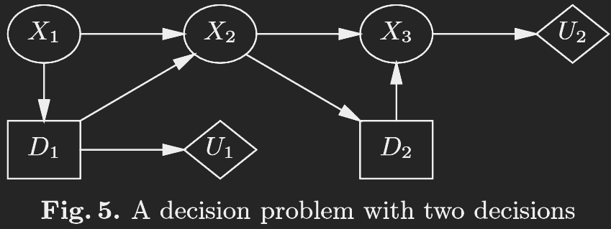
Limited Memory Influence Diagram
LIMID: extends the influence diagram by relaxing the non-forgetting assumption and total order
  Decisions require explicit links
  Can be significantly less computationally complex than an influence diagram

Slide 14
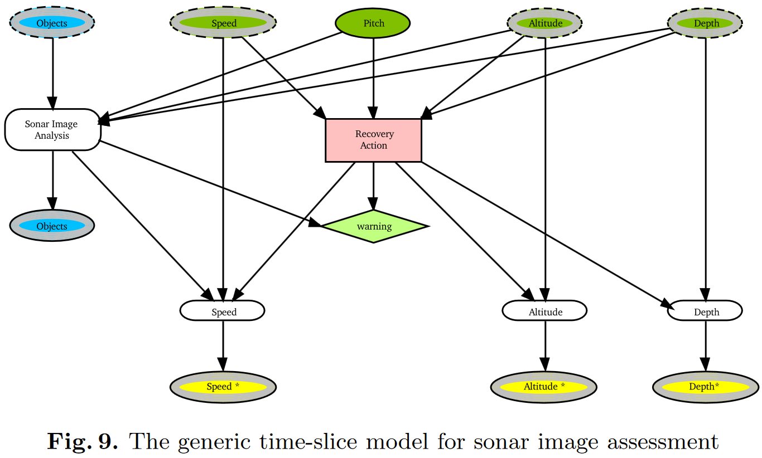
Object Oriented Limited Memory Influence Diagram
OO LIMID: extension of a LIMID with support for object oriented constructions
  Contains instance nodes represented by boxes with rounded corners
  Dashed lines indicate input nodes

Slide 15
Knowledge Extraction Methodology
Construction of a LIMID requires knowledge acquisition and formulation
  Can be a labor intensive process
Cause hierarchy was built before the LIMID
  Consists of a problem hierarchy that relates the states of different parts of a vehicle and it’s environment
  Permissible Diagnoses: group of causes that are satisfactory explanations of the problem
  Possible Diagnoses: subset of permissible diagnoses that can be identified on available information
LIMIDs are generated from a cause hierarchy

Slide 16
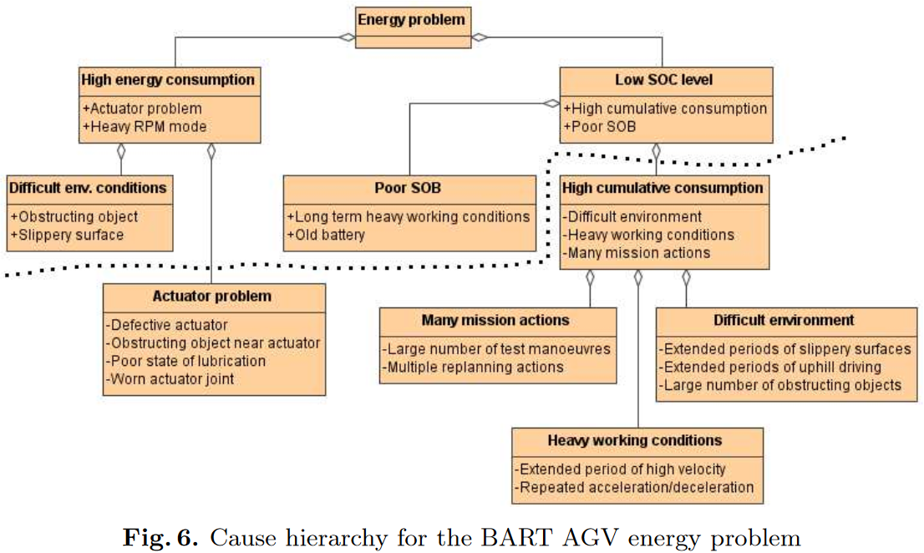
Knowledge Extraction Methodology
Cause hierarchy of the energy problem of the BART AGV
  Possible diagnoses are denoted by (+) and are above the line
  Permissible diagnoses that are not possible are denoted by (-) and are below the line

Slide 17
Results
One LIMID per robotic platform was developed and solved for a specific problem
Each LIMID model was encapsulated in an Intelligent Module
Validation of the Intelligent Module was completed by investigating the performance and behavior of the system during test cases
  Test cases covered all important, critical and realistically possible situations

Slide 18
Overview
ADVOCATE II Project Background
VORTEX AUV
BART AGV
DeepC AUV
Discussion

Slide 19
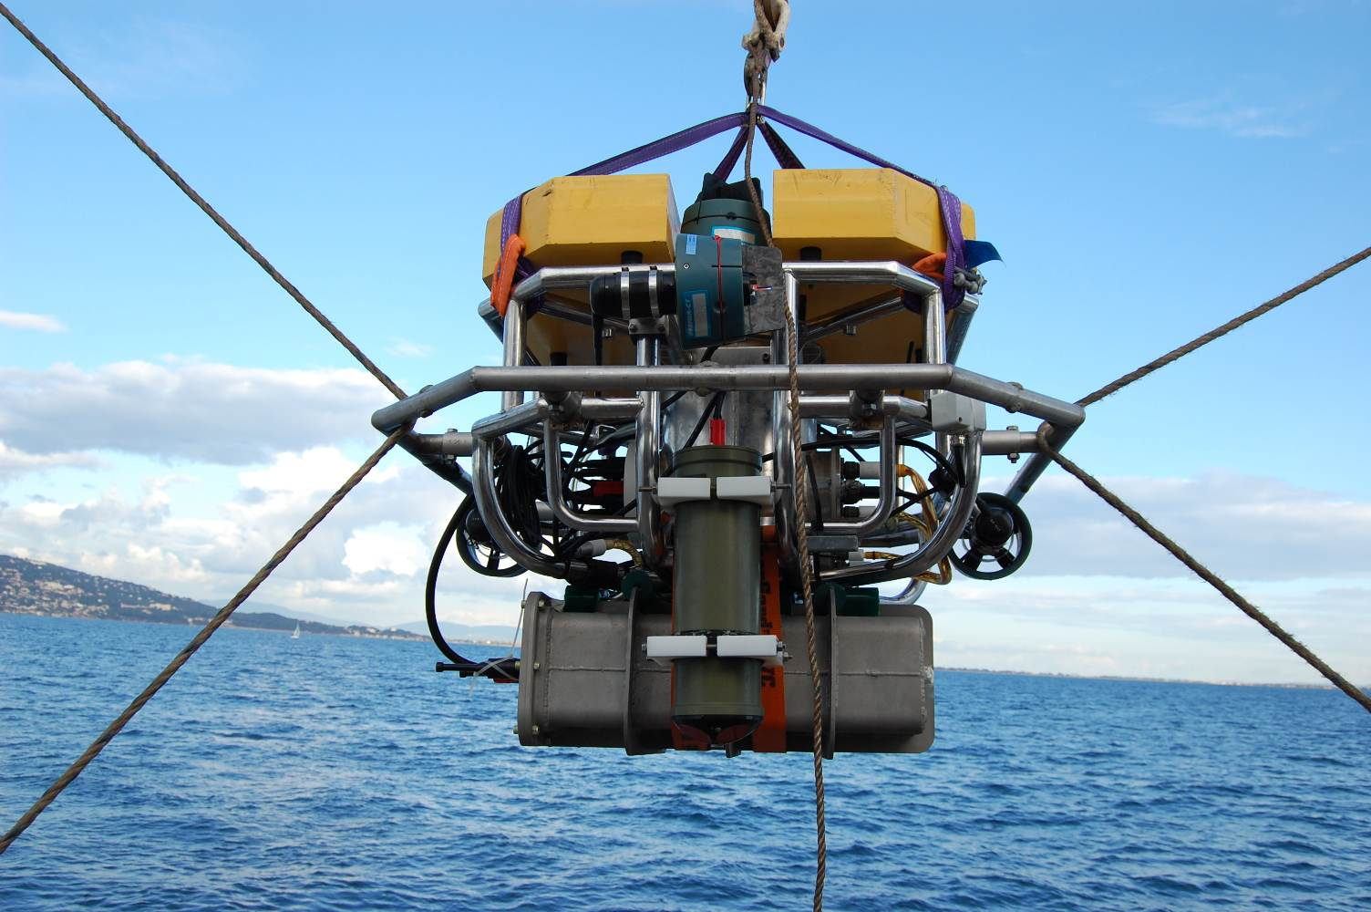
VORTEX AUV
VORTEX: Versatile and Open subsea Robot for Technical Experiments
Modular
Designed for remote and autonomous operation
Used for scientific applications
http://wwz.ifremer.fr/cmsm/Les-Moyens-d-Essais/Vortex

Slide 20
VORTEX AUV: Problem Domain
Optimize mission planning
Diagnose abnormalities and provide recovery actions
Reduce aborted missions
Avoidance of vehicle loss

Slide 21
VORTEX AUV: Intelligent Module
Purpose of the intelligent module for VORTEX is to assess the status of its energy consumption
  Must compute the probabilities of possible root causes of unexpected energy consumption
    High instantaneous energy consumption: current level of energy consumption is significantly higher than anticipated
    Low state of charge: results from abnormally high cumulative energy consumption or poor state of the battery
  Must determine the expected utilities of various recovery actions

Slide 22
VORTEX AUV: Intelligent Module
Root causes of unexpected energy consumption:
  Old battery
  Long-term heavy working conditions
  Poor state of battery
  Cold battery
  High cumulative energy consumption
  Obstructing object
  Strong currents
  Fast acceleration
  Actuator problem
  Unhealthy payload
Recovery actions
  Mission action
    Continue
    Reduce velocity
    Abort
  Test state of battery
  Replace battery
  Back/forth maneuver
  Check payload sensors

Slide 23
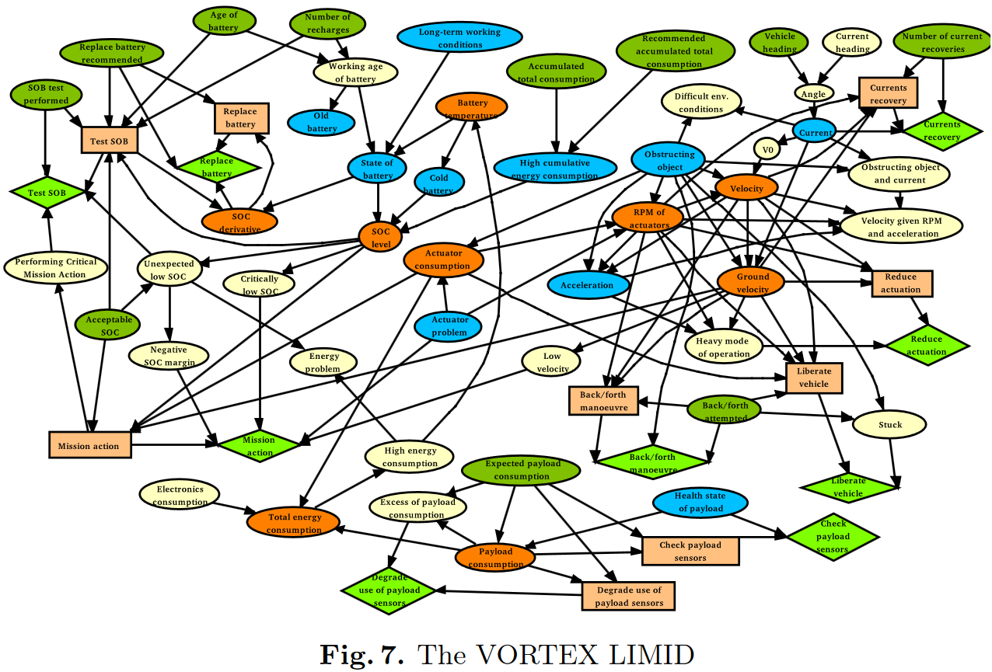
VORTEX AUV: LIMID
Key:
Ovals random variables
Rectangles decision variables
Diamonds
utility functions

Slide 24
VORTEX AUV: Results
No real trial data was available for the VORTEX model
Results from the simulation were promising
  Data quality was too low for validation

Slide 25
Overview
ADVOCATE II Project Background
VORTEX AUV
BART AGV
DeepC AUV
Discussion

Slide 26
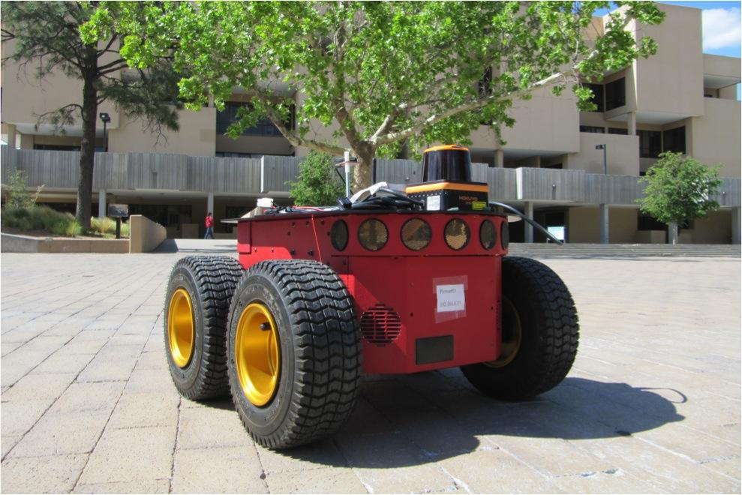
BART AGV
Built from the MobileRobots Pioneer 3-AT platform by the University of Alcalá
Used for telesurveillance
http://www.seas.upenn.edu/~nicbezzo/pio.jpg 4/11/2016

Slide 27
BART AGV: Problem Domain
Manage energy consumption
Manage navigational issues

Slide 28
BART AGV: Intelligent Module
Purpose of the Intelligent Module for BART is to assess the status of its energy consumption
  BART and VORTEX are both battery powered so the models are virtually identical
  Root causes of unexpected energy consumption
    High instantaneous energy consumption
    Low state of charge
  Must determine the expected utilities of various recovery actions

Slide 29
BART AGV: Cause Hierarchy

Slide 30
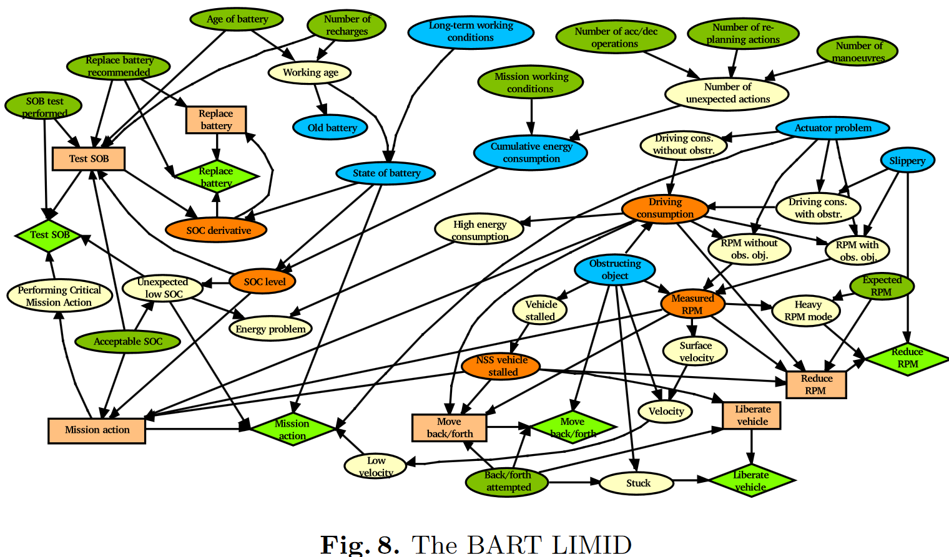
BART AGV: LIMID
Key:
Ovals random variables
Rectangles decision variables
Diamonds
utility functions

Slide 31
BART AGV: Results
BART model had a 93.4% accuracy on 36 test cases
Test cases were hand generated to reflect operation at the University of Alcalá campus

Slide 32
Overview
ADVOCATE II Project Background
VORTEX AUV
BART AGV
DeepC AUV
Discussion

Slide 33
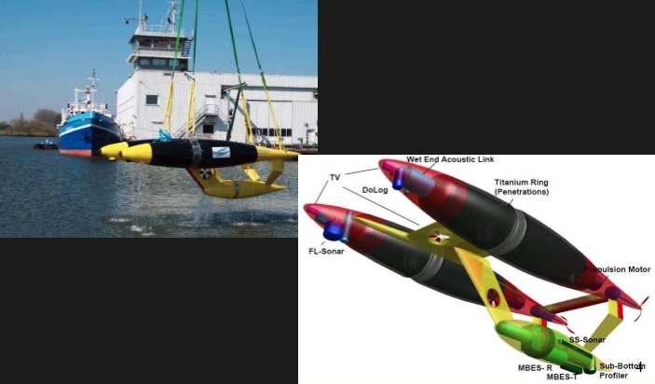
DeepC AUV
Hydrogen powered
Can perform missions up to 60 hours long
Equipped with sonar object detection and avoidance system
http://de.slideshare.net/marcuwesimon/prsentation-autonomous-underwater-vehicles/4
4/18/2016
Notes:
http://citeseerx.ist.psu.edu/viewdoc/download?doi=10.1.1.128.8383&rep=rep1&type=pdf
Supposed to be used for:
Mapping ocean floor
Large area sampling
Pipeline and cable inspection
Environmental monitoring
Able to achieve depths of up to 4000 meters.

Slide 34
DeepC AUV: Problem Domain
Increase reliability
Limit aborted missions
  Very expensive
Object detection and avoidance using sonar
  Analyze sonar image quality
  Suggest actions for improving sonar images

Slide 35
DeepC AUV: Intelligent Module
Purpose of the Intelligent Module for DeepC is to assess the quality of the sonar image and to suggest actions to avoid damage or loss of the vehicle
Sonar image is evaluated in three areas:
  Pixel entropy
  Pixel mean value
  Pixel substance
Sonar images are time dependent
  Must use an OO LIMID
  Time interval of 8 seconds

Slide 36
DeepC AUV: OO LIMID
Key:
Ovals random variables
Rectangles decision variables
Diamonds utility functions
Rounded Boxes instance nodes
Dashed Line input nodes

Slide 37
DeepC AUV: Results
DeepC AUV model had an 88.4% accuracy on image quality assessment for the test cases
  1048 sonar images
Sonar images from real sea trials were recorded at the ATLAS test pond

Slide 38
Overview
ADVOCATE II Project Background
VORTEX AUV
BART AGV
DeepC AUV
Discussion

Slide 39
Discussion
Success of ADVOCATE II Project
  Objective 1: Design and develop a general purpose software architecture for AUVs and AGVs
    Fully met
  Objective 2: Develop software-based systems that increase their automation, efficiency and reliability
    Satisfactorily completed for BART and DeepC but not VORTEX
Continued Focus of Research
  Further develop object oriented framework to model discrete time processes

Slide 40
WORK CITED
1. Anders L. Madsen and Uffe B. Kjaerulff. "Applications of HUGIN to Diagnosis and Control of
Autonomous Vehicles." "Peter Lucas, Jose Gamez, and and Antonio Salmeron (eds.).
Advances in Probabilistic Graphical Models. Springer, 313-332, 2007.

Slide 41
Questions?

