Slide 1
CSCE 822 Project Presentation Schedule
Nov 26
Bokinsky, Huston
Cheng, Wen
Cipolli, William
Fan, Xiaochuan
Zhou,Jun
Dec 3
Han, Shizhong
Hou, Peijie
Lane, Bryan J.
Lin, Yuewei
Liu, Ping
Dec 5
Mahalingam, Sanjay Kumar
Meagher, Kenneth M.
Meng, Zibo
O'Reilly, James P.
Omar, Hanin R.
Dec 10
Panchenko, Ivan
Patthi, Ashwin K.
Xia, Ruofan
Zhang, Yan
Zheng, Kang
Dec 10
Zhou, Haiming
Feng,Bing
Zhou, Youjie
Thomas, Robert W.

Slide 2
Hadoop: what is it?

Slide 3
Hadoop manages:
processor time
memory
disk space
network bandwidth
Does not have a security model
Can handle HW failure

Slide 4
Issues:
race conditions
synchronization
deadlock
i.e., same issues as distributed OS & distributed filesystem

Slide 5
Hadoop vs other existing approaches
Grid computing: (What is this?)
e.g. Condor
MPI model is more complicated
does not automatically distribute data
requires separate managed SAN

Slide 6
Hadoop:
simplified programming model
data distributed as it is loaded
HDFS splits large data files across machines
HDFS replicates data
failure causes additional replication

Slide 7
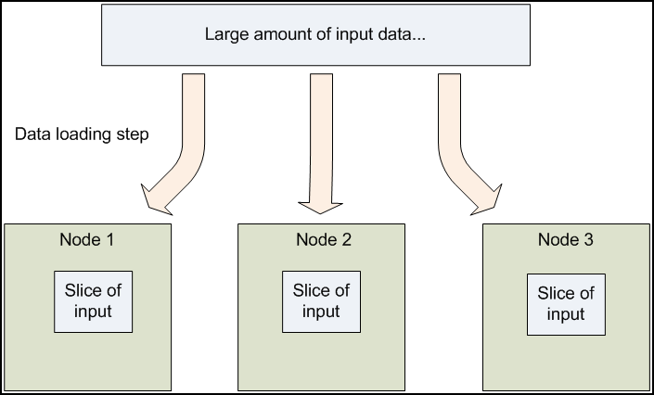
Distribute data at load time

Slide 8
MapReduce
Core idea: records are processed in isolation
Benefit: reduced communication
Jargon:
mapper – task that processes records
Reducer – task that aggregates results from mappers

Slide 9
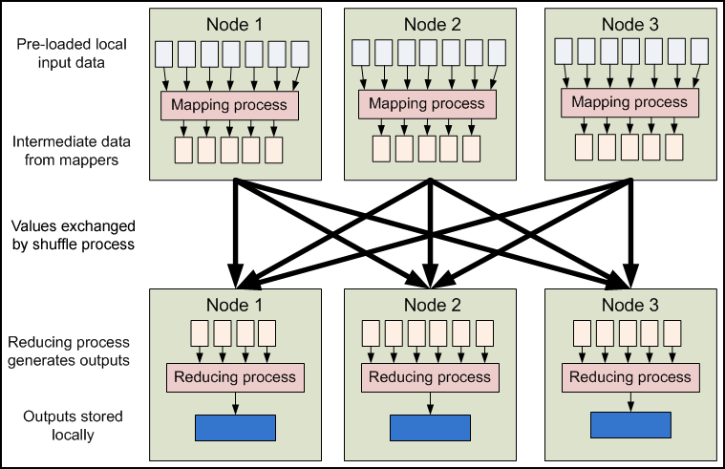
MapReduce

Slide 10
How is the previous picture different from normal grid/cluster computing?
Grid/cluster:
Programmer manages communication via MPI
vs
Hadoop:
communication is implicit
Hadoop manages data transfer and cluster topology issues

Slide 11
Scalability
Hadoop overhead
MPI does better for small numbers of nodes
Hadoop – flat scalabity ➔ pays off with large data
Little extra work to go from few to many nodes
MPI – requires explicit refactoring from small to larger number of nodes

Slide 12
Hadoop Distributed File System
NFS: the Network File System
Saw this in OS class
Supports file system exporting
Supports mounting of remote file system

Slide 13
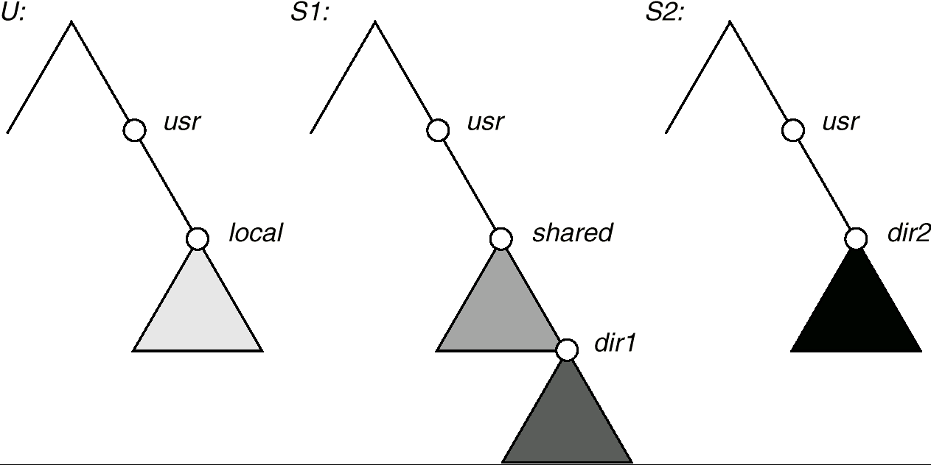
NFS Mounting: Three Independent File Systems

Slide 14
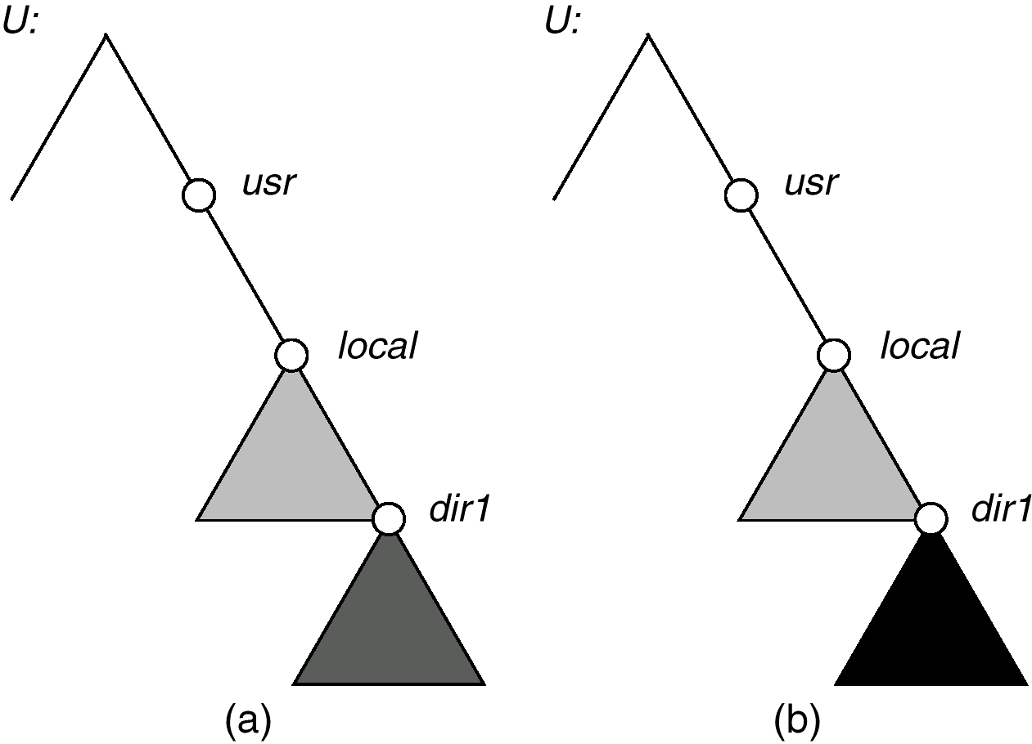
Mounting in NFS
Mounts
Cascading mounts

Slide 15
NFS Mount Protocol
Establishes logical connection between server and client.
Mount operation: name of remote directory & name of server
Mount request is mapped to corresponding RPC and forwarded to mount server running on server machine.
Export list – specifies local file systems that server exports for mounting, along with names of machines that are permitted to mount them.

Slide 16
NFS Mount Protocol
server returns a file handle—a key for further accesses.
File handle – a file-system identifier, and an inode number to identify the mounted directory
The mount operation changes only the user’s view and does not affect the server side.

Slide 17
NFS Advantages
Transparency – clients unaware of local vs remote
Standard operations - open(), close(), fread(), etc.
NFS disadvantages
Files in an NFS volume reside on a single machine
No reliability guarantees if that machine goes down
All clients must go to this machine to retrieve their data

Slide 18
Hadoop Distributed File System
HDFS Advantages:
designed to store terabytes or petabytes
data spread across a large number of machines
supports much larger file sizes than NFS
stores data reliably (replication)

Slide 19
Hadoop Distributed File System
HDFS Advantages:
provides fast, scalable access
serve more clients by adding more machines
integrates with MapReduce →local computation

Slide 20
Hadoop Distributed File System
HDFS Disadvantages
Not as general-purpose as NFS
Design restricts use to a particular class of applications
HDFS optimized for streaming read performance →not good at random access

Slide 21
Hadoop Distributed File System
HDFS Disadvantages
Write once read many model
Updating a files after it has been closed is not supported (can’t append data)
System does not provide a mechanism for local caching of data

Slide 22
Hadoop Distributed File System
HDFS – block-structured file system
File broken into blocks distributed among DataNodes
DataNodes – machines used to store data blocks

Slide 23
Hadoop Distributed File System
Target machines chosen randomly on a block-by-block basis
Supports file sizes far larger than a single-machine DFS
Each block replicated across a number of machines (3, by default)

Slide 24
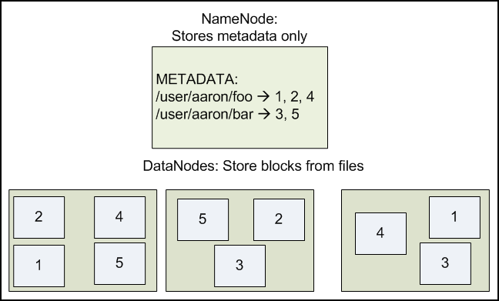
Hadoop Distributed File System

Slide 25
Hadoop Distributed File System
Expects large file size
Small number of large files
Hundreds of MB to GB each
Expects sequential access
Default block size in HDFS is 64MB
Result:
Reduces amount of metadata storage per file
Supports fast streaming of data (large amounts of contiguous data)

Slide 26
Hadoop Distributed File System
HDFS expects to read a block start-to-finish
Useful for MapReduce
Not good for random access
Not a good general purpose file system

Slide 27
Hadoop Distributed File System
HDFS files are NOT part of the ordinary file system
HDFS files are in separate name space
Not possible to interact with files using ls, cp, mv, etc.
Don’t worry: HDFS provides similar utilities

Slide 28
Hadoop Distributed File System
Meta data handled by NameNode
Deal with synchronization by only allowing one machine to handle it
Store meta data for entire file system
Not much data: file names, permissions, & locations of each block of each file

Slide 29
Hadoop Distributed File System

Slide 30
Hadoop Distributed File System
What happens if the NameNode fails?
Bigger problem than failed DataNode
Better be using RAID ;-)
Cluster is kaput until NameNode restored
Not exactly relevant but:
DataNodes are more likely to fail.
Why?

Slide 31
Cluster Configuration
First download and unzip a copy of Hadoop (http://hadoop.apache.org/releases.html)
Or better yet, follow this lecture first ;-)
Important links:
Hadoop website http://hadoop.apache.org/index.html
Hadoop Users Guide http://hadoop.apache.org/docs/current/hadoop-project-dist/hadoop-hdfs/HdfsUserGuide.html
2012 Edition of Hadoop User’s Guide http://it-ebooks.info/book/635/

Slide 32
Cluster Configuration
HDFS configuration is in conf/hadoop-defaults.xml
Don’t change this file.
Instead modify conf/hadoop-site.xml
Be sure to replicate this file across all nodes in your cluster
Format of entries in this file:
<property>
<name>property-name</name>
<value>property-value</value>
</property>

Slide 33
Cluster Configuration
Necessary settings:
fs.default.name - describes the NameNode
Format: protocol specifier, hostname, port
Example: hdfs://punchbowl.cse.sc.edu:9000
dfs.data.dir – path on the local file system in which the DataNode instance should store its data
Format: pathname
Example: /home/sauron/hdfs/data
Can differ from DataNode to DataNode
Default is /tmp
/tmp is not a good idea in a production system ;-)

Slide 34
Cluster Configuration
dfs.name.dir - path on the local FS of the NameNode where the NameNode metadata is stored
Format: pathname
Example: /home/sauron/hdfs/name
Only used by NameNode
Default is /tmp
/tmp is not a good idea in a production system ;-)
dfs.replication – default replication factor
Default is 3
Fewer than 3 will impact availability of data.

Slide 35
Single Node Configuration
<configuration>
<property>
<name>fs.default.name</name> <value>hdfs://your.server.name.com:9000</value>
</property>
<property>
<name>dfs.data.dir</name> <value>/home/username/hdfs/data</value>
</property>
<property>
<name>dfs.name.dir</name> <value>/home/username/hdfs/name</value>
</property>
</configuration>

Slide 36
Configuration
The Master Node needs to know the names of the DataNode machines
Add hostnames to conf/slaves
One fully-qualified hostname per line
(NameNode runs on Master Node)
Create Necessary directories
user@EachMachine$ mkdir -p $HOME/hdfs/data
user@namenode$ mkdir -p $HOME/hdfs/name
Note: owner needs read/write access to all directories
Can run under your own name in a single machine cluster
Do not run Hadoop as root. Duh!

Slide 37
Starting HDFS
Start by formatting the FS
user@namenode:hadoop$ bin/hadoop namenode -format
Only do this once ;-)
Start the File System
user@namenode:hadoop$ bin/start-dfs.sh
This starts the NameNode server
Script will ssh into each slave to start each DataNode

Slide 38
Working with HDFS
Most commands use bin/hadoop
General format:
user@machine:hadoop$ bin/hadoop moduleName -cmd args...
Where moduleName specifies HDFS functionality
Where cmd specifies which command
Example from previous slide:
user@namenode:hadoop$ bin/hadoop namenode -format

Slide 39
Working with HDFS
Listing files:
hduser@saluda:/opt/hadoop$ bin/hadoop dfs -ls
hduser@saluda:/opt/hadoop$
Note: nothing listed!!! -ls command returns zilch
Why?
No concept of current working directory
With NO arguments, -ls refers to “home directory” in HDFS
This is not /home/rose

Slide 40
Working with HDFS
Try specifying a directory
hduser@saluda:/opt/hadoop$ bin/hadoop dfs -ls /
Found 2 items
drwxr-xr-x - hduser supergroup 0 2012-09-20 19:40 /hadoop
drwxr-xr-x - hduser supergroup 0 2012-09-20 20:08 /tmp
Note: in this example hduser is the user name under which the hadoop daemons NameNode and DataNode were started.

Slide 41
Loading data
First create a directory
hduser@saluda:/opt/hadoop$ bin/hadoop dfs -mkdir /user/rose
Next upload a file (uploads to /user/rose)
hduser@saluda:/opt/hadoop$ bin/hadoop dfs -put InterestingFile.txt /user/rose/
Verify the file is in HDFS
hduser@saluda:/opt/hadoop$ bin/hadoop dfs -ls /user/rose

Slide 42
Loading data
You can also “put” multiple files
Consider a directory: myfiles
Contents: file1.txt file2.txt subdir/
Subdirectory: subdir/
Content: anotherFile.txt
Let’s “put” all of these file in the HDFS
hduser@saluda:/opt/hadoop$ bin/hadoop -put myfiles /user/rose
hduser@saluda:/opt/hadoop$ bin/hadoop dfs -ls /user/rose
Found 1 items
-rw-r--r-- 1 hduser supergroup 1366 2013-03-20 17:29 /user/rose/README.txt
hduser@saluda:/opt/hadoop$ bin/hadoop dfs -ls myfiles
Found 3 items
/user/rose/myfiles/file1.txt <r 1> 186731 2008-06-12 20:59 rw-r--r-- hduser supergroup /user/rose/myfiles/file2.txt <r 1> 168 2008-06-12 20:59 rw-r--r-- hduser supergroup /user/rose/myfiles/subdir <dir> 2008-06-12 20:59 rwxr-xr-x hduser supergroup

Slide 43
Loading data
There was something new in the directory listing:
/user/rose/myfiles/file1.txt <r 1> 186731 2008-06-12 20:59 rw-r--r-- hduser supergroup
Q: What does <r 1> mean?
A: The number of replicas of this file
(Note: when I tried this on saluda there was no <r 1> )

Slide 44
Getting data from HDFS
We can use cat to display a file to stdout
hduser@saluda:/opt/hadoop$ bin/hadoop dfs -cat /user/rose/README.txt
We can “get” files from the Hadoop File System
hduser@saluda:/opt/hadoop$ bin/hadoop dfs -get /user/rose/README.txt AAAREADME.txt
hduser@saluda:/opt/hadoop$ ls
AAAREADME.txt hadoop-ant-1.0.4.jar ivy README.txt
Bin hadoop-client-1.0.4.jar ivy.xml sbin
build.xml hadoop-core-1.0.4.jar lib share
c++ hadoop-examples-1.0.4.jar libexec src
CHANGES.txt hadoop-minicluster-1.0.4.jar LICENSE.txt webapps
Conf hadoop-test-1.0.4.jar logs
Contrib hadoop-tools-1.0.4.jar NOTICE.txt

Slide 45
Shutting down HDFS
hduser@saluda:/opt/hadoop$ bin/stop-dfs.sh
Response:
stopping namenode
localhost: stopping datanode
localhost: stopping secondarynamenode

Slide 46
Other commands
Hadoop will list all commands that can be run with the FS Shell with the command:
hduser@saluda:/opt/hadoop$ bin/hadoop dfs

